Slide 1


Slide 2



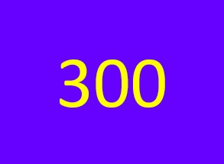
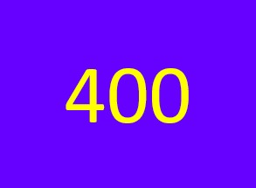
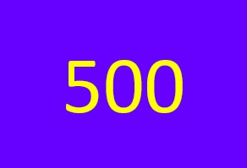
Find definition | Complete sentence | Answering question | Matching words

Slide 3

Give definitions to the abbreviations: CBT and CAD
Answer

Slide 4

Computer-Based Training Computer Aided Design
Home

Slide 5
Give definitions to these terms:
Click-through rate
Geo targetting
Answer

Slide 6
The click-through rate is the ratio of clicked advertisements to the number of advertisements that are viewed
Geo targeting is the process of showing advertisements in geographical areas where they are relevant
Home

Slide 7
Give definitions to these words: redundancy, embedded systems, oscilloscope
Answer

Slide 8
Redundancy is the inclusion of duplicate components in a system to maintain production when one components fails.
An embedded system is a combination of hardware and software designed to perform a specific task.
An oscilloscope is a device that allows the user to view the electrical voltage of a machine.
Home

Slide 9
Give definitions to these abbreviations: PaaS, IaaS and SaaS
Answer

Slide 10
Platform as a service is a service where users receive a computing operating system and related components over the Internet.
Infrastructure as a Service delivers such elements as servers and software over the Internet.
Software as a Service is a service where users receive applications over the Internet instead of buying and installing them.
Home

Slide 11
Give definitions to these words:
Sweep
Rootkit
Toggle
Lab-on-a chip
Answer

Slide 12
To sweep a computer system is to search it for computer viruses.
A rootkit is a type of computer virus that is created to gain total control over a computer system by overwriting parts of its operating system.
To toggle is to move from one file or setting to another.
A lab–on–a-chip is a tiny device that holds cells and fluid that a doctor can analyze easily.
Home

Slide 13
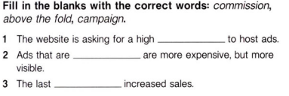

Slide 14
commission
above the fold
campaign
Answer

Slide 15
commission
above the fold
campaign

Slide 16
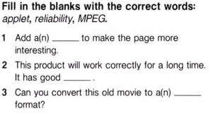

Slide 17
applet
reliability
MPEG

Slide 18
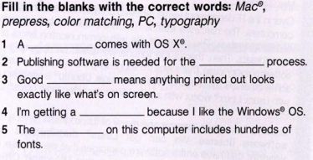

Slide 19
Mac
prepress
color matching
PC
typography

Slide 20
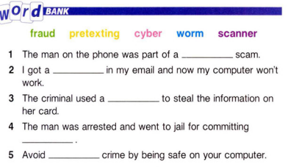

Slide 21
pretexting
worm
scanner
fraud
cyber

Slide 22
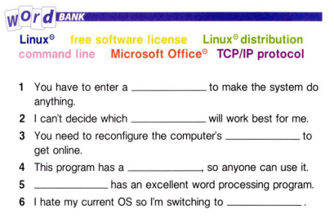

Slide 23
1. Command line
2. Linux distribution
3. TCP/IP protocol
4. Free software license
5. Microsoft Office
6. Linux

Slide 24
How do computer viruses impact business?
Answer

Slide 25
Viruses usually spread very quickly and in most cases, they will cause damage to the host system. They can affect the screen and display appearance or decrease memory space, destroy programs, and steal information and data from the entire network which may be confidential.
Home

Slide 26



Slide 27

1. Why do companies use automation? 2. Why do people prefer operating system over another? (600)

Slide 28

1. Companies use automotation to integrate different technologies so as to achieve efficiency and cost savings. 2. Usually, people take into consideration what they will use their computer for when choosing an operating system. Perhaps one OS offers more features or greater hardware and software compatibility.

Slide 29
1. How can people avoid falling for fishing schemes? 2. What kind of medical technology do you know about?
Answer

Slide 30
1. Phishing scams occur when thieves trick people into giving out personal information by email such as online passwords and credit card details. 2. Laser dentistry. It is quite painless and can reduce time.
Home

Slide 31
1. Are there any problems with anti-virus software? 2. What are the challenges of telecommuting, for workers and management?
Answer

Slide 32
1. Instant scans can be slow and dominate resources while running, resulting in users disabling them a virus detected. 2. One of the major challenges for a telecommuter is managing to keep skill levels up to date. Technical support and training programs are important issues for telecommuting.
Home

Slide 33
1. How is Linux different from other operating system? 2. Why would a business use Linux?
Answer

Slide 34
1. With Linux users can have access and alter source code to the kernel. This brings about faster improvements and fixes any bugs immediately. The source code is also freely available to everyone. 2. By using this system, maintenance is minimized as PCs don’t need to be upgraded as often…
Home

Slide 35
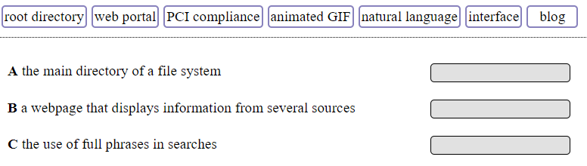
Answer

Slide 36
A. root directory B. web portal C. natural language
Home

Slide 37
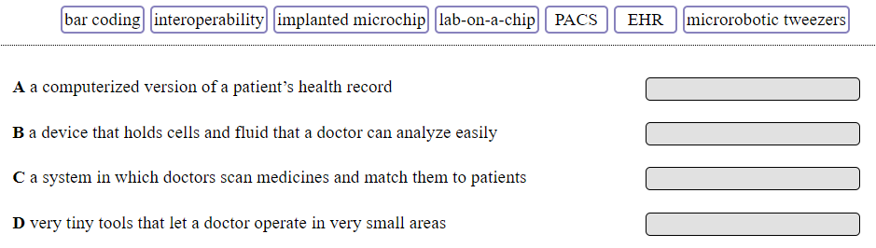
Answer

Slide 38
A. EHR B. lab-on-a-chip C. Bar coding D. Microbiotic tweezers
Home

Slide 39
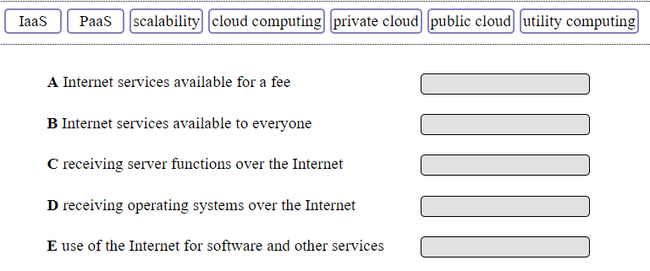
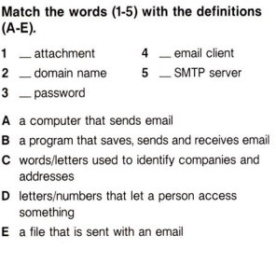
Answer

Slide 40
A. Private cloud B. Public cloud C.IaaS D. PaaS E. Cloud computing
Home

Slide 41
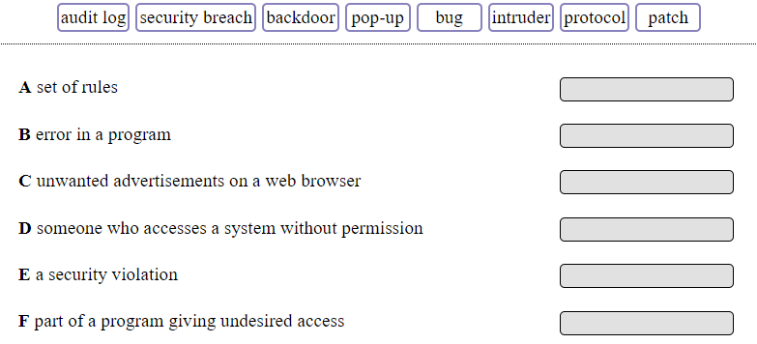

Slide 42
A. protocol B. bug C. pop-up D. intruder E. security breach F. backdoor

Slide 43
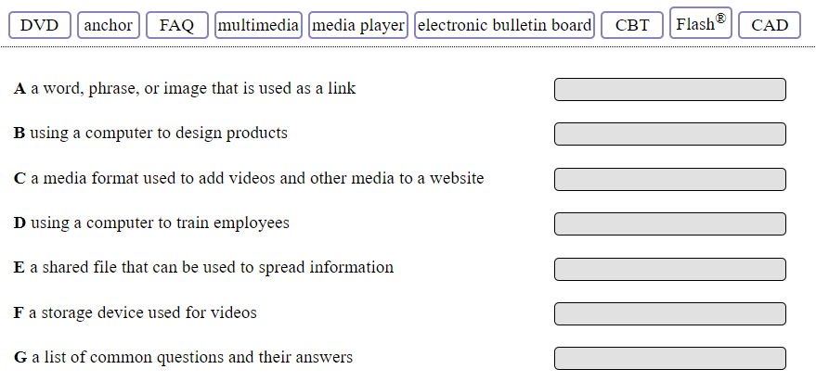

Slide 44
A. Anchor B. CAD C. Flash D. CBT E. Electronic bulletin board F. DVD G.FAQ
Home

Slide 45
What’s the capital of France?
Answer

Slide 46
Paris
Home

Slide 47
What’s the capital of Portugal?
Answer

Slide 48
Lisbon
Home

Slide 49
What’s the capital of Chile?
Answer

Slide 50
Santiago
Home

Slide 51
What’s the capital of Mongolia?
Answer

Slide 52
Ulaanbaatar
Home

Slide 53
What is the highest grossing film of all time?
Answer

Slide 54
Avengers: Endgame
Home

Slide 55
What was the first movie that started of the MCU and when was it made?
Answer

Slide 56
Iron man (2008)
Home

Slide 57

Hidden Bonus Question

Slide 58
What is the full name of 3rd Episode of Star Wars? (600)
Answer

Slide 59
Star Wars: Episode III – Revenge of the Sith
Home

Slide 60
At which year was the first Dumb and Dumber movie released?
Answer

Slide 61
1994
Home

Slide 62
What was the name of drug used in the movie “Limitless”?
Answer

Slide 63
NZT-48
Home

Slide 64

Name it.
Answer

Slide 65
Hyundai
Home

Slide 66

Name it
Answer

Slide 67
Tissot
Home

Slide 68

Name it
Answer

Slide 69
Air Jordan
Home

Slide 70


Name it
Answer

Slide 71
Nintendo Switch
Home

Slide 72

Name it
Answer

Slide 73
Michelin
Home

Slide 74
Which CELEBRITY has the most followers on Instagram?

Slide 75
Cristiano Ronaldo

Slide 76
Who is the World's Highest-paid celebrity in 2019?
Kim Kardashian
Taylor Swift
Justin Bieber
Robert Downey Jr.

Slide 77
Taylor Swift

Slide 78
Who originally sang the song "Last Christmas"?

Slide 79
Wham!

Slide 80
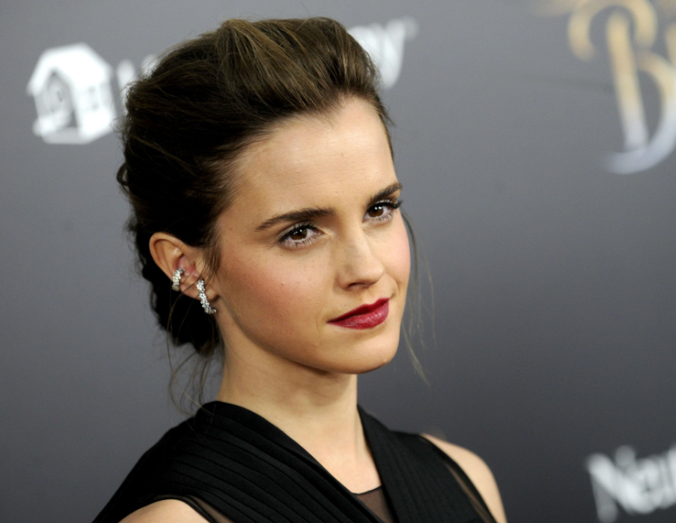
What’s her name?
Hermione Granger
Kristen Stewart
Emma Watson
Selena Gomez

Slide 81
Emma Watson

Slide 82
Which actor, who is still alive, has played the most roles?

Slide 83
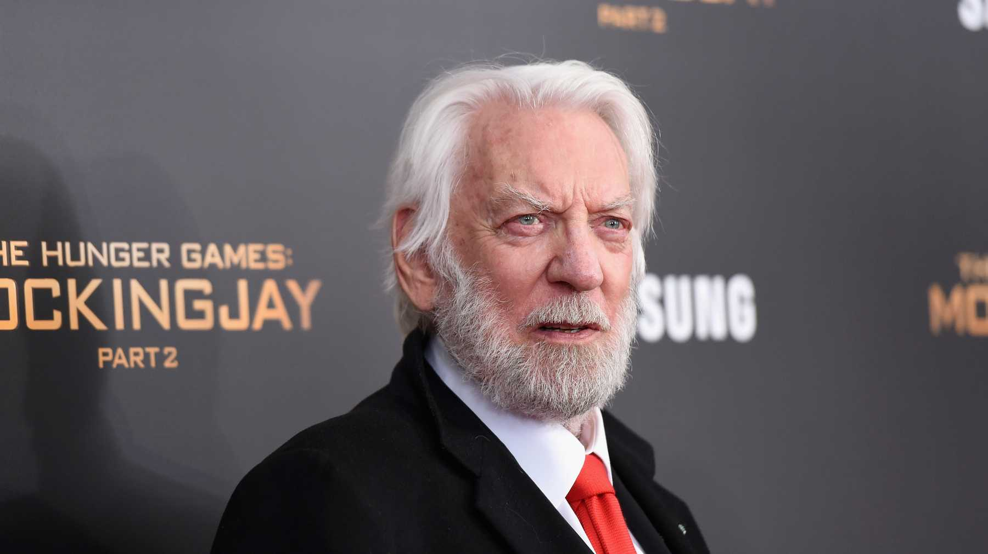
Donald Sutherland

