Slide 1


Slide 2






Find definition | Complete sentence | Answering question | Matching words

Slide 3

Give definitions to the words:
LCD, CRT, IP
Answer

Slide 4

Liquid Crystal Display
Cathode Ray Tube
Internet Protocol address is a group of numbers that identify a computer on a network
Home

Slide 5
Give definitions to these terms:
Hyperlink and ISP
Answer

Slide 6
A hyperlink is a word or image on a web page that you can click on to go to a different web page
Internet Service Provider is a company that gives its customers access to the internet, email addresses and data storage
Home

Slide 7
Give definitions to these words:
Meta tag
HTML
Answer

Slide 8
A meta tag is text that is used in the codes of a web page to provide information about the site to search engines.
Hypertext Markup Language is a computer language that is used to construct websites on the Internet.
Post Office Protocol is a method that allows computer users to receive email from a server.
Home

Slide 9
Give definitions to these words:
Page layout
URL
Tint
Answer

Slide 10
Page layout is the process of arranging text and graphics on a page.
Uniform Resource Locator is the text and symbols that form a web address.
Simple Mail Transfer Protocol is a method that allows computer users to send emails to other users.
A tint is a small amount of a color in something.
Home

Slide 11
Give definitions to these words:
1.Offset lithography
2.SMPT
3. POP3
4. JPEG
Answer

Slide 12
Offset lithography is a common form of printing.
2. Simple Mail Transfer Protocol is a method that allows computer users to send emails to other users.
3. Post Office Protocol is a method that allows computer users to receive email from a server.
4. Joint Photographic Experts Group is a kind of computer file used to store pictures on a computer.
Home

Slide 13
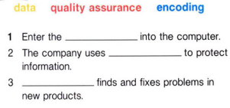
NASA

Slide 14
data
encoding
Quality assurance
Answer

Slide 15
data
encoding
Quality assurance

Slide 16
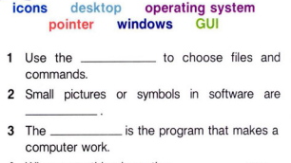
pointer
icons
operating system

Slide 17
pointer
icons
operating system

Slide 18
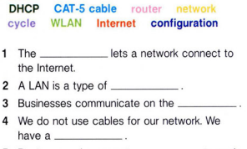

Slide 19
Router
Network
Internet
WLAN

Slide 20
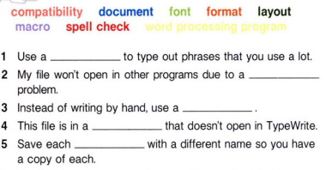
IMF

Slide 21
macro
compatibility
word processing program
format
document

Slide 22
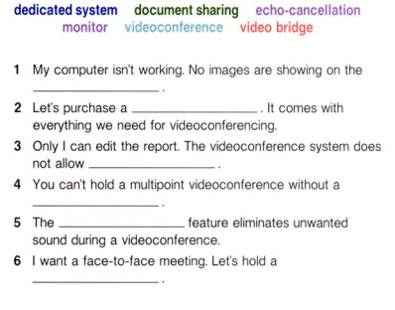
PAWS

Slide 23
1. monitor
2. dedicated system
3. document sharing
4. video bridge
5. echo-cancellation
6. videoconference

Slide 24
What do you know about desktop publishing?
Answer

Slide 25
Desktop publishers - format and combine texts, create graphics, convert photographs and drawings into digital images, and design page layouts.
Home

Slide 26
1. What is videoconferencing?
2. What can video conferencing be used for?
Answer

Slide 27
1. Video conferencing is an interactive communication technology which allows two or more users to interact using video and audio.
2. It allows business executives and their staff to keep in touch around the world.
Home

Slide 28
1. What makes a good business website?
2. What kind of websites do you like to use?
Answer

Slide 29
1. It should contain high quality content and be easy to navigate. It should also be fast loading and informative
2. For example: Facebook, MySpace, etc.
Home

Slide 30
1. What kind of information do you find in database?
2. What do you use spreadsheets for?
Answer

Slide 31
1. A database is a collection of information that is related to a particular subject or purpose, they are very useful for keeping a music collection or tracking customer’s or clients’ orders.
2. All kinds of people use a spreadsheet to store data and make decisions.
Home

Slide 32
1. What is User Interface?
2. How does a User Interface make computing easy?
Answer

Slide 33
1. The term “User Interface” refers to a part of a software application that allows users to interact with a computer, usually on a computer screen and with sets of commands, messages, and clickable images.
2. A User Interface makes computing easy because it enables a computer operator to utilize all the features of the system without too much hard work.
Home

Slide 34
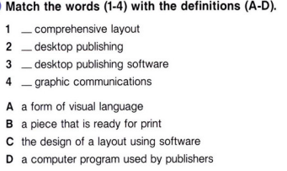
Answer

Slide 35
1. B
2. C
3. D
4. A
Home

Slide 36
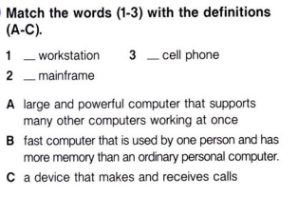
Answer

Slide 37
1. A
2. B
3. C
Home

Slide 38
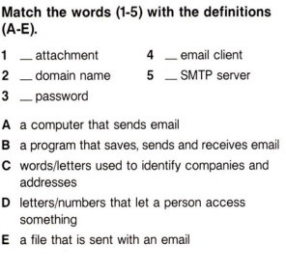
Answer

Slide 39
1. E
2. C
3. D
4. B
5. A
Home

Slide 40
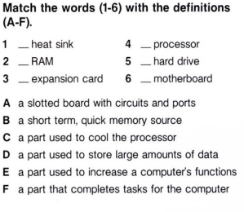

Slide 41
1. C
2.B
3. E
4. F
5. D
6. A

Slide 42
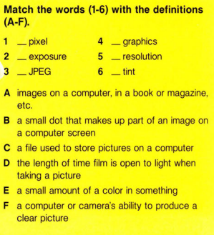

Slide 43
1. B
2. D
3. C
4. A
5. F
6. E
Home

Slide 44
What’s the capital of France?
Answer

Slide 45
Paris
Home

Slide 46
What’s the capital of Portugal?
Answer

Slide 47
Lisbon
Home

Slide 48
What’s the capital of Chile?
Answer

Slide 49
Santiago
Home

Slide 50



Slide 51

What’s the capital of Malta?
(1000)

Slide 52

Valetta

Slide 53
What’s the capital of Mongolia?
Answer

Slide 54
Ulaanbaatar
Home

Slide 55
What is the highest grossing film of all time?
Answer

Slide 56
Avengers: Endgame
Home

Slide 57
What was the first movie that started of the MCU and when was it made?
Answer

Slide 58
Iron man (2008)
Home

Slide 59

Hidden Bonus Question

Slide 60
What is the full name of 3rd Episode of Star Wars?
(600)
Answer

Slide 61
Star Wars: Episode III – Revenge of the Sith
Home

Slide 62
At which year was the first Dumb and Dumber movie released?
Answer

Slide 63
1994
Home

Slide 64
What was the name of drug used in the movie “Limitless”?
Answer

Slide 65
NZT-48
Home

Slide 66

Name it.
Answer

Slide 67
Hyundai
Home

Slide 68

Name it
Answer

Slide 69
Tissot
Home

Slide 70

Name it
Answer

Slide 71
Air Jordan
Home

Slide 72


Name it
Answer

Slide 73
Nintendo Switch
Home

Slide 74

Name it
Answer

Slide 75
Michelin
Home

Slide 76
Which CELEBRITY has the most followers on Instagram?

Slide 77
Cristiano Ronaldo

Slide 78
Who is the World's Highest-paid celebrity in 2019?
Kim Kardashian
Taylor Swift
Justin Bieber
Robert Downey Jr.

Slide 79
Taylor Swift

Slide 80
Who originally sang the song "Last Christmas"?

Slide 81
Wham!

Slide 82
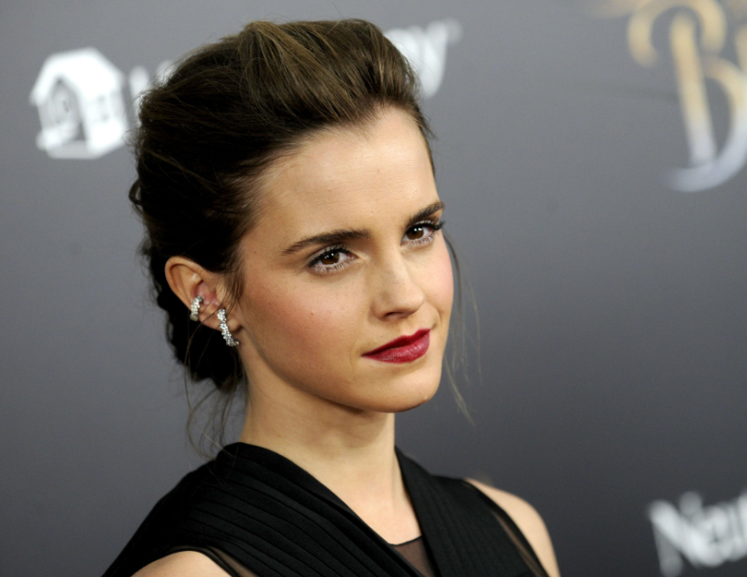
What’s her name?
Hermione Granger
Kristen Stewart
Emma Watson
Selena Gomez

Slide 83
Emma Watson

Slide 84
Which actor, who is still alive, has played the most roles?

Slide 85
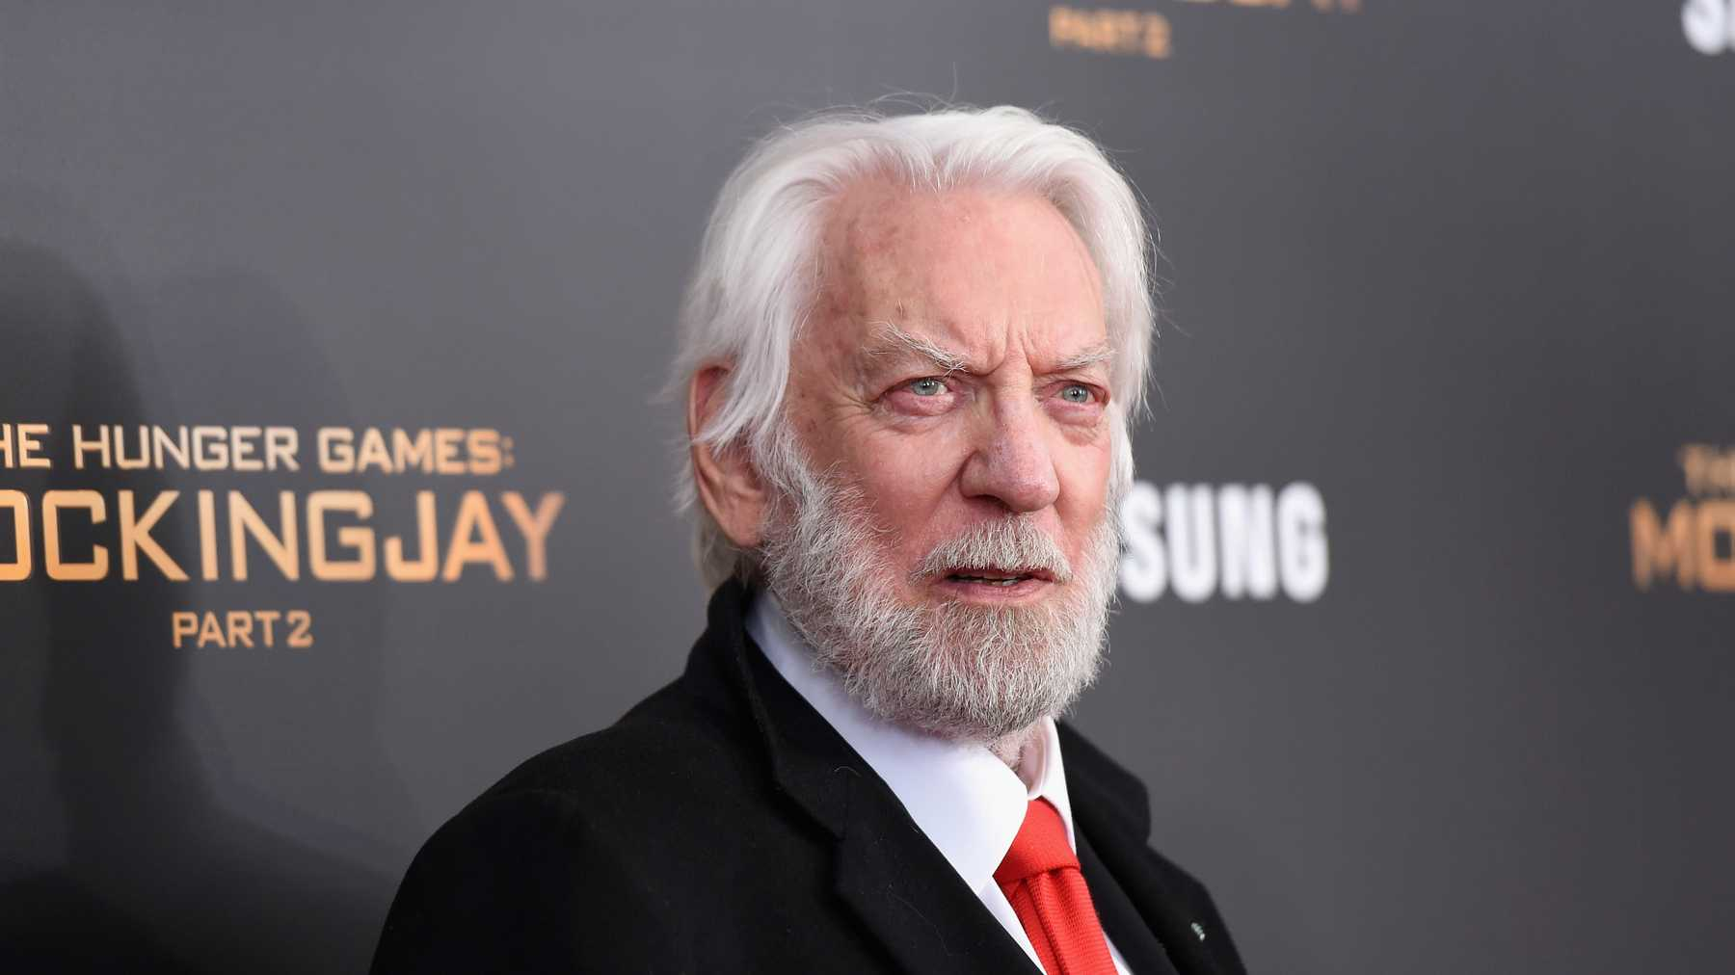
Donald Sutherland

