Slide 1


Slide 2






Find definition | Complete sentence | Answering question | Matching words

Slide 3

Give definitions to the words: SIMM and DIMM
Answer

Slide 4

Single Inline Memory Module Dual Inline Memory Module
Home

Slide 5
Give definitions to these terms:
Compilers and links
Answer

Slide 6
A compiler changes human-readable source code into machine code that a CPU can understand.
A linker takes the machine code created by a compiler and makes it in into an executable file.
Home

Slide 7
Give definitions to these words:
CCDs, DPI and transparency adapter
Answer

Slide 8
Charge Coupled Device is a light-sensitive chip that is used when capturing digital images.
Dots Per Inch is the number of dots used per inch to create an image.
A transparency adapter is a device that is used with a scanner to capture see-through documents like slides.
Home

Slide 9
Give definitions to these abbreviations:
UPC, EPC and electronic statement
Answer

Slide 10
Universal Product Code is a 12-digit number used to identify consumer items.
Electronic Product Code is a number used to identify specific individual items.
An electronic statement is a summary of account activity that is viewable on a computer, but not on paper.
Home

Slide 11
Give definitions to these words:
1. Boolean operators
2. Ezproxy
3. actuators
4. Enabling device
Answer

Slide 12
A Boolean operator narrows a database search with words like “and”, “or” and “not”.
EZproxy is a library server program that allows remote users to access the library’s electronic materials.
An actuator is a piece of equipment that uses energy to make a robot move.
An enabling device is a device that a person activates to allow a robot to move.
Home

Slide 13
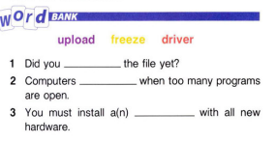
NASA

Slide 14
upload
freeze
driver
Answer

Slide 15
upload
freeze
driver

Slide 16
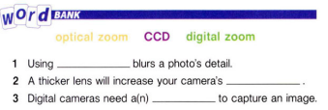

Slide 17
digital zoom
optical zoom
CCD

Slide 18
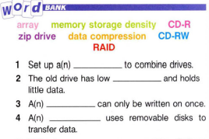

Slide 19
array
memory storage density
CD-R
data compression

Slide 20
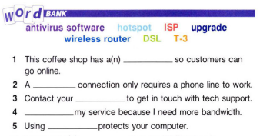

Slide 21
hotspot
DSL
ISP
Upgrade
antivirus software

Slide 22
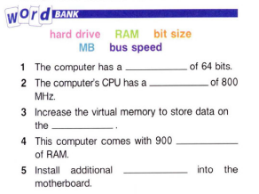

Slide 23
1. bit size
2. bus speed
3. hard drive
4. MB
5. RAM

Slide 24
How have cell phones changed business?
Answer

Slide 25
They have allowed people to take their work out of the office but stay connected to their colleagues and workplace. Smartphones allow users to check and send email, browse the Internet, and have immediate contact with clients around the world. Business plans and appointments can be rearranged on the move, giving more schedule flexibility.
Home

Slide 26
1. How many ways can businesses communicate with each other? 2. What are the benefits of different kinds of electronic communication?
Answer

Slide 27
1. A common method today is by using a smartphone which can access the Internet and function as a phone and portable media player. 2. Cell phones for example allow interaction between people residing in different geographical locations and to receive messages on the spot.
Home

Slide 28
1. Why do people use GPS? 2. How can GPS aid businesses?
Answer

Slide 29
1. Cab drivers, truckers, and delivery men rely on it to reach their destinations and can save on time and fuel expenses. 2. Firms that run a large vehicle fleet can adopt a GPS vehicle tracking system to improve efficiency and reduce fuel waste.
Home

Slide 30
1. What topics can people research online? 2. How can information technology combine business and education?
Answer

Slide 31
1. Millions of people spend a significant amount of time on the Internet as it is a leading source for up-to-date news, educational material and international weather and sports reports. 2. Information technology can combine business and education in various ways, for example by tailoring individual classes or curriculum to individual needs.
Home

Slide 32
1. What can people use robots for? 2. How do robots change business?
Answer

Slide 33
1. Industrial robots do jobs that are difficult and dangerous. They lift heavy objects, paint, and do assembly work. At home, robots can take over the housework. 2. Businesses can increase their profits as robots are capable of producing a much better product in a shorter amount of time.
Home

Slide 34
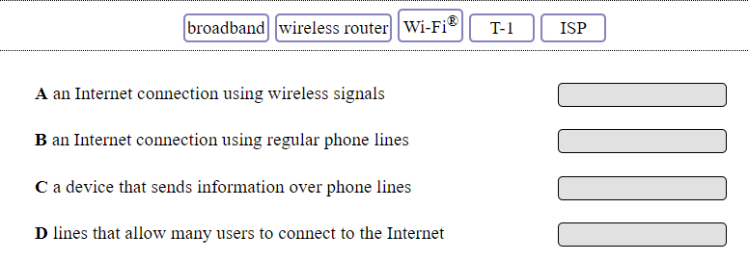
Answer

Slide 35
A. Wi-Fi B. ISP C. wireless router D. T-1
Home

Slide 36
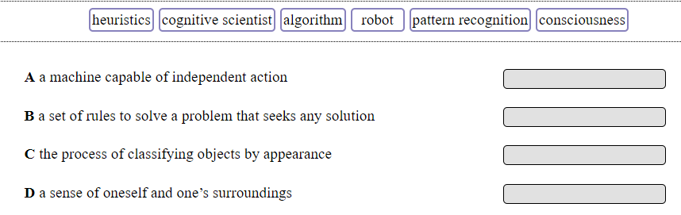
Answer

Slide 37
A. robot B. heuristics C. pattern recognition D. consciousness
Home

Slide 38
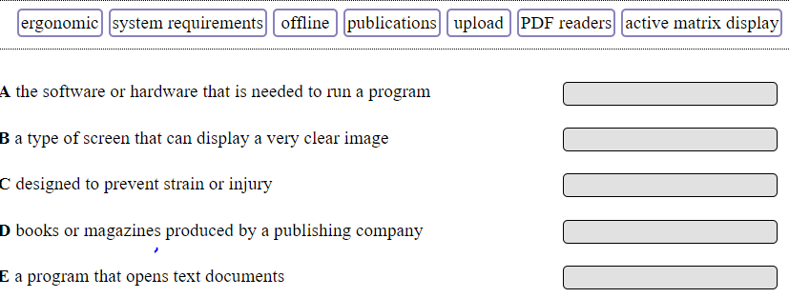
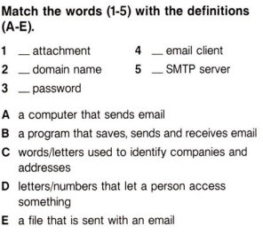
Answer

Slide 39
A. system requirements B. active matrix display C. ergonomic D. publications E. PDF readers
Home

Slide 40
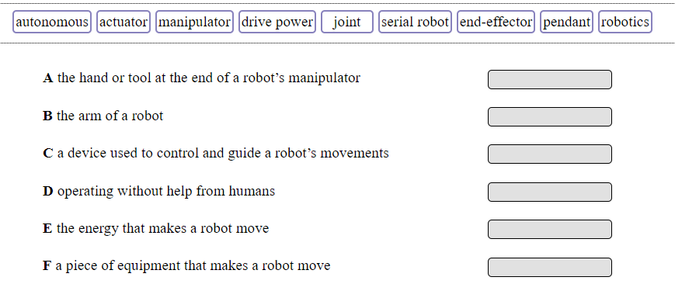

Slide 41
A. end-effector B. manipulator C. Pendant D. autonomous E. drive power F. actuator

Slide 42
A. Latitude B. Elevation C. Accuracy D. Integrity E. Coordinates F. cartography G. longitude

Slide 43
1. B 2. D 3. C 4. A 5. F 6. E
Home

Slide 44
What’s the capital of France?
Answer

Slide 45
Paris
Home

Slide 46
What’s the capital of Portugal?
Answer

Slide 47
Lisbon
Home

Slide 48
What’s the capital of Chile?
Answer

Slide 49
Santiago
Home

Slide 50



Slide 51

What’s the capital of Malta? (1000)

Slide 52

Valetta

Slide 53
What’s the capital of Mongolia?
Answer

Slide 54
Ulaanbaatar
Home

Slide 55
What is the highest grossing film of all time?
Answer

Slide 56
Avengers: Endgame
Home

Slide 57
What was the first movie that started of the MCU and when was it made?
Answer

Slide 58
Iron man (2008)
Home

Slide 59

Hidden Bonus Question

Slide 60
What is the full name of 3rd Episode of Star Wars? (600)
Answer

Slide 61
Star Wars: Episode III – Revenge of the Sith
Home

Slide 62
At which year was the first Dumb and Dumber movie released?
Answer

Slide 63
1994
Home

Slide 64
What was the name of drug used in the movie “Limitless”?
Answer

Slide 65
NZT-48
Home

Slide 66

Name it.
Answer

Slide 67
Hyundai
Home

Slide 68

Name it
Answer

Slide 69
Tissot
Home

Slide 70

Name it
Answer

Slide 71
Air Jordan
Home

Slide 72


Name it
Answer

Slide 73
Nintendo Switch
Home

Slide 74

Name it
Answer

Slide 75
Michelin
Home

Slide 76
Which CELEBRITY has the most followers on Instagram?

Slide 77
Cristiano Ronaldo

Slide 78
Who is the World's Highest-paid celebrity in 2019?
Kim Kardashian
Taylor Swift
Justin Bieber
Robert Downey Jr.

Slide 79
Taylor Swift

Slide 80
Who originally sang the song "Last Christmas"?

Slide 81
Wham!

Slide 82
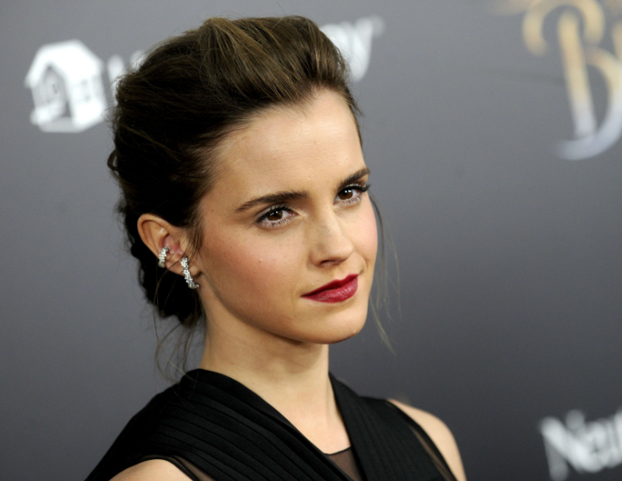
What’s her name?
Hermione Granger
Kristen Stewart
Emma Watson
Selena Gomez

Slide 83
Emma Watson

Slide 84
Which actor, who is still alive, has played the most roles?

Slide 85
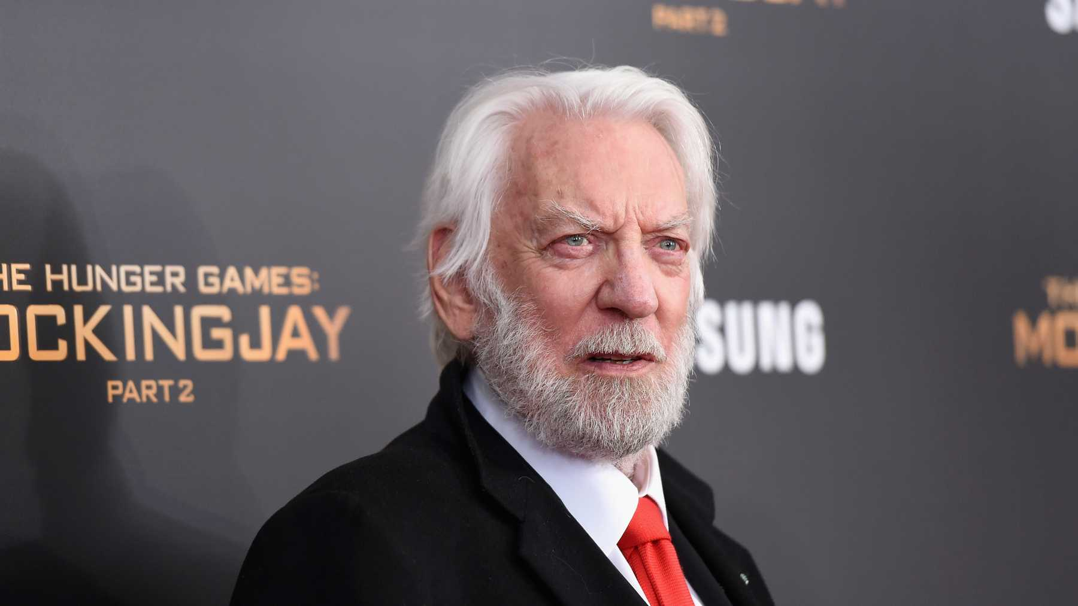
Donald Sutherland

