Slide 1
Databases
VS
Spreadsheets
Unit 11

Slide 2
Objectives: at the end of the lesson, students will be able to:
1. identify the purpose of databases and spreadsheets;
2. read for a specific purpose;
3. analyze and compare the use cases, functionalities, and advantages of databases and spreadsheets in different scenarios.

Slide 3
Let’s Discuss!
1
What are some common uses of spreadsheets?
Lead-in
2
What kind of information do you find in databases?
3
Tell features of spreadsheets

Slide 4
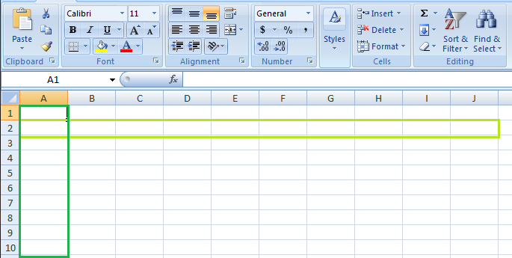
Spreadsheets: Designed for data entry, calculation, and simple analysis. Useful for small datasets or personal use.
Databases: Designed for managing large volumes of data, enabling efficient storage, retrieval, and manipulation. Suitable for complex data relationships and multi-user access.
Spreadsheets: Grid-based interface (rows and columns), formula-driven calculations, typically used for numerical or textual data.

Slide 5
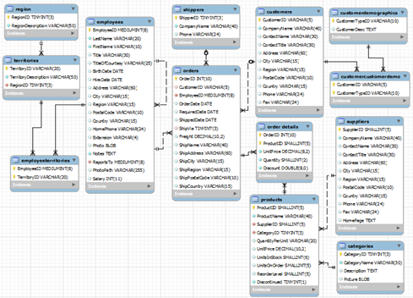
Databases: Structured data storage with tables (entities and attributes), supports complex queries, and relationships between data tables.

Slide 6
Vocabulary Building
Key Terms
Worksheet – a single page of a spreadsheet
Example: A worksheet (also known as a spreadsheet) consists of cells in which you can enter and calculate data. The cells are organized into columns and rows. A worksheet is always stored in a workbook. A workbook can contain many worksheets.
Database – A database is an organized collection of structured information, or data, typically stored electronically in a computer system.
Example: A database is usually controlled by a database management system (DBMS).

Slide 7
Field – In the context of technology and computing, a field can be seen as a specific area in a database or a form where you enter data. It's essentially a place where you can store information, such as a name or an address in a form, or a piece of data in a spreadsheet or database.
Example: Enter the client names and addresses into the database fields.
Query- A query is a request for data or information from a database table or combination of tables.
Example: In the context of queries in a database, it can be either a select query or an action query.
Spreadsheet – is a computer program that represents information in a two-dimensional grid of data, along with formulas that relate the data.
Example: Historically, a spreadsheet is an accounting ledger page that shows various quantitative information useful for managing a business.
Cell – is a unit of a spreadsheet that holds a piece of information.
Example: Use the data in the cells of a worksheet to create these charts.

Slide 8
Match the words with the definitions (A-E).
Worksheet, sort, database, field, formula
A. to arrange the information in a database
B. a large group of data organized in a computer
C. a mathematical instruction that performs spreadsheet calculations
D. a single page of a spreadsheet
E. a database category that holds a type of information

Slide 9
Activity: Read the sentence pairs. Choose which word best fits each blank.
timecard
database
An employee must correctly record their work hours on a ________________.
Important information is often stored in a ____________________.
budget
workbook
A _____________ helps determine how a company spends money.
A _____________ file created by a spreadsheet is often three pages long.
Answers: 1. timecard; 2. database; 3. budget; 4. workbook

Slide 10
Choose the word that is closest in meaning to the underlined part
1. Sue types in a(n) symbol that performs a specific calculation on the line.
A. cell B. operator C .worksheet
2. Please arrange the client addresses in a single collection of information in a database.
A. Table B. Field C. query
3. Dave adds up the values with a mathematical spreadsheet calculation.
A. Worksheet B. formula C. database
4. Jim organizes records in a computer program that organizes information and performs calculations.
A. Function B. query C. spreadsheet

Slide 11
Choose the word that is closest in meaning to the underlined part
5. Martha finds clients who live nearby with a(n) search that locates all information of a specific type.
A. Query B. field C. operator
6. Some information in one unit of a spreadsheet that holds a piece of information is incorrect.
A. table B. function C. cell

Slide 12
Reading
Understanding Databases vs. Spreadsheets
Databases and spreadsheets are fundamental tools for managing and analyzing data, each serving distinct purposes depending on the complexity and scale of information.
Spreadsheets provide a user-friendly interface for data entry, calculations, and basic analysis. Ideal for small to medium datasets, they excel in tasks like budgeting, simple inventory management, and personal finance. However, they can encounter issues with data integrity and scalability when handling large volumes of data.
Databases, on the other hand, offer structured data storage with tables, enabling efficient data organization, retrieval, and complex queries. They are essential for managing extensive datasets in environments such as customer relationship management (CRM) systems, e-commerce platforms, and data-intensive applications. Despite a steeper learning curve and initial setup complexity, databases ensure data integrity, scalability, and support for multiple users.
Choosing between databases and spreadsheets depends on factors like data volume, complexity, and collaborative needs. Integrating both tools where appropriate enhances workflow efficiency, ensuring optimal data management and analysis in diverse operational contexts.

Slide 13
Activity: Read the text and mark the following statements as true (T) or false (F).
Spreadsheets are suitable for managing large volumes of data efficiently.
Databases provide structured data storage with tables for efficient data organization and retrieval.
Spreadsheets are commonly used for tasks like budgeting, inventory management, and personal finance.
Databases have a user-friendly interface and are easy to learn for beginners.
Choosing between databases and spreadsheets depends on factors like data volume, complexity, and collaborative needs.
Spreadsheets are suitable for environments like CRM systems and e-commerce platforms.
Both databases and spreadsheets can be integrated effectively to enhance workflow efficiency.
Answers: 1. False; 2. True; 3. True; 4. False; 5. True; 6. False; 7. True

Slide 14
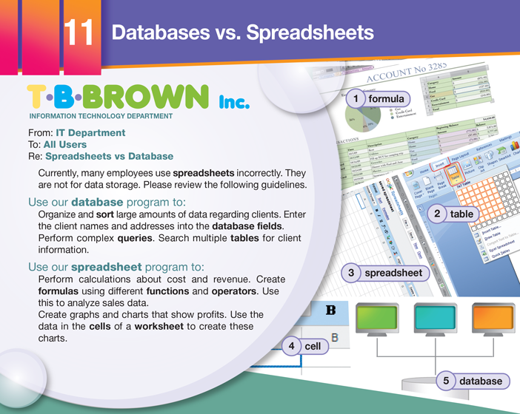

Slide 15
Read the email from the IT department of T.B. Brown Inc. Then, read the paraphrase of the email. Fill in the blanks with the correct words from the word bank.
Employees often use databases and spreadsheets incorrectly. Use a 1) _______ to organize large amounts of information about 2) ______ . A database makes it easy to search multiple 3) ________ for client information. Use a spreadsheet to perform 4) ________ about sales data. Spreadsheets are also able to create graphs and charts showing 5) ___________ .
database
clients
tables
calculations
profits
profits, tables, clients, database, calculations

Slide 16

Listen to a conversation between two co-workers at T.B. Brown Inc. Mark the following statements as True or False.
1. Sam is using a database program.
A. True
B. False
2. Rachel tells Sam to perform a query.
A. True
B. False
3. Sam enters a formula that calculates profits.
A. True
B. False

Slide 17
Listen again and complete the conversation
Sam: Rachel, I need help. I don’t understand this 1) ____________ program.
Rachel: Sure. What are you trying to do?
Sam: I need to 2) ___________ our estimated profits for next month. But I don’t know how to do that.
Rachel: Well, is all the 3) _____________ in the 4) _____________ correct?
Sam: Yes, I’m sure it is.
Rachel: Okay. Then just type this 5) ______________ into the top cell.
Sam: Really? That’s all?
Rachel: Yes. The formula calculates the estimated 6) __________ and shows them at the bottom of the spreadsheet.
Answers: 1. spreadsheet; 2. calculate; 3. data; 4. cells; 5. formula; 6. profits

Slide 18
Speaking
With a partner, act out the roles below.
Use languages such as:
I don’t even know what meta tags are.
Our site appears at the top of the search results.
Customers click on our hyperlink first.
Student A: You are a worker at T.B. Brown Inc. Student B needs help using a spreadsheet. Talk about:
• what the problem is
• possible mistakes
• solutions
Student B: You are Student A's co-worker. You need help using a spreadsheet. Answer Student A's questions.

Slide 19

Use the conversation from Task 8 to complete the page.
Question: How do I ___________ our customer __________ for last month?
Make sure all the ________ in the __________ is correct.
Enter the _________ into the ________cell.
The formula calculates the customer orders and shows them at the ____________ of the spreadsheet.
calculate
orders
data
cells
formula
top
bottom

Slide 20
Home assignment
Research and Analysis:
Choose two different real-world scenarios where either a spreadsheet or a database would be more suitable. Examples could include:
Case A: Managing a personal budget and financial records.
Case B: Operating a small online retail business with inventory management.
For each case, conduct research to determine which tool (spreadsheet or database) would be more appropriate based on factors like data volume, complexity, collaborative needs, and scalability.
Write a comparison report (approximately 500-800 words).

Slide 21

Thanks
Take care☺

Slide 22

Web Design vs
Web Development
Unit 12

Slide 23
Objectives:
01
02
03
differentiate between web design and web development
explain the collaborative process between designers and developers
evaluate user-centered design principles.

Slide 24
Lead-in: Let’s talk!
Option a
Option B
01
What makes a good business website?
02
What kind of websites do you like to use?

Slide 25
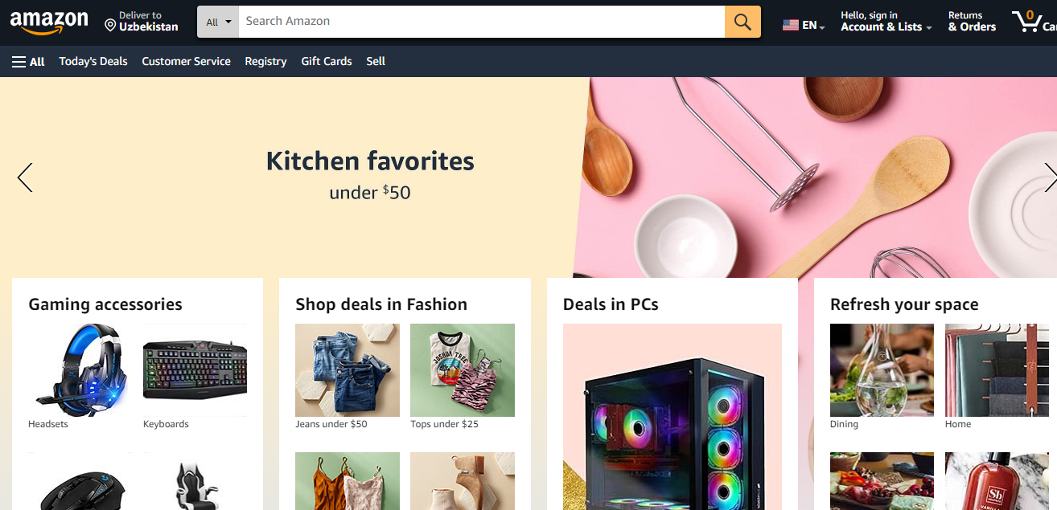
Activity: Showcasing the website to highlight interactive features and functionalities (e.g., forms, navigation menus). Here are some common and effective interactive elements of the Amazon website.

Slide 26
Sliders and Carousels:
• Image sliders showcasing products, services, or featured content.
• Testimonial carousels with quotes from customers or users.
Interactive Charts and Graphs:
• Data visualizations using charts (e.g., bar charts, pie charts, line graphs).
• Interactive elements like tooltips or drill-down options for deeper exploration.
Interactive Tables:
• Tables with sortable columns.
• Expandable rows for showing additional details or actions.
Video and Multimedia:
• Embedded videos with play controls.
• Audio players for podcasts or music.

Slide 27
Features and functionalities of the website
Forms:
Contact forms with fields for name, email, message, etc.
Registration forms for signing up to a service or newsletter.
Feedback forms to gather user opinions or reviews.
Navigation Menus:
Responsive navigation menus that adapt to different screen sizes (mobile-friendly).
Dropdown menus for hierarchical navigation.
Mega menus for displaying a large number of options in an organized manner.
Search Functionality:
Search bars with autocomplete suggestions.
Advanced search filters (e.g., by date, category, location).

Slide 28
‍Activity: Comparing and analyzing using Venn diagram
What’s the difference between a web designer and a web developer?
What’s the difference between a web designer and a web developer?
Similarity

Slide 29
Key Terms
Web design – is the act or practice of determining how a website looks
Example: The new company focused on web design.
Visibility – is how easily people find a website using search engines, based on how many other websites link to it
Example: Learn ways to increase a website’s visibility.
Coding – is a programming language that makes up a website
Example: The reason for this was to protect sensitive Javascript coding from launching unnecessary actions.
Navigation – is the act of using and finding things on a website
Example: As its name implies, structural navigation follows the structure of a website.

Slide 30
Usability – is how easy it is for a person to use a website
Example: Usability is one of the most important factors that affects the user experience of any application, website, or any other piece of software.
Content – is the material on a web page, including text and graphics
Example: Create attractive content to catch a user’s attention.
CSS – (Cascading Style Sheets) is a simple language that decides how a web page looks
Example: Use CSS to change a website’s style.

Slide 31
Match the words with the definitions (A-F).
content | visibility | coding | Web design | usability | navigation
A. choosing a website’s visuals _____
B. how easily you can find a website on a search engine ______
C. a website’s programming ________
D. how easily a user can use a website _______
E. moving around a website _________
F. everything contained in a website __________
A. web design; B. visibility; C. coding; D. usability; E. navigation; F. content

Slide 32
Fill in the blanks with the correct words and phrases from the word bank
CSS | appearance | functionality | web development
1. The website doesn’t work well. I want to improve its _____________.
2. My website looks boring. I’ll give it a more interesting ___________.
3. If you are interested in making a website, take a ____________ class.
4. I’m learning ____________ so that I can change my website.
Answers: 1. functionality; 2, appearance; 3. web development; 4. CSS

Slide 33
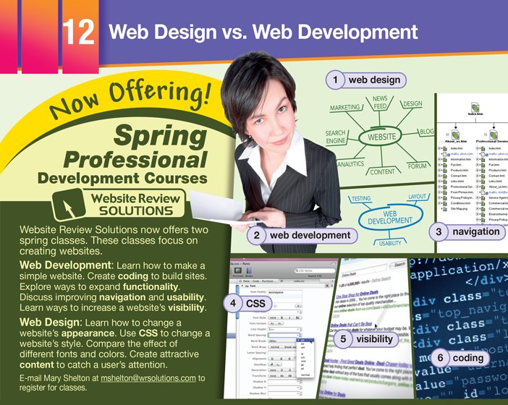

Slide 34

Read the article from a business newsletter. Then, choose the correct answers.
1. What does the Web Development class NOT teach?
A. making a website easy to use
B. improving a website's visibility
C. using code to program a website
D. how to market a new website
2. What can you infer about the Web Design class?
A. Attending the class is mandatory.
B. The first class addresses functionality.
C. It focuses on improving a site's visual element.
D. Its registration fee is less than the Web Development class.
3. What is the function of CSS?
A. It helps improve navigation.
B. It decreases a website's visibility.
C. It changes the style of a web page.
D. It expands the functionality of a website.

Slide 35

Listen to a conversation between an instructor for a web development class and an employee. Choose the correct answers.
1. What do the speakers mostly talk about?
A. how to change content
B. why sheets are separate
C. choosing the correct CSS style sheet
D. the difference between content and style
2. What happens when the style sheet and the content are separated?
A. It alters the content.
B. The content does not change.
C. Content needs creating.
D. The words are changed in the content.

Slide 36
Listen again and complete the conversation.
Instructor: So, that's how we change the website's style. Does anyone have any questions?
Employee: Yes. I have one. It's about 1) __________.
Instructor: Oh, the 2) ______ ______ _____. What do you want to know?
Employee: Why do we separate the style sheet and the 3) __________?
Instructor: It makes changing the 4) _____ _____ easier. The 5) __________ changes, but the content doesn't.
Employee: So, I change the style sheet. What happens to the content?
Instructor: Nothing, because the two are 6) _____________.
Employee: Okay. I understand now. The words stay the same, but their appearance changes.
Answers: 1. CSS; 2. cascading style sheets; 3. content; 4. web page; 5. appearance; 6. separate

Slide 37
Group working and Speaking
Activity: Web Design Task
Students are divided into groups and assigned to create a simple webpage layout using paper and markers. Emphasize elements like header, navigation bar, content area, and footer. Discuss design principles such as alignment, contrast, and consistency.
01
02
60%
40%
Group Work
Proposal A
Proposal B

Slide 38
Summary
Highlight skills and qualifications needed for each role and the importance of collaboration between designers and developers in real-world projects. Write your findings as a summary.

Slide 39
Thanks
Take care ☺

