Slide 1
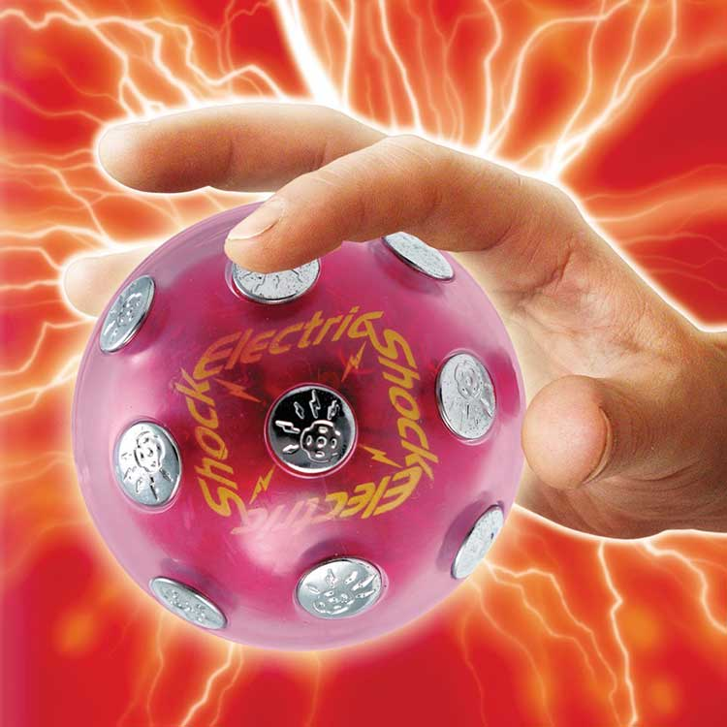
Shock Ball Hot Potato

Slide 2
Electronic Publishing / ARTIFICIAL INTELLIGENCE (AI)
Units 14 & 15

Slide 3




Slide 4
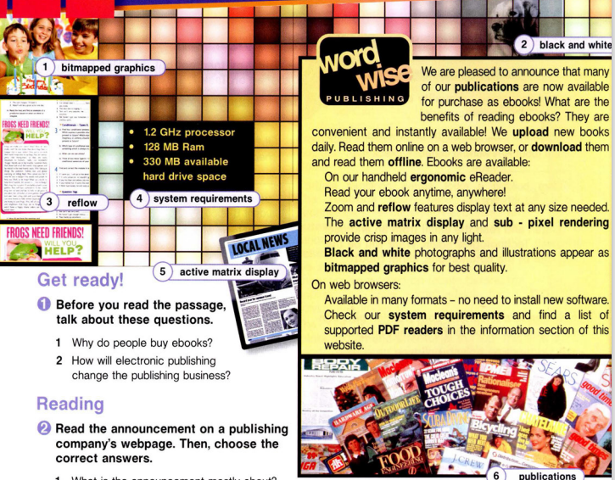
TARGET
65%
35%
€1,500/year
Gender
AVERAGE SPEND
+60
mercury
+50
jupiter
+40
venus
AGE
PROFESSION

Slide 5
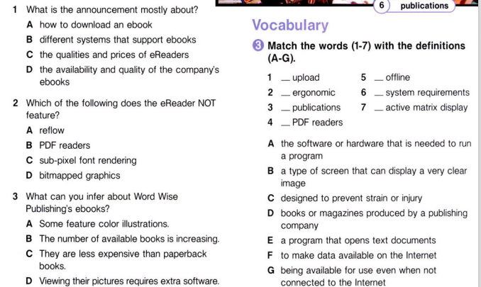
CONTENTS OF THIS TEMPLATE
Here’s what you’ll find in this Slidesgo template:
A slide structure based on a business presentation, which you can easily adapt to your needs. For more info on how to edit the template, please visit Slidesgo School or read our FAQs.
To view this template with the correct fonts in ppt format, download and install on your computer the fonts that we have used. You can learn how to download and install fonts here.
An assortment of graphic resources that are suitable for use in the presentation can be found in the alternative resources slide.
A thanks slide, which you must keep so that proper credits for our design are given.
A resources slide, where you’ll find links to all the elements used in the template.
Instructions for use.
Final slides with:
  The fonts and colors used in the template.
  A selection of illustrations. You can also customize and animate them as you wish with the online editor. Visit Storyset to find more.
  More infographic resources, whose size and color can be edited.
  Sets of customizable icons of the following themes: general, business, avatar, creative process, education, help & support, medical, nature, performing arts, SEO & marketing, and teamwork.
You can delete this slide when you’re done editing the presentation.
F
G
C
A
D
B
E

Slide 6
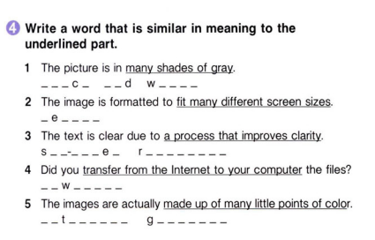
MISSION STATEMENT
Do you know what helps you make your point clear?
Lists like this one:
They’re simple
You can organize your ideas clearly
You’ll never forget to buy milk!
And the most important thing: the audience won’t miss the point of your presentation

Slide 7
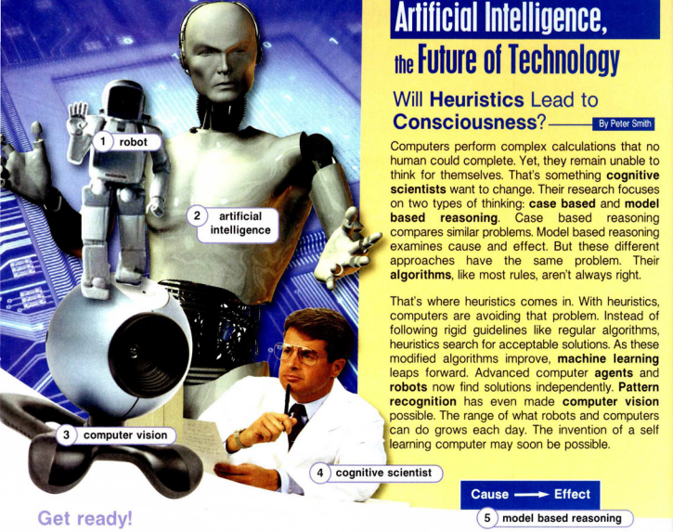
PROBLEM VS. SOLUTION
Mercury is the closest planet to the Sun and the smallest one in the Solar System—it’s only a bit larger than the Moon
problem
Venus has a beautiful name and is the second planet from the Sun. It’s hot and has a poisonous atmosphere
solution

Slide 8
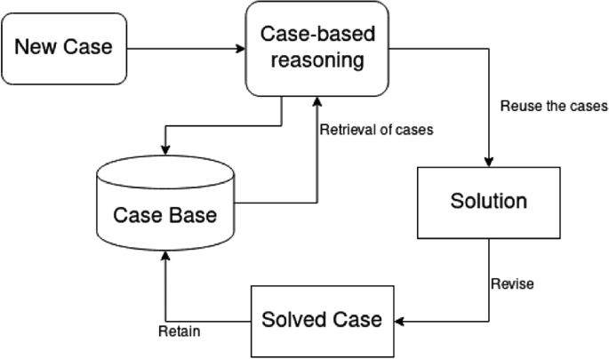
Case-based reasoning (CBR) is an experience-based approach to solving new problems by adapting previously successful solutions to similar problems. Addressing memory, learning, planning and problem solving, CBR provides a foundation for a new technology of intelligent computer systems that can solve problems and adapt to new situations.

Slide 9
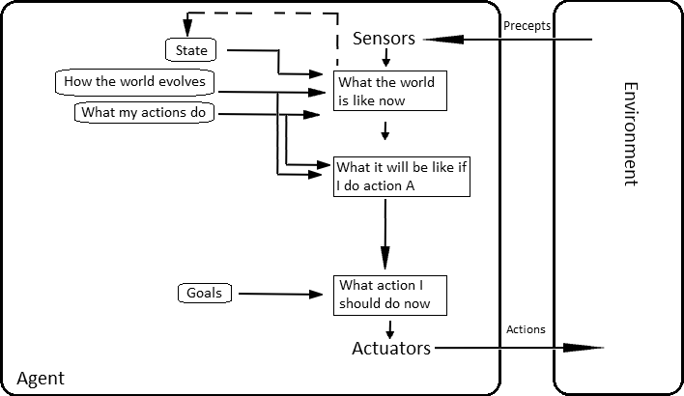
Model based reasoning
In artificial intelligence, model-based reasoning refers to an inference method used in expert systems based on a model of the physical world. With this approach, the main focus of application development is developing the model.

Slide 10
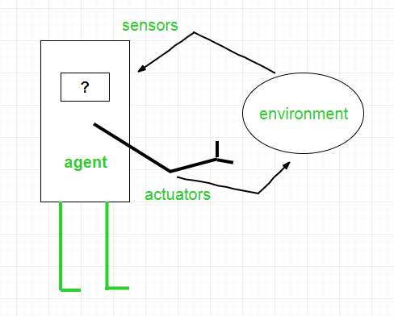
Agent
An agent is anything that can be viewed as :
perceiving its environment through sensors and
acting upon that environment through actuators
An agent is a computer that observes and reacts to the conditions in a certain environment

Slide 11
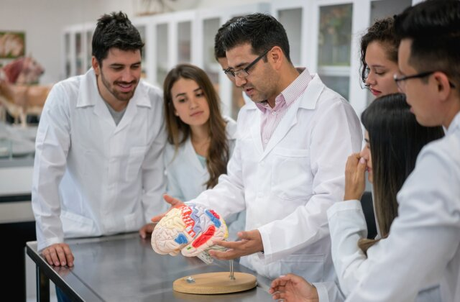
Cognitive scientists study intelligence and behavior, with a focus on how nervous systems represent, process, and transform information.

Slide 12
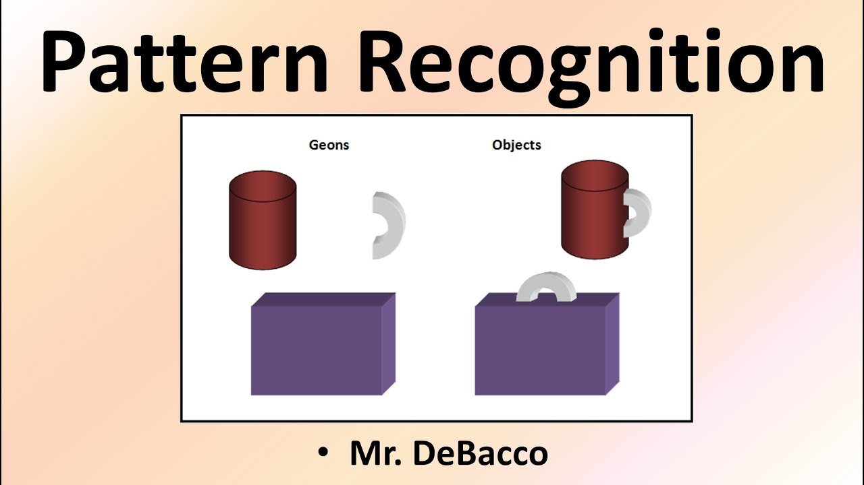
Pattern recognition
It’s a process of classifying objects by appearance

Slide 13
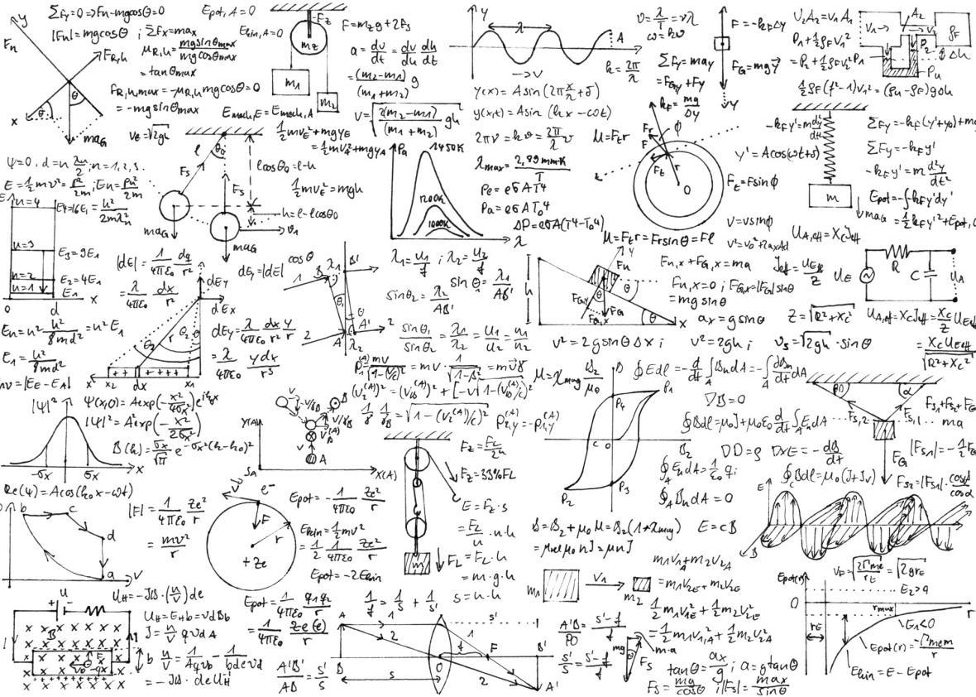
An algorithm is a rule or set of rules that provides steps to take or questions to ask in order to solve a problem.

Slide 14
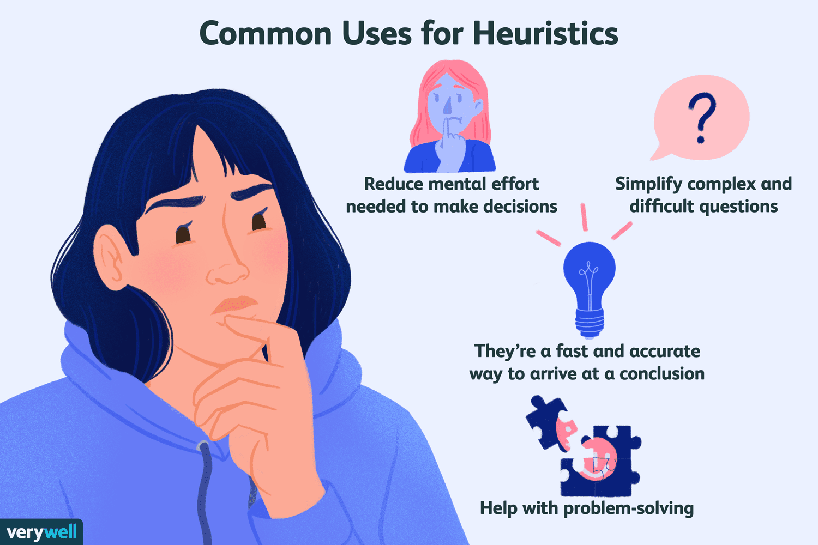
A heuristic is an inexact algorithm that is based on intuitive and plausible arguments which are “likely” to lead to reasonable solutions for a given problem, but are not guaranteed to do so.

Slide 15
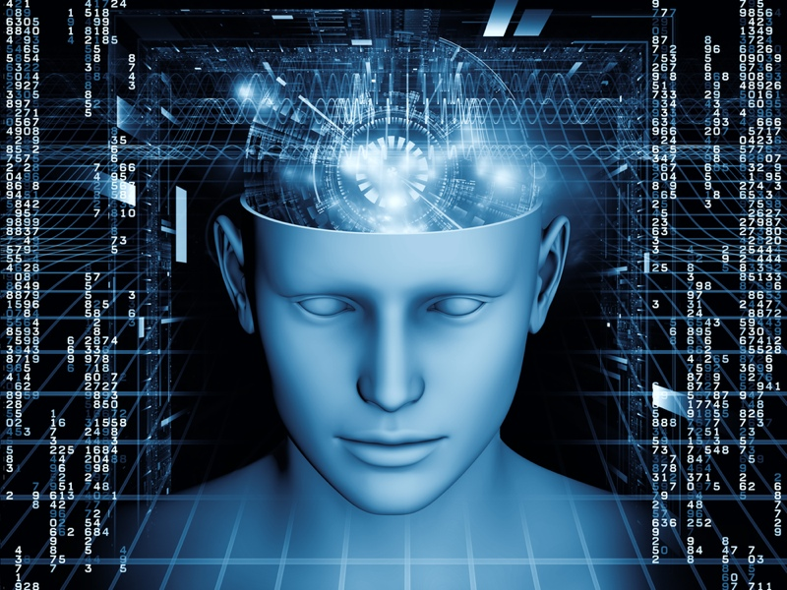
The state of understanding and realizing something

Slide 16
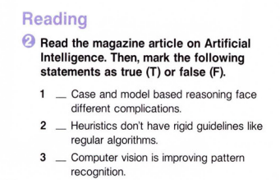
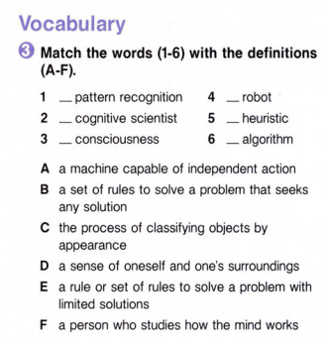
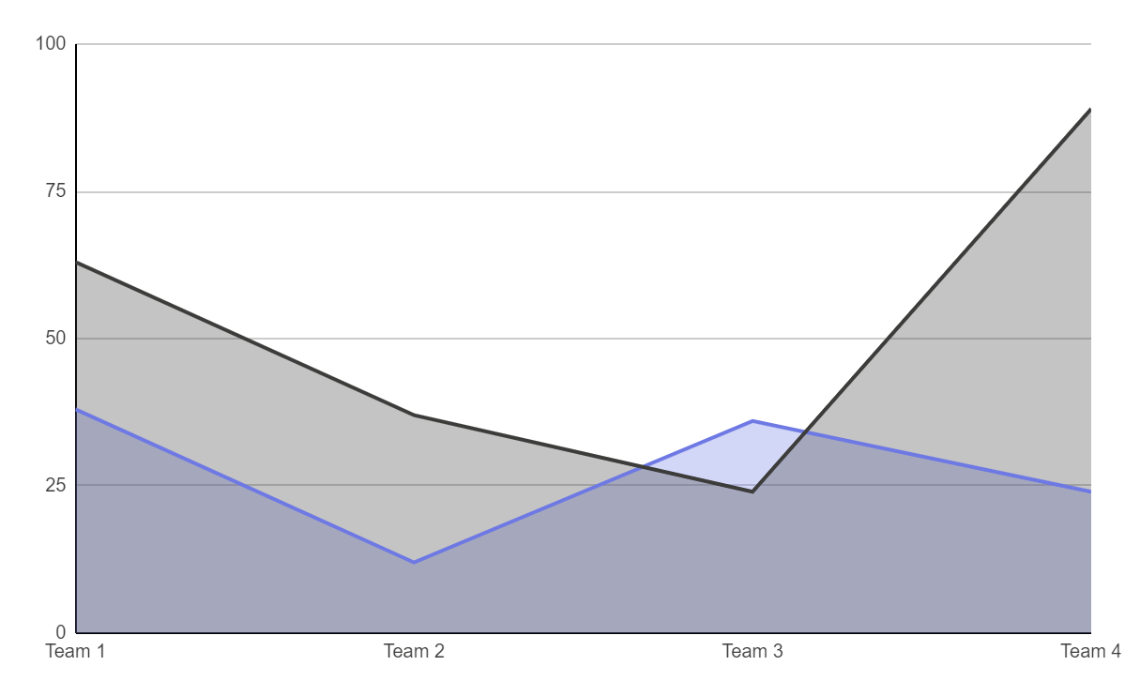
Working on Vocabulary
Periode 1
A
Mercury is the closest planet to the Sun
C
F
B
D
E
Periode 2
F
Venus is the second planet from the Sun
T
Follow the link in the graph to modify its data and then paste the new one here. For more info, click here
F

Slide 17
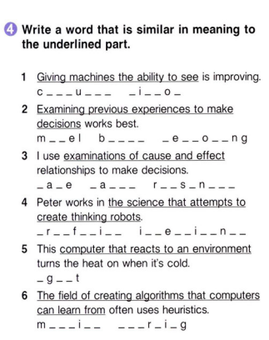
01.
BUSINESS OVERVIEW
You can enter a subtitle here if you need it

Slide 18


I group
II group
Create 3 the hardest questions
Give your questions to other teams

Slide 19
ALTERNATIVE RESOURCES
Try in a group complete the text

Slide 20

THANKS
Do you have any questions?

