Slide 1

E-COMMERCE & COMPUTER MEMORY

Slide 2

AGENDA
Describe minimum requirements
Learn specific vocabulary
Clarify information

Slide 3

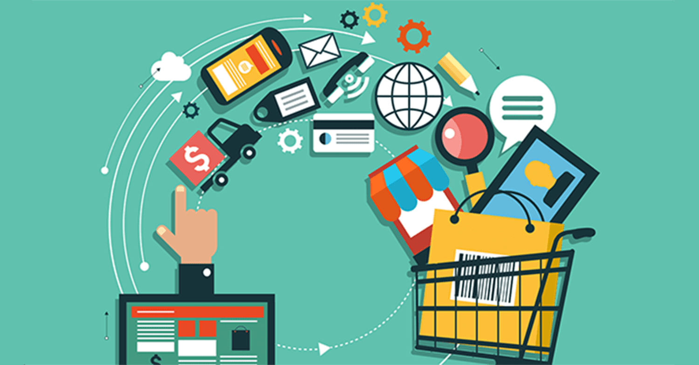
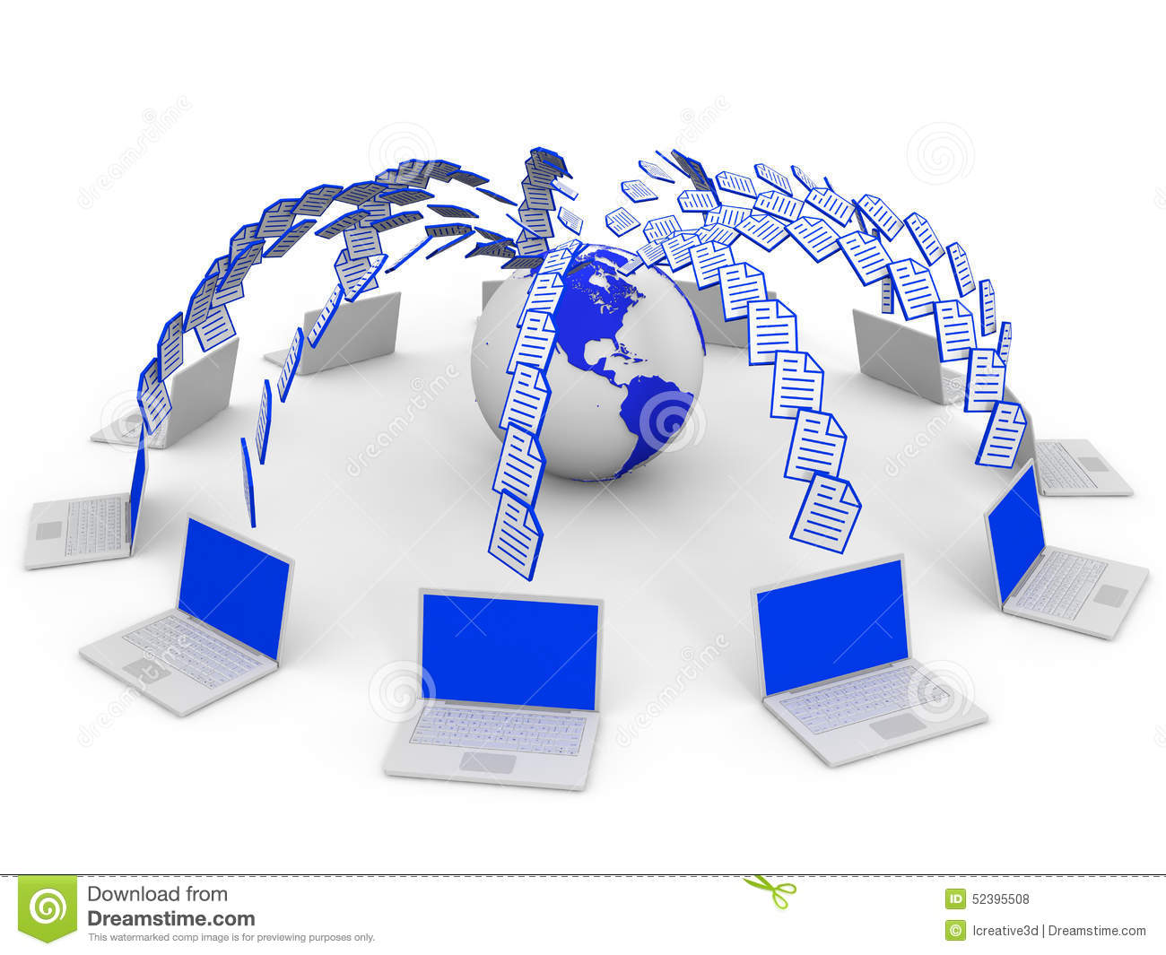
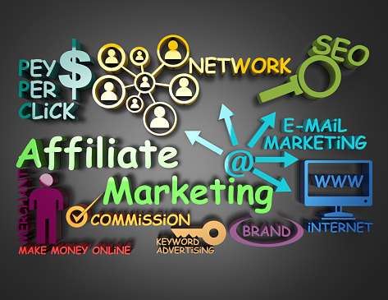
Enhance your vocabulary
E-commerce – is the purchase or sale of items on the internet.
Traffic – is the total number of users that go to and view a website in a certain amount of time.
Affiliate – is a person or business that directs Internet traffic to a business’s website in exchange for a percentage of sales.

Slide 4
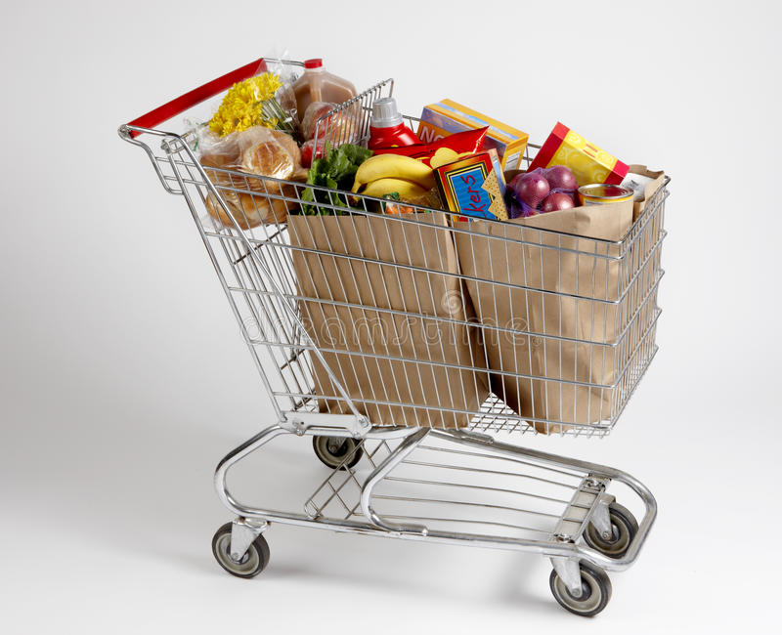

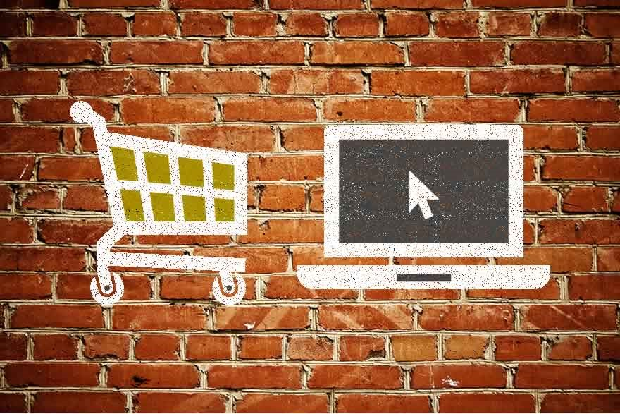
4. Shopping cart – is a part of an online store that displays items that a consumer has selected for purchase , but has not yet paid yet 5. FAQs – (Frequently Asked Questions) are a set of questions and answers that are provided on a website to provide users with information that users commonly want to know 6. Brick and mortar – is a business that operates in a physical location instead of online

Slide 5

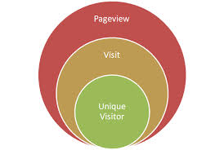
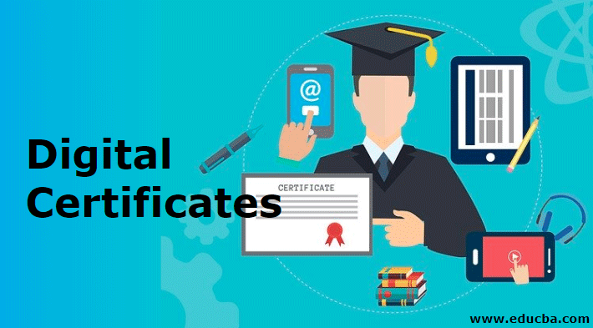
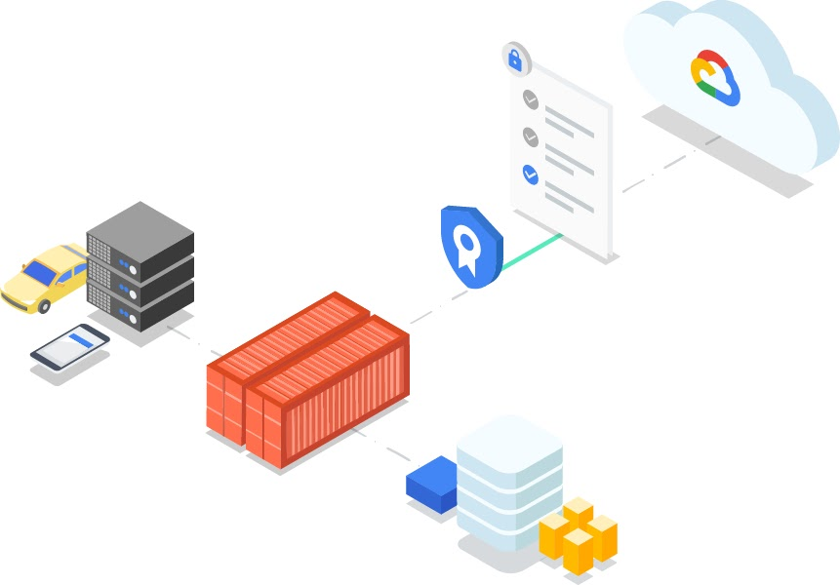
7. Page views – is a request from a computer to load a page of a website. They can be counted to analyze the number of people viewing a website. 8. Digital certificate – is an electronic document that proves an online business or person is who that business or person claims to be. 9. Certificate authority – it creates, offers and verifies reliable digital certificates.

Slide 6

2. How does online shopping help businesses?
1. What do you buy online?
Let’s talk about these questions

Slide 7

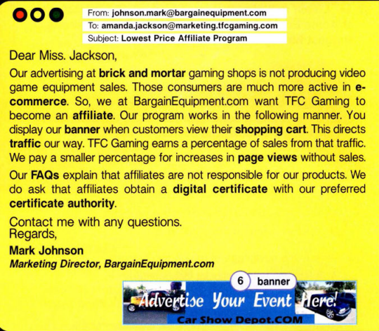
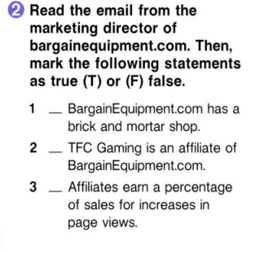

OUR COMPANY
F
Mercury is the closest planet to the Sun and the smallest one in the Solar System—it’s only a bit larger than the Moon
F
T

Slide 8
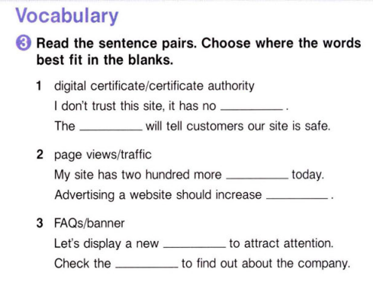
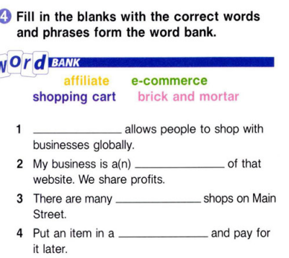
MERCURY
MARS
digital certificate
certificate authority
Mercury is the closest planet to the Sun
Despite being red, Mars is a cold place
E-commerce
VENUS
SATURN
Venus has a
beautiful name
page views
Saturn is the ringed one and a gas giant
affiliate
traffic
JUPITER
NEPTUNE
It’s the biggest planet in our Solar System
brick and mortar
It’s the farthest planet from the Sun
banner
FAQs
shopping cart

Slide 9

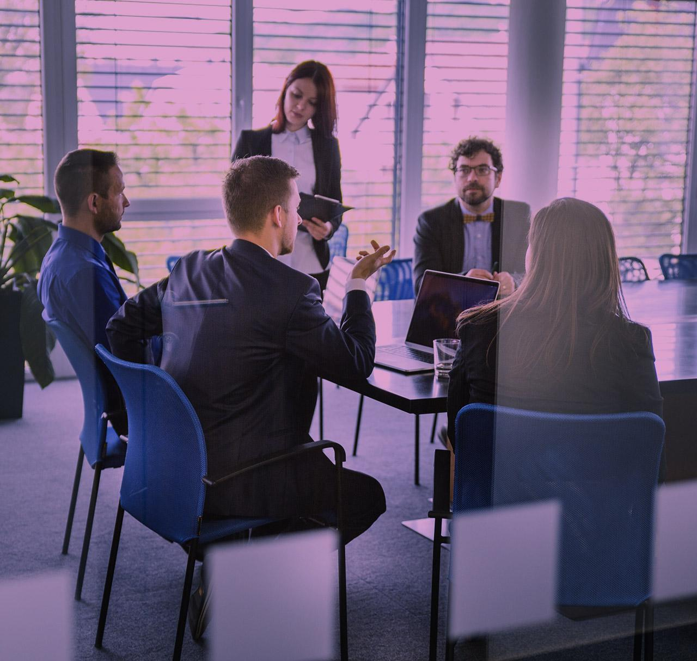
Listen to part of a conversation between employee of BargainEquipment.com and TFC Gaming. Choose the correct answers.

Slide 10
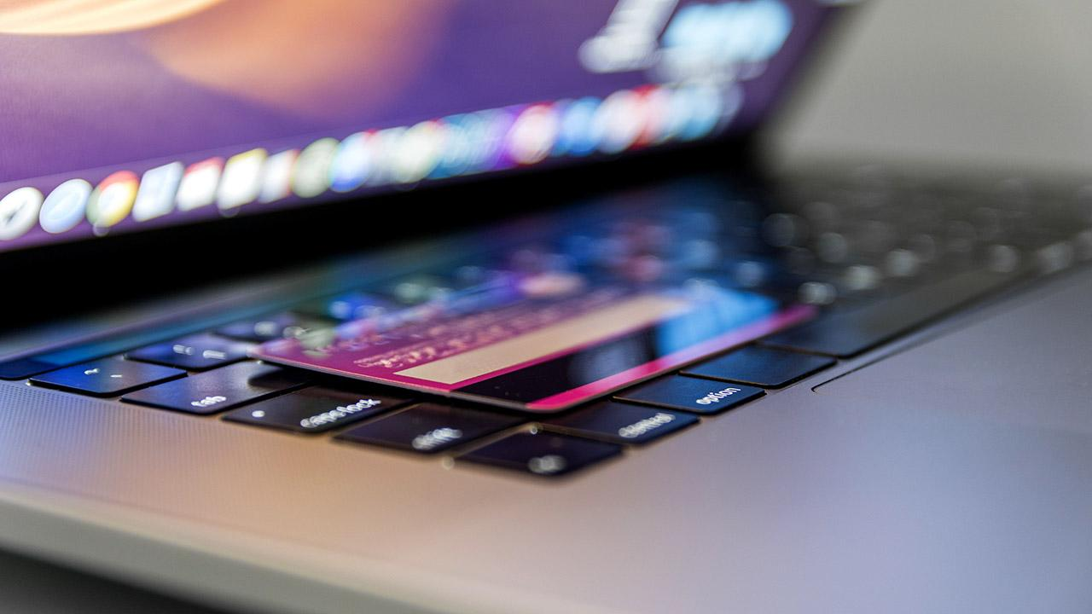
Computer Memory

Slide 11

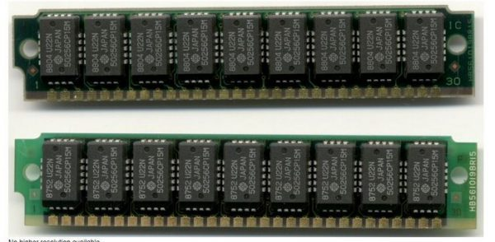
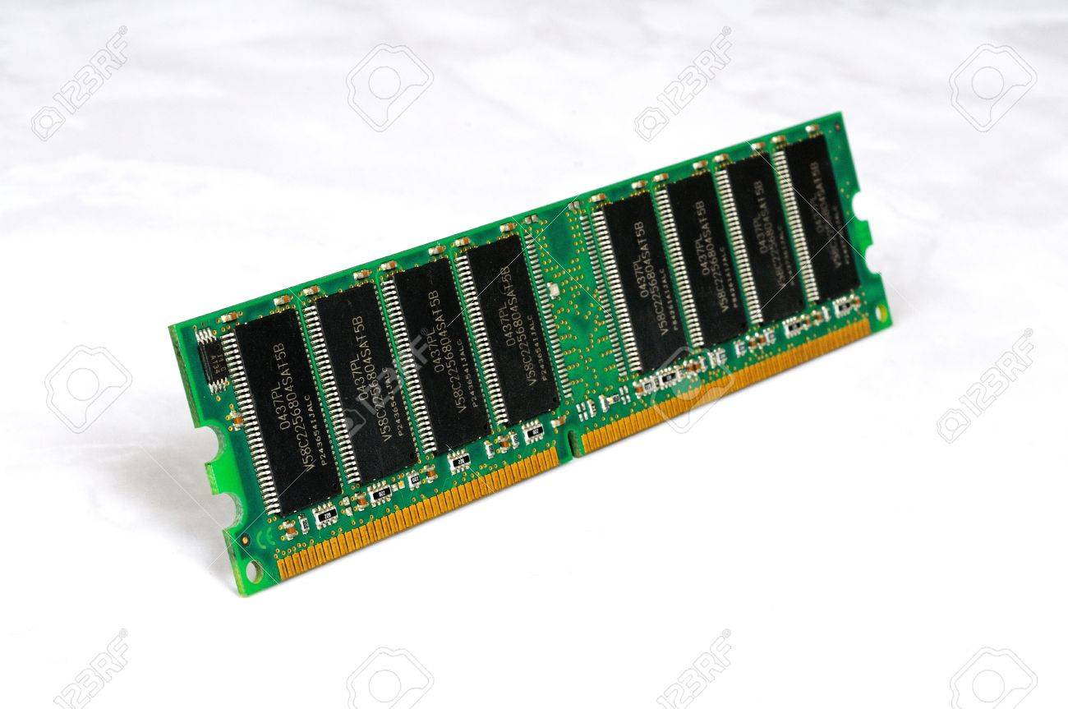
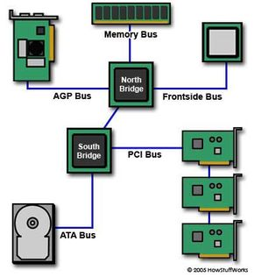
Let’s boost your vocabulary!
SIMMs – Single Inline Memory Module is an older type of memory module. It sends up to 32 bits of data to CPU.
DIMMs – Dual Inline Memory Module is a newer type of memory module. It sends 64 bits of data to the CPU.
Bus speed – a computer’s bus speed measures how many times the CPU can access a group of bits per second. This is measured in MHz.

Slide 12

Watch the video about computer memory and answer the questions

Slide 13

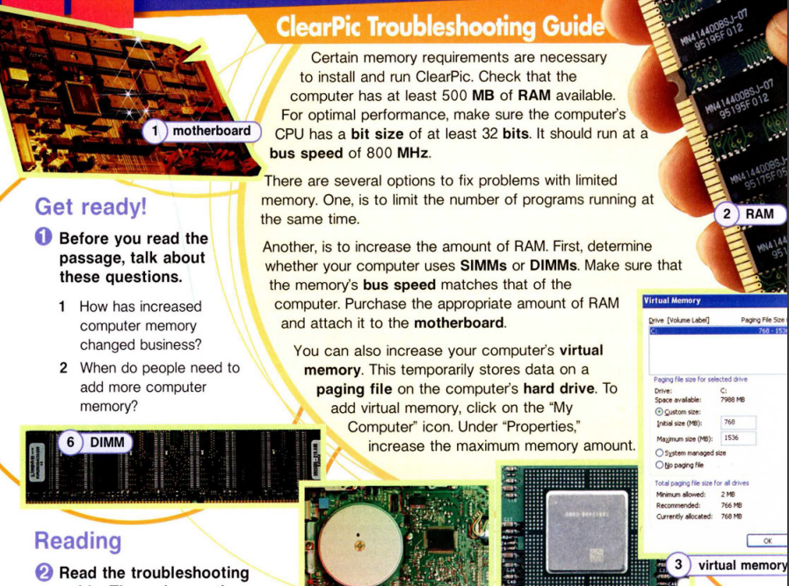
THEM
US
Mercury is the closest planet to the Sun and the smallest one in the
Solar System
Venus is the second planet from the Sun. Its atmosphere is extremely poisonous

Slide 14

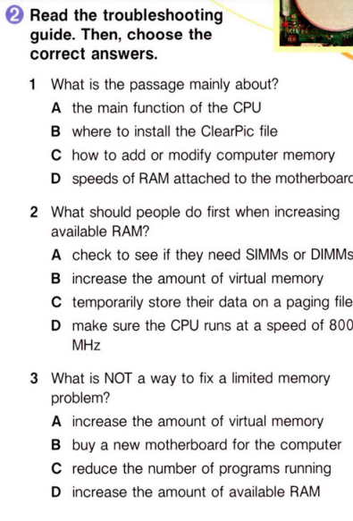
02

Slide 15

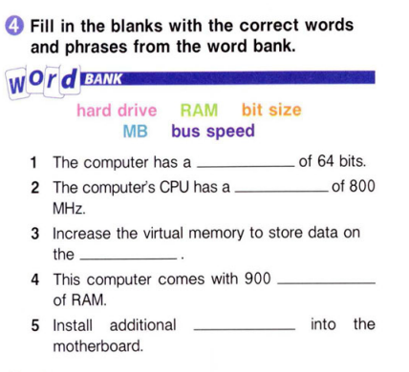

Computer Memory
Despite being red, Mars is a cold place
Venus has a beautiful name, but it’s terribly hot
Mercury is the closest planet to the Sun

Slide 16
It is high time to review all materials!

Slide 17
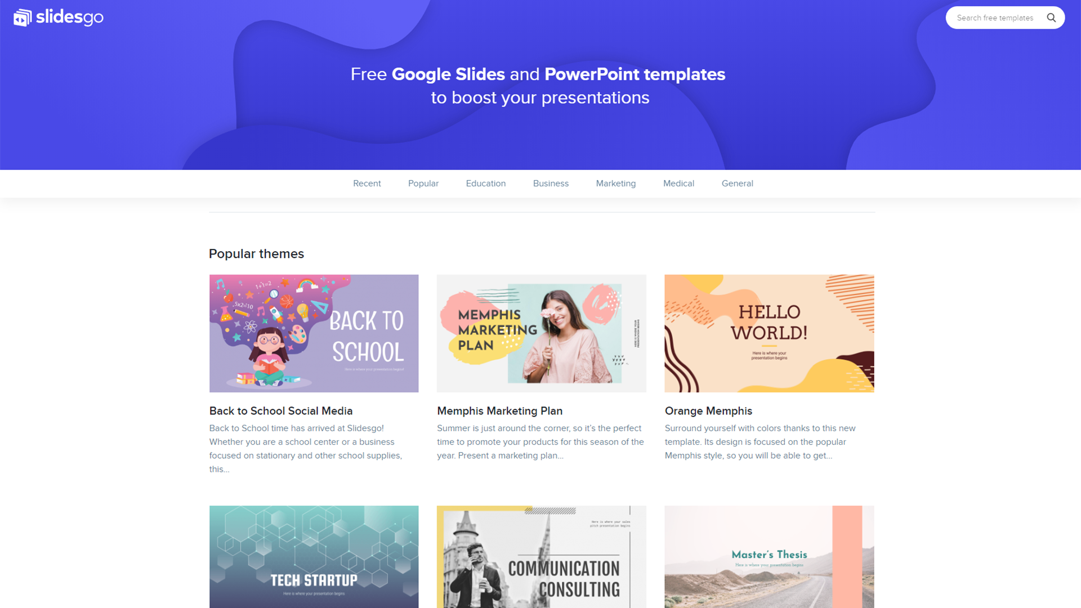
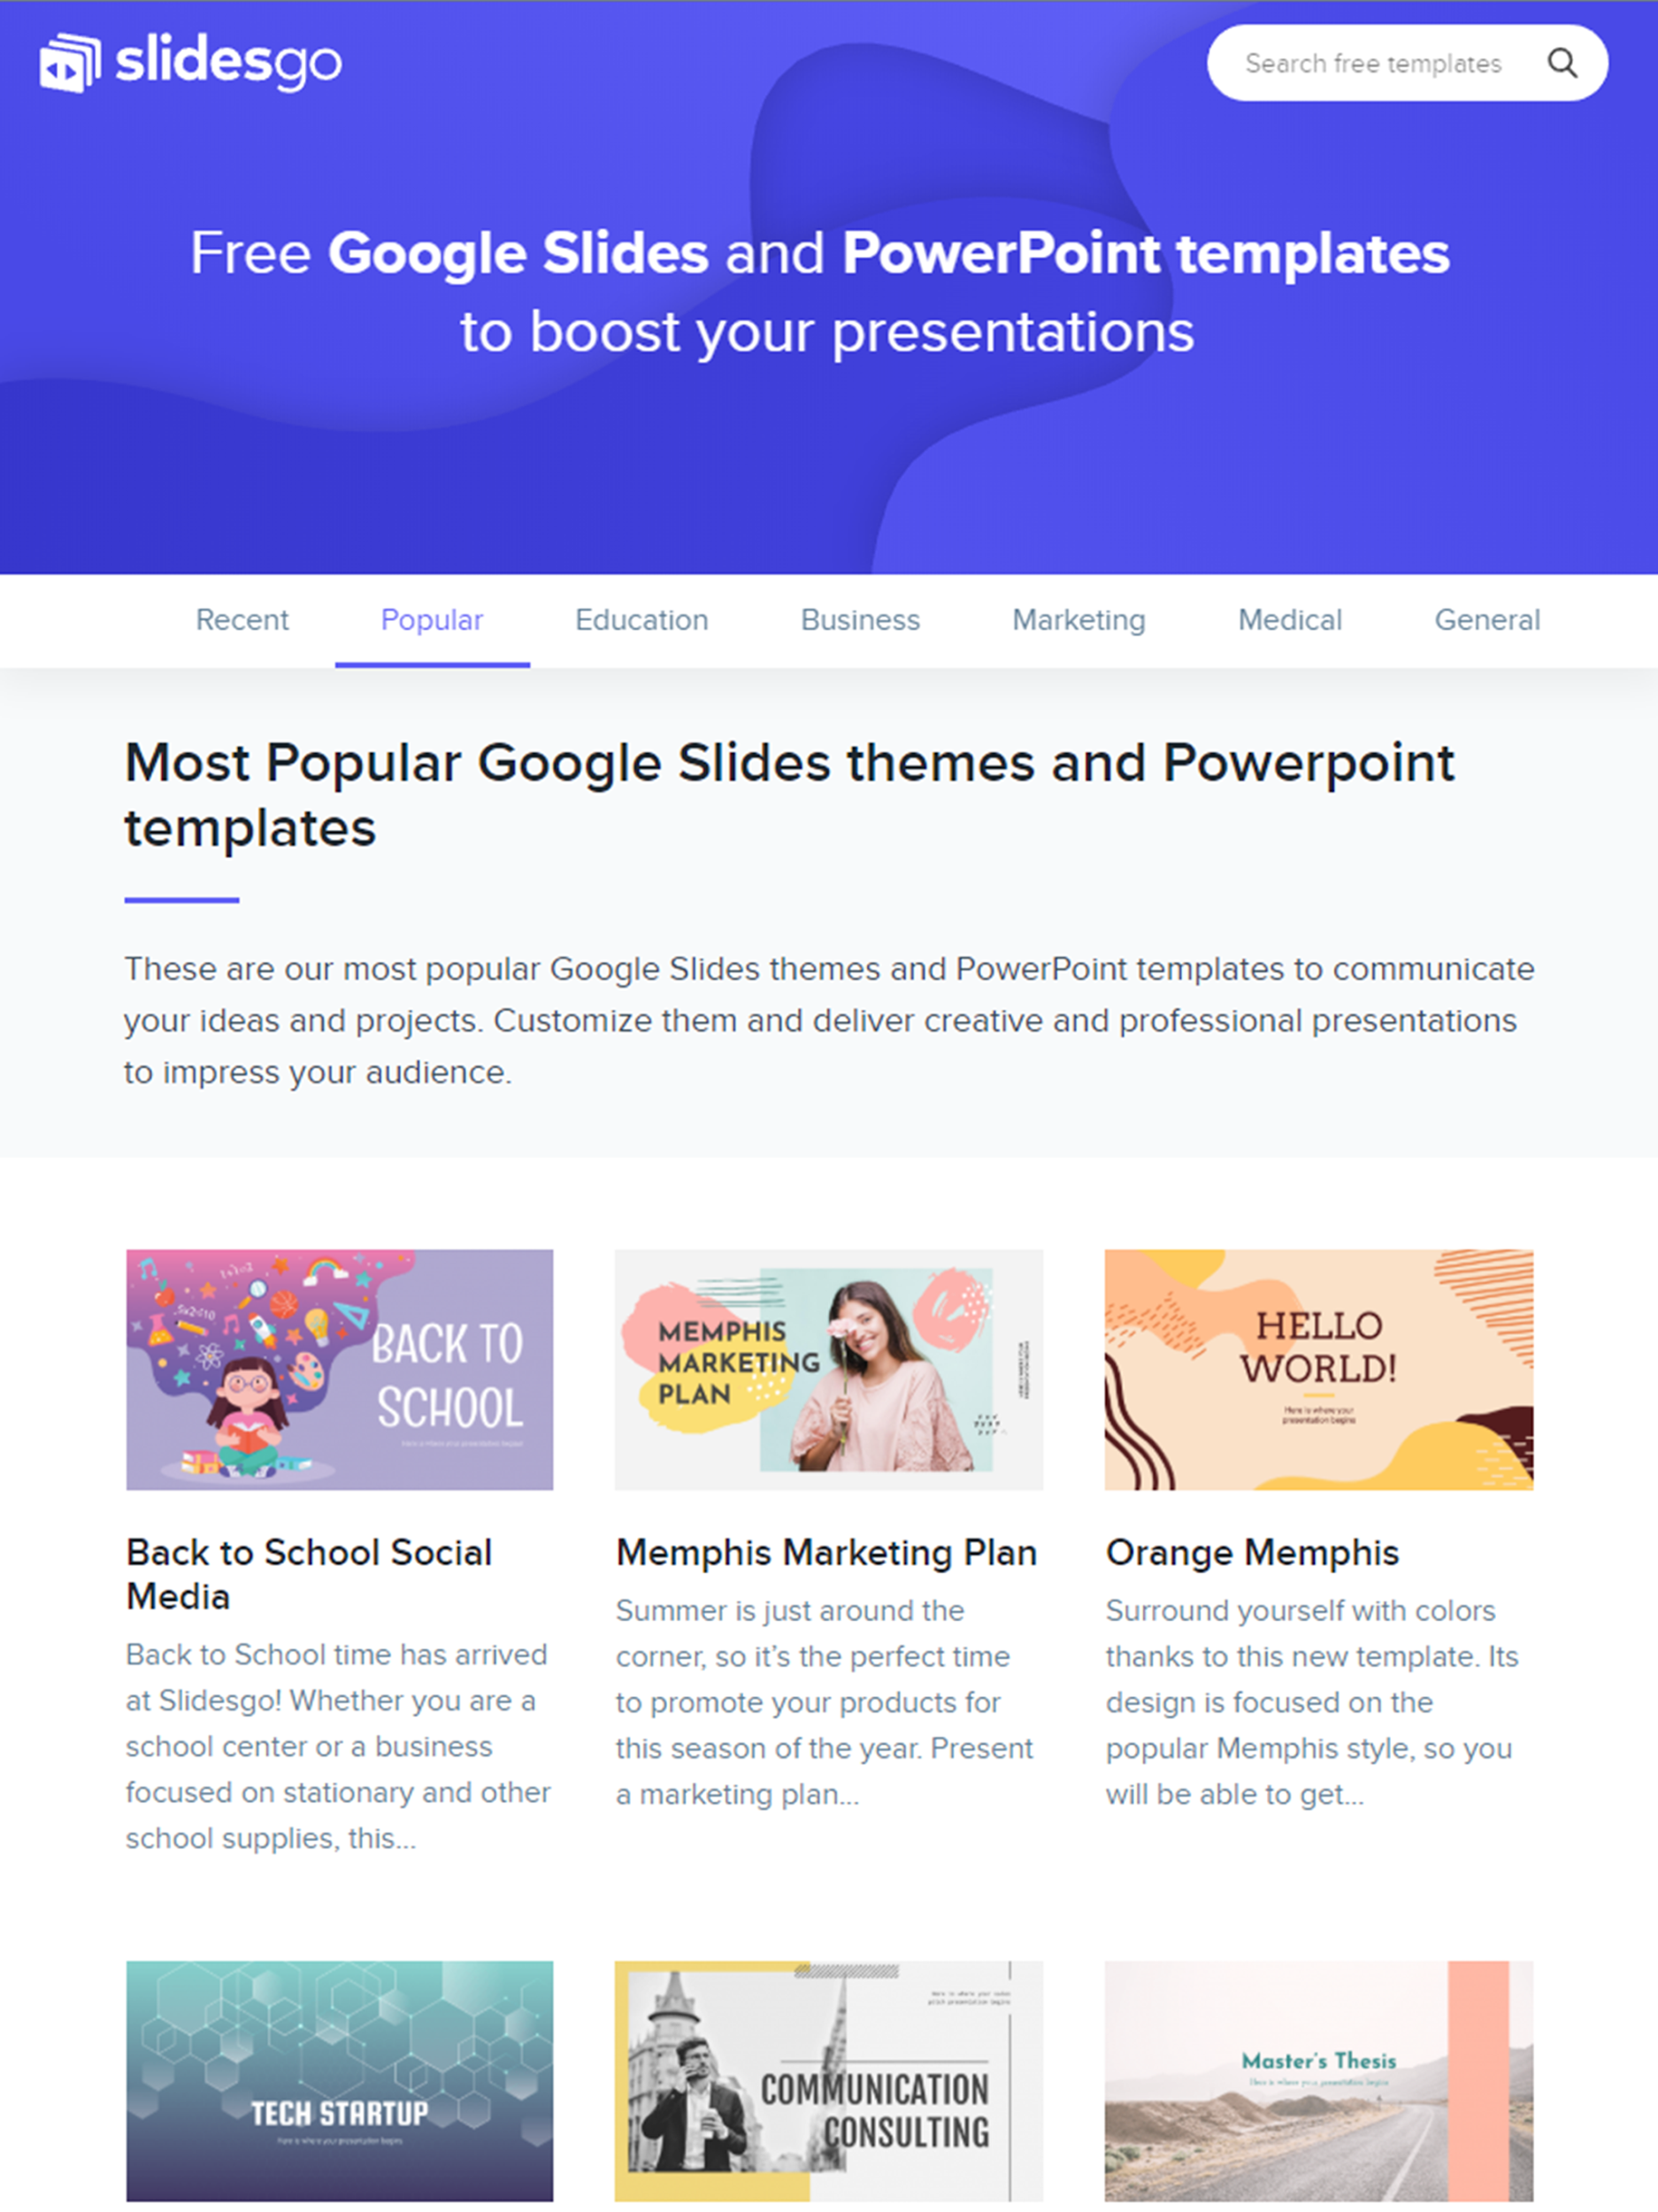
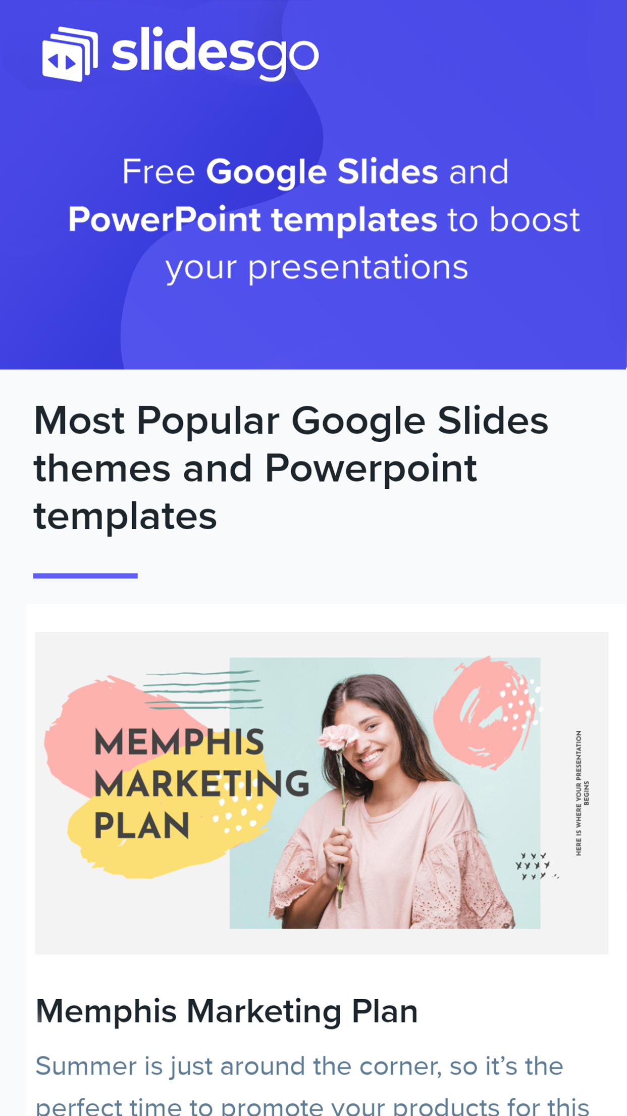
Home Assignment
Learn the terms/specific words which you studied during the lessons.
Get ready to make the presentation.

Slide 18

THANKS!
Do you have any questions?

