Slide 1
Storage Devices/Peripherals
Units 4 & 5

Slide 2
AGENDA
1
2
3
Learn about storage devices/peripherals
Ask about deadlines
Make a recommendation

Slide 3
Get ready!
01
How has digital technology changed photography and printing?
03
What types of businesses use scanners, printers and digital cameras?
02
04
Which types of storage devices do people use?
What do people use USB flash drives for?

Slide 4

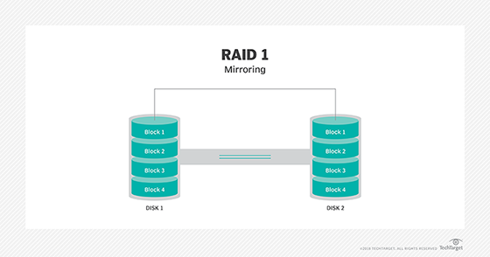

Array is a group of disk drives that are connected and used as a single unit.
RAID is a method for combining multiple disk drives into a single storage unit that can increase computer performance dramatically.
SATA is an interface for connecting storage devices to a computer system.

Slide 5



CD-R is a blank CD that can have information written on it only once.
CD-RW is a blank CD that can have information written on it multiple times.
A failure occurs when a disk drive malfunctions and the data stored on it cannot be accessed.

Slide 6

Watch a video and answer the questions

Slide 7
1. How many types of memory were mentioned in this video? What are they?
2. What are the differences of these memories?
3. What are the features of the secondary memory?
4. Name the types of the storage devices.
5. Write about the types of CDs & DVDs?
6. What does SD stand for?

Slide 8


Slide 9
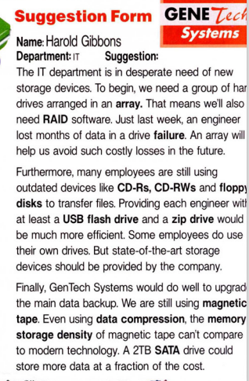
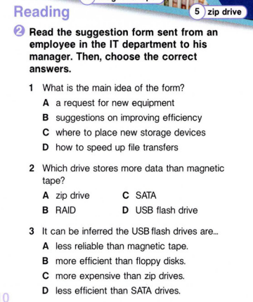

Slide 10
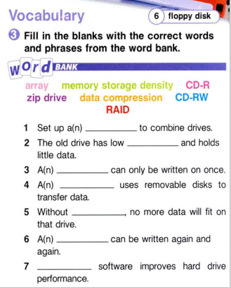
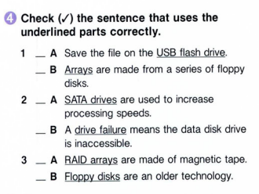
array
memory storage density
CD-R
data compression
CD-RW
RAID
zip drive

Slide 11

Listen to a conversation between an IT employee and his manager. Mark the following statements as True or False.
1. The company will purchase an array.
True
False
2. All of the requests were approved.
True
False
3. Management thinks a new main data backup device is too expensive.
True
False

Slide 12
Listen again and complete the conversation.
Manager: Harold, could I see you for a few minutes?
Employee: Sure, Mrs. Smith. What's going on?
Manager: A few of the requests you sent in have been approved.
Employee: That's great! So what did we get?
Manager: Management didn't like hearing about the 1) ________ _________ , so we're getting the array.
Employee: Yes, that was pretty bad. What about some of the 2) ___________ ____________ ?
Manager: They weren't approved. It just seemed too expensive.
Employee: 3) _____________ ______________ , but I guess you've got to save money somehow. How about the main data backup?
Manager: We're interested in the savings you mentioned. Could you 4) _________ _______ _______ a more 5) _____ _________ ?
Employee: Absolutely. When would you like that?
Manager: 6) _______ ________ ___________ _______________ .
Employee: Sounds good. I'll have something for you tomorrow.

Slide 13
When do you need … by?
Why do you need it soon/then?
I need you to finish that by…
I need … by…
1.Update the resources
2. update the main data backup
3. give each employee a USB flash drive
4. transfer information from CD-Rs to files
5. back up data
6. get a SATA drive

Slide 14

You are an employee in IT. Use the conversation from Task 8 to complete the memo to your co-workers telling them which types of new equipment were approved for purchase and why.
Memorandum
From: Simon Rogers
To: IT Employees
I am pleased to inform you that a few of our ______ for new equipment have been _____ . We are getting a group of ______ drives arranged in an _______ as management didn't like hearing about the _______ loss. Also, if I can come up with a more detailed _______ regarding the main _______ backup, management is very ________. I look forward to hearing your __________ and any further _________.

Slide 15
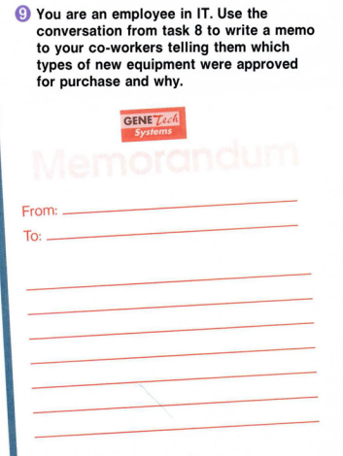
Writing
Suggested answer:
From: Simon Rogers
To: IT Employees
I am pleased to inform you that a few of our requests for new equipment have been approved. We are getting a group of hard drives arranged in an array as management didn’t like hearing about the data loss. Also, if I can come up with a more detailed proposal regarding the main data backup, management is very interested. I look forward to hearing your comments and further suggestions.

Slide 16
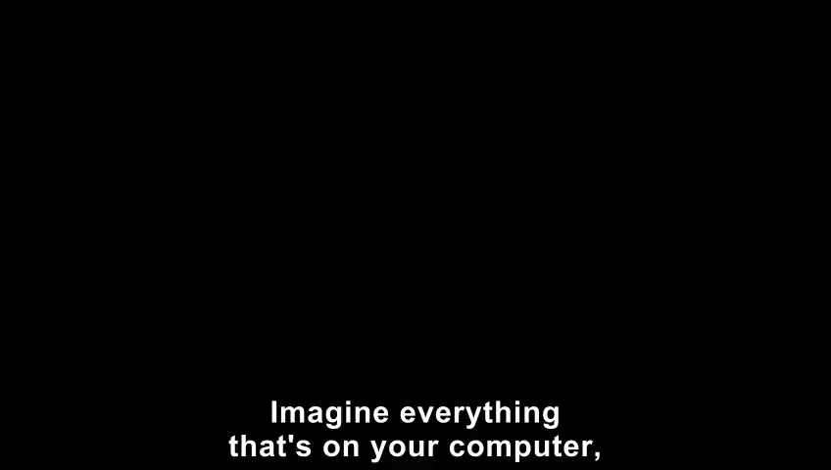
VIDEO EXERCISE

Slide 17
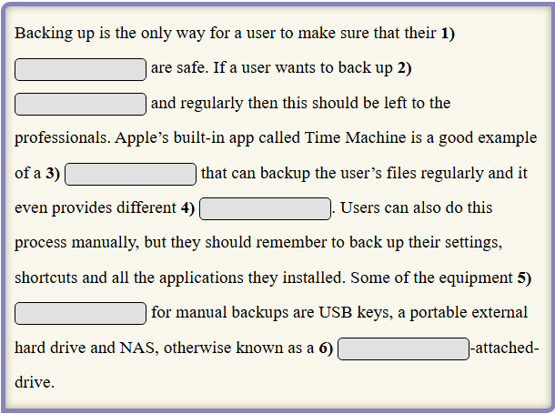
Use the words below to complete the text.
consistently | program | available | files | network | versions

Slide 18
Review the terms
You’ll be divided into 2 teams. The word will be written on the board and the first team will be given 10 seconds to make a sentence using that term. If the sentence is correct, the team gets 1 point. But if the sentence is incorrect or they can’t make a sentence, then the second team steal the point by using the word correctly.

Slide 19

Group Work Activity
Give a presentation on the pros and cons of various storage devices.

Slide 20
Home assignment
Make a short presentation comparing a report on different storage devices, focusing on aspects like capacity, speed, and cost.

Slide 21

Peripherals

Slide 22
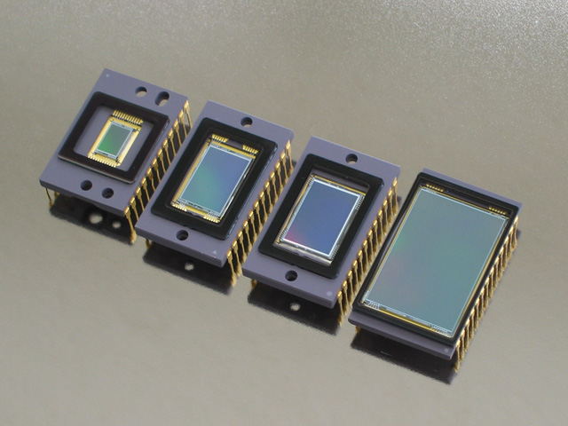
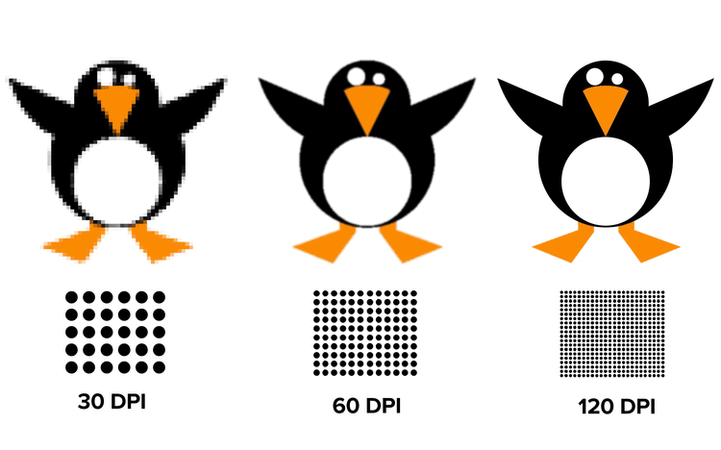
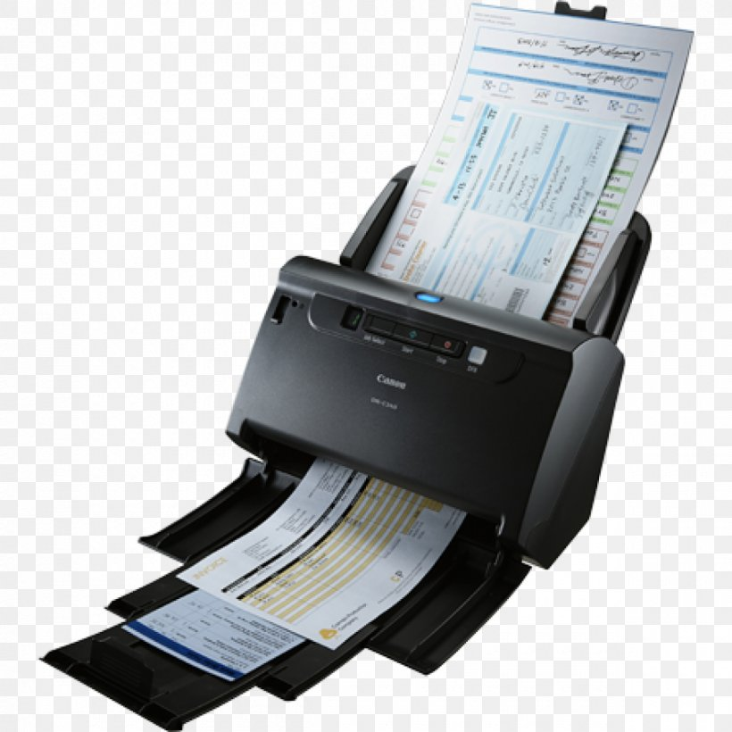
CCDs (Charge-Coupled Device) is a light-sensitive chip that is used when capturing digital images.
DPI (Dots Per Inch) is the number of dots used per inch to create an image.
Automatic document feeder (ADF) is a device that feeds multiple pages into a scanner.

Slide 23

New version of “TIC &TOE”
Two students will go to the board and one by one they write a vocabulary word in each box. One student chooses a grid and writes a word, another student needs to give definition to it. If he/she gets it correct, he/she draws an “X” over the square. Next the other student does the same.

Slide 24

Resources
Did you like the resources on this template? Get them for free at our other websites:
Photos
Modern and equipped computer lab
Blue optic fiber with ethernet cables and laptop
Freelance worker using laptop
Hard drive with blue light top view
Top view hard drive with blue light
Vectors
Electronic board with lights background
Icons
Big Data | Lineal

Slide 25
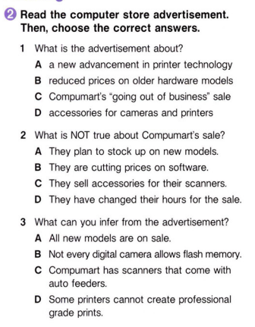

Slide 26
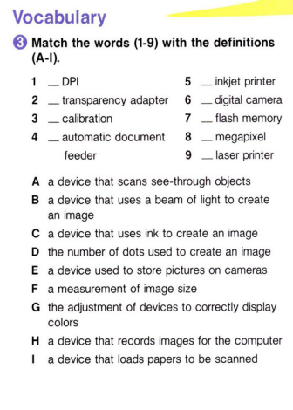
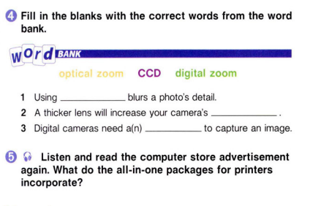

Slide 27
Listen to a conversation between a salesman and a photographer. Choose the correct answers.
1. What does the woman want to do?
A return her inkjet printer
B exchange her SuperShot 350
C buy more professional equipment
D research inkjet and laser printers
2. What can you infer about the woman?
A Her last inkjet printer broke.
B She is buying her first digital camera.
C She plans on selling her old equipment.
D She wants to improve the quality of her work.

Slide 28
Listen again and complete the conversation.
Salesman: You look like you need some help.
Photographer: Yeah. I'm an amateur photographer and I need better equipment.
Salesman: May I recommend the SuperShot 350? It has 15 times 1) __________ __________ and 2 times digital zoom.
Photographer: That's pretty much what I have now. I'm looking for something a bit 2) ._____________ _____________
Salesman: Okay ... how about the SnapPro series? This one has 30 times optical zoom and 5 times digital.
Photographer: How many 3) ___________ does it have?
Salesman: Fifteen, which gives you incredible detail.
Photographer: That 4) ____________ _______________ . Now, I'd also like to start printing my own pictures.
Salesman: Well, we have some great deals on inkjet and 5) ________________ _________________ .
Photographer: I'm leaning towards a laser printer. Inkjets just can't print as well.
Salesman: Okay, the PrintBeam EX is a two-in-one laser printer and scanner. It prints at 2400 6) _________________ .
Photographer: That's perfect. Thanks so much.

Slide 29
Understanding Computer Peripherals
A computer peripheral is an external device that connects to a computer to add functionality. Common peripherals include keyboards, mice, printers, and monitors.
Key Peripherals:
Keyboard: A keyboard is used to type letters, numbers, and symbols into a computer. It has keys for each letter and number, as well as special keys like Shift and Enter.
Mouse: The mouse is a pointing device used to control the cursor on the screen. It has two main buttons (left and right) and sometimes a scroll wheel. By moving the mouse, you can move the cursor and click on items.
Printer: A printer is used to produce physical copies of documents and images from a computer. There are different types of printers, such as inkjet and laser printers. Inkjet printers use liquid ink, while laser printers use toner.
Monitor: The monitor is the screen that displays information from the computer. It shows the operating system, applications, and any other visual content. Monitors can come in different sizes and resolutions.
Connecting Peripherals:
Most peripherals connect to a computer via USB ports. Some devices, like mice and keyboards, might use wireless technology, requiring batteries and a wireless receiver.

Slide 30
Based on the scenario, use the conditionals to discuss troubleshooting steps and solutions.
Situation: Your wireless keyboard is not connecting to your computer, and you need to troubleshoot.
Instructions: 1.Check Batteries; 2.Check Bluetooth Connection; 3.Reconnect the Device; 4.Restart Devices; 5.Test the Keyboard.
Example: 1. If the keyboard does not connect after replacing the batteries, check if the keyboard is in pairing mode.

Slide 31
1. Write 3-4 troubleshooting steps using conditional sentences. For example:
"If the printer is not printing, check if there is paper in the tray."
"If the mouse is not working, make sure it is plugged in.“
2. Create a conversation where one person describes the problem and the other offers solutions using conditional sentences.
For example:
Person A: "My keyboard isn’t connecting to my computer. What should I do?"
Person B: "If the keyboard is not in pairing mode, you need to activate pairing. If it’s still not working, check the batteries."

Slide 32
Role-play scenarios
Scenario 1: The Graphic Designer
Background: A graphic designer is working on several high-resolution projects and needs to ensure they have adequate storage for their large files, including design assets and project backups.
Role-Play: The designer is concerned about running out of storage space and wants a reliable solution that also ensures file security. Students should suggest solutions such as external hard drives, SSDs, cloud storage services with high storage limits, and backup software that automates data backups.

Slide 33
Scenario 2: The Small Business Owner
Background: A small business owner is setting up a new office and needs to store a growing amount of business data, including customer records, financial documents, and marketing materials.
Role-Play: The business owner needs a solution that balances cost, security, and future growth. Students should suggest solutions such as network-attached storage (NAS), cloud storage with encryption options
and a combination of local and cloud-based backups.

Slide 34
Thanks!
Do you have any questions?

