Slide 1
Macs and PCs/ Linux
Units 1 & 2
Book 3

Slide 2
1. Why do people prefer one operating system over another?
2. How might one operating system benefit a company more than another?

Slide 3
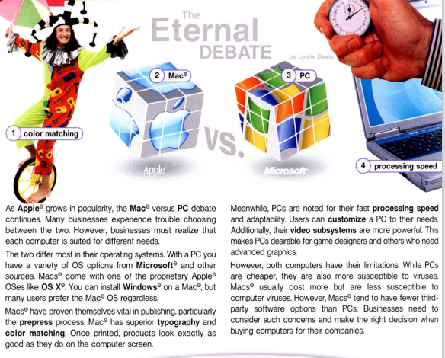
Contents of this template
Here’s what you’ll find in this Slidesgo template:
A slide structure based on an Education template for University, which you can easily adapt to your needs. For more info on how to edit the template, please visit Slidesgo School or read our FAQs.
An assortment of graphic illustrations that are suitable for use in the presentation can be found in the alternative resources slide.
A thanks slide, which you must keep so that proper credits for our design are given.
A resources slide, where you’ll find links to all the elements used in the template.
Instructions for use
Final slides with:
The fonts and colors used in the template.
A selection of illustrations. You can also customize and animate them as you wish with the online editor. Visit Storyset to find more.
More infographic resources, whose size and color can be edited.
Sets of customizable icons of the following themes: general, business, avatar, creative process, education, help & support, medical, nature, performing arts, SEO & marketing, and teamwork.
You can delete this slide when you’re done editing the presentation.

Slide 4
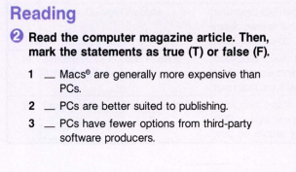
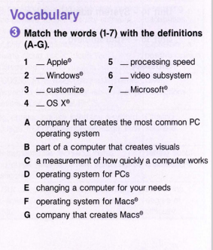
Most popular programs
G
C
Harper - 22%
D
B
Stanford - 12%
E
A
Mars is red and cold
F
T
Mercury is very small
F
Harvard - 43%
Georgia - 23%
F
Earth is where we live on
Venus has a nice name
Follow the link in the graph to modify its data and then paste the new one here. For more info, click here

Slide 5

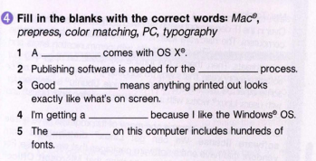
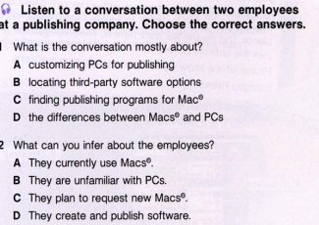
01
02
03
Introduction
Computers
Science
04
05
06
Degree
College IT
Conclusion
Mac
You can describe the topic of the section here
You can describe the topic of the section here
You can describe the topic of the section here
prepress
color matching
PC
You can describe the topic of the section here
You can describe the topic of the section here
You can describe the topic of the section here
typography

Slide 6
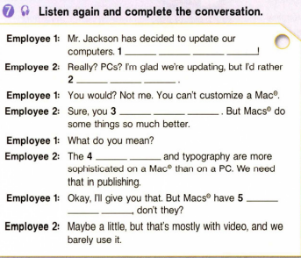
Prerequisites for entering
Do you know what helps you make your point clear?
Lists like this one:
They’re simple
You can organize your ideas clearly
You’ll never forget to buy milk!
And the most important thing: the audience won’t miss the point of your presentation!

Slide 7
Speaking
Use language such as:
We’re switching to PCs.
You can customize PCs.
But Macs have slower processing speeds.
Talk to Student B about switching to PCs and benefits
Talk to Student A about benefits of Macs

Slide 8
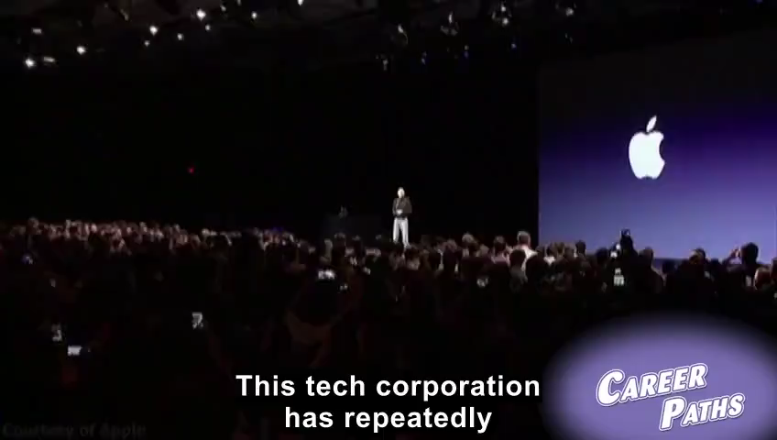
Admission rate
80%
43%
70%
Neptune is the farthest planet from the Sun
Jupiter is the biggest planet of them all
Saturn is a gas giant and has several rings

Slide 9
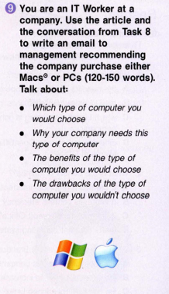
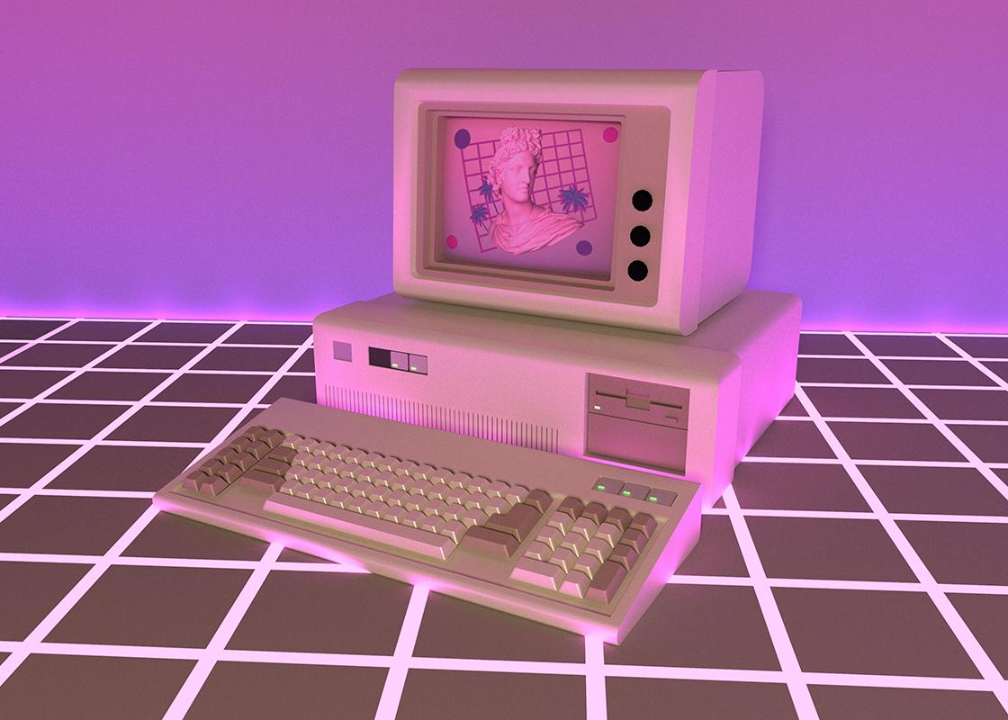
Writing
Images reveal large amounts of data, so remember: use an image instead of a long text. Your audience will appreciate it

Slide 10
LINUX
UNIT 2 (Book 3)

Slide 11
Let’s discuss!
1. How is Linux different from other operating systems?
Questions!
2. Why would a business use Linux?

Slide 12
The Transmission Control Protocol (TPC) is a transport protocol that is used on top of IP to ensure reliable transmission of packets. TCP includes mechanisms to solve many of the problems that arise from packet-based messaging.

Slide 13
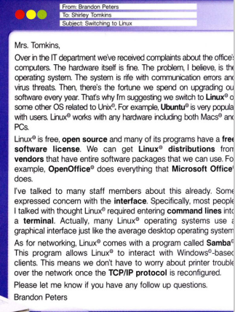
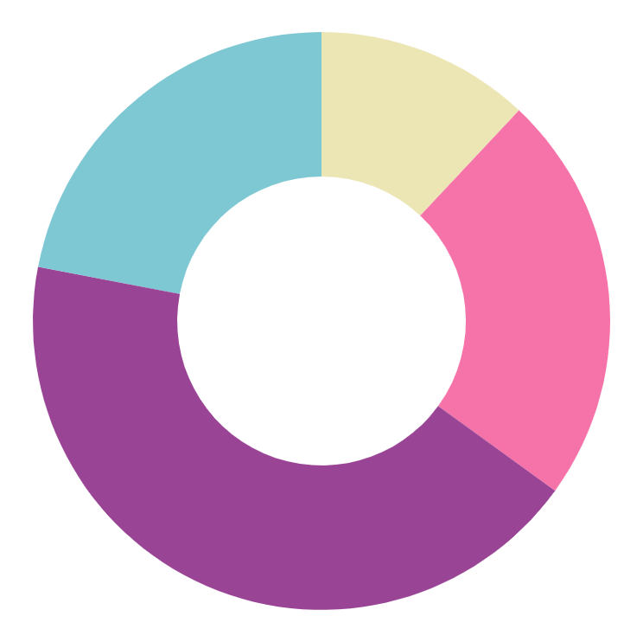
Most popular programs
Harper - 22%
Stanford - 12%
Mars is red and cold
Mercury is very small
Harvard - 43%
Georgia - 23%
Earth is where we live on
Venus has a nice name
Follow the link in the graph to modify its data and then paste the new one here. For more info, click here

Slide 14
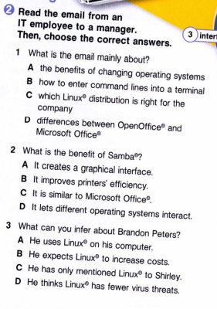
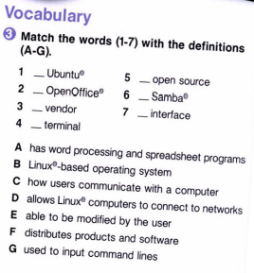
Degree timeline
B
E
A
D
F
C
G
Year #01
Year #02
Year #03
Year #04
Earth is where we all live on
Venus has a nice name, but it’s hot
Pluto is considered a dwarf planet
Saturn is a gas giant and has rings

Slide 15
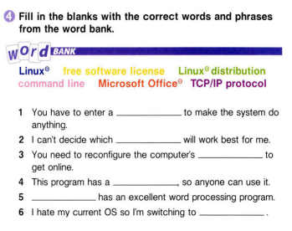
Next steps
Request info
Ask around
Study
Take exam
Receive letter
Join us!
Earth is the third planet from the Sun
Venus has a beautiful name, but it’s very hot
Despite being red, Mars is actually a cold place
command line
Linux protocol
TCP/IP protocol
free software license
Jupiter is the biggest planet of them all
Ceres is located in the main asteroid belt
Saturn is a gas giant and has several rings
Microsoft Office
Linux

Slide 16
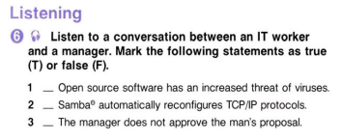
WHOA
F
This can be the part of the presentation where you introduce yourself, write your email…
F
T

Slide 17

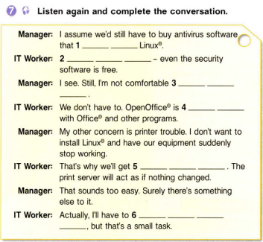
A picture is worth a thousand words

Slide 18
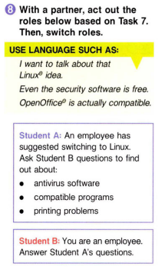
2,405.8
Big numbers catch your audience’s attention

Slide 19
Read your answers to the questions
Answer the questions working in a team
Retell it to your partner
Use your notes

Slide 20
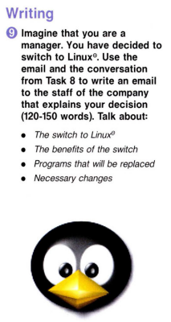
AWESOME WORDS

Slide 21
Any questions?
Thank you for your attention!

