Slide 1
Cloud computing/ Improving health
Cloud
Computing
Units 11 & 12

Slide 2
Food for thought
01
02
03
04
How can installing new software be difficult?
How can a business benefit from online services?
How can technology benefit doctors and hospitals?
What kind of medical technology do you know about?

Slide 3
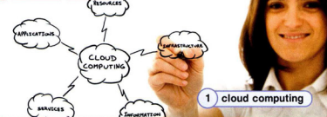
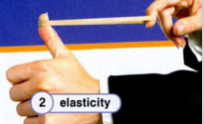
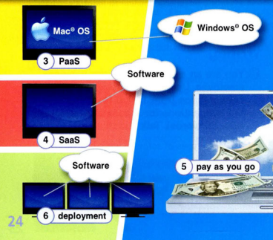

Slide 4


Slide 5
1 Storing data on a cloud actually means storing it online. | True False
2 In the past, emails were only stored on someone’s computer. | True False
3 Through Gmail® or Yahoo Mail®, you can access your emails anywhere you have an internet connection. | True False
4 Your photos can only be stored on the hard disk of your computer. | True False
5 Google Docs® allows you to create, edit, and save documents online without having to install any software on your computer. | True False
6 Storing your documents on a cloud is safer than storing them on your hard disk. | True False
7 With cloud computing you are no longer responsible for updating software. | True False
8 Cloud computing is not very popular with big companies. | True False

Slide 6
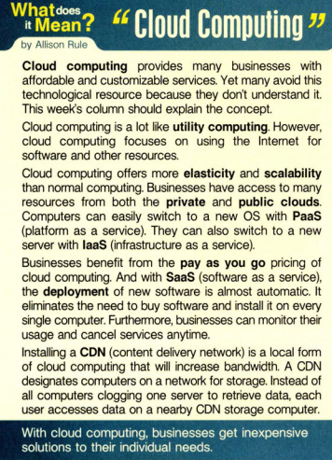
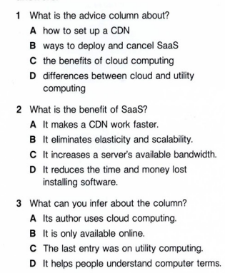
Examples
Venus has a beautiful name and is the second planet from the Sun
Earth is the third planet from the Sun and the only one that harbors life
Mars is full of iron oxide dust, which gives the planet its reddish cast
Neptune is the fourth-largest object by diameter in the Solar System
Jupiter is a gas giant and the biggest planet in the Solar System
Saturn was named after the Roman god of wealth and agriculture

Slide 7
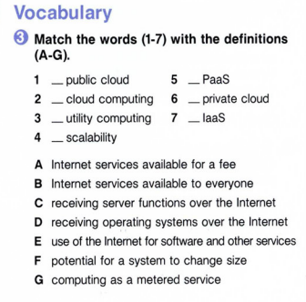
01
Theory lesson
B
D
E
A
G
C
F
You can enter a subtitle here if you need it
2022

Slide 8
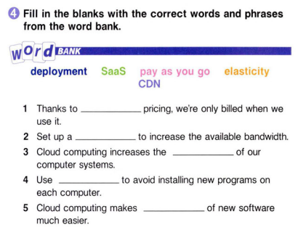
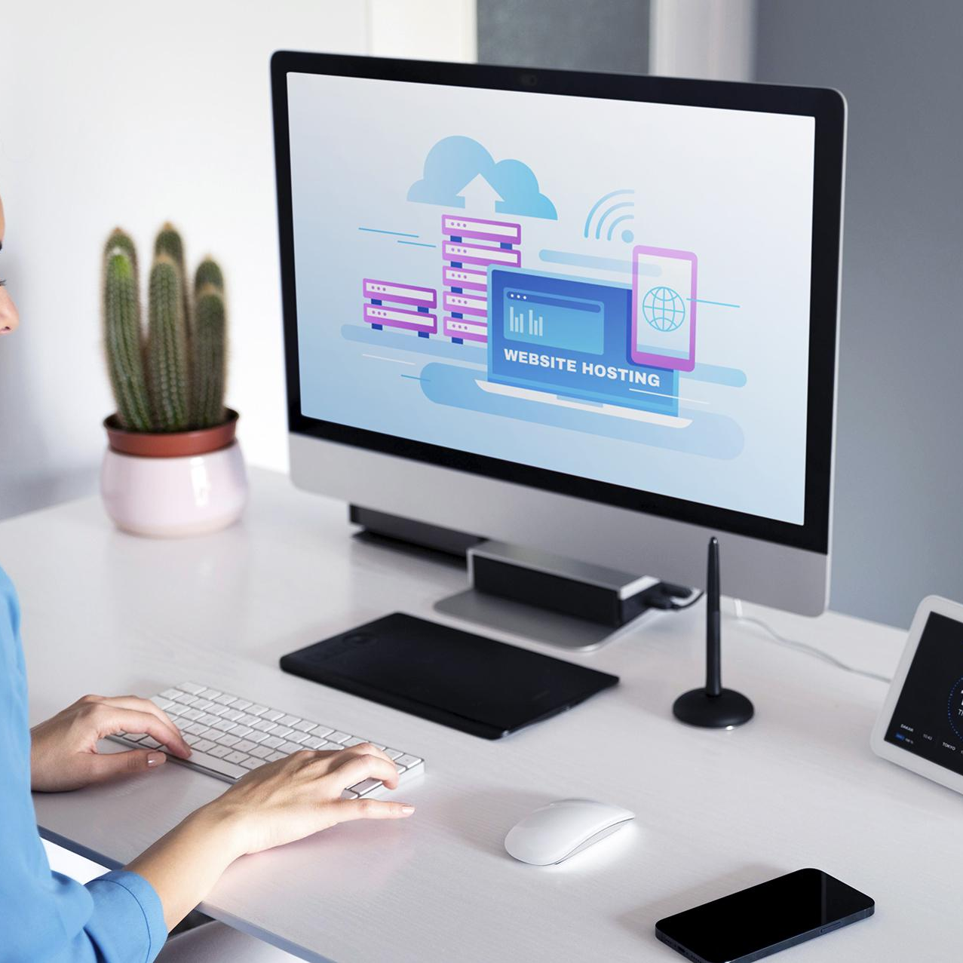
Introduction
pay as you go
You can give a brief description of the topic you want to talk about here. For example, if you want to talk about Mercury, you can say that it’s the smallest planet in the entire Solar System
CDN
elasticity
SaaS
Workshop
deployment

Slide 9
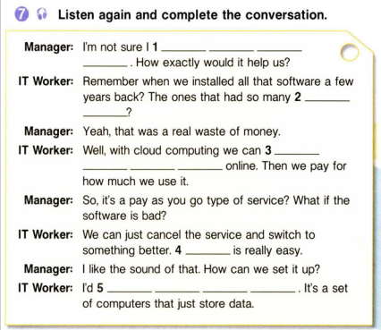

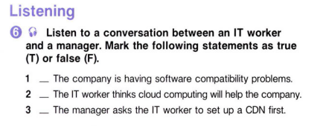
Concepts
Mercury
Earth
Mercury is the closest planet to the Sun
Earth is the third planet from the Sun
F
Venus
Mars
T
Venus is the second planet from the Sun
Despite being red, Mars is actually a cold place
F

Slide 10
Improving Health
Computing

Slide 12
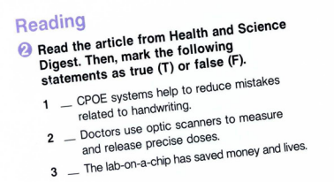

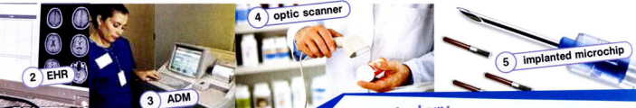
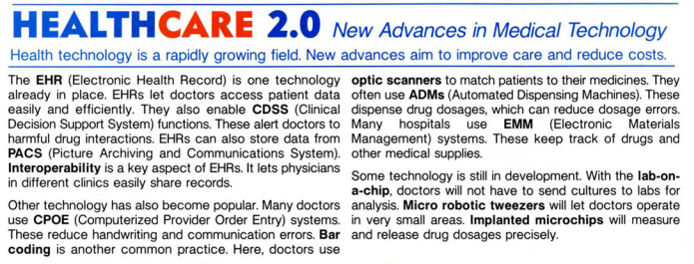
T
F
F

Slide 13
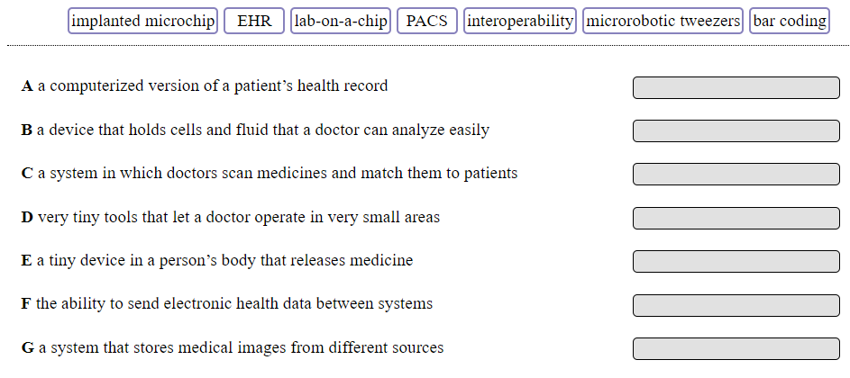
EHR
lab-on-a-chip
bar coding
macrobotic tweezers
implanted microchip
interoperability
PACS

Slide 14
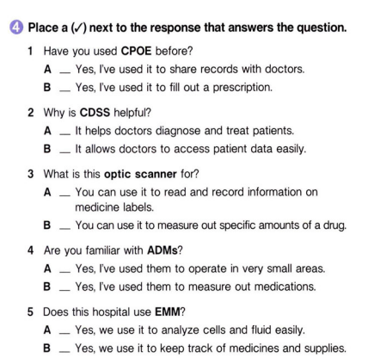
550,000
Cloud
Big numbers catch your audience’s attention

Slide 15
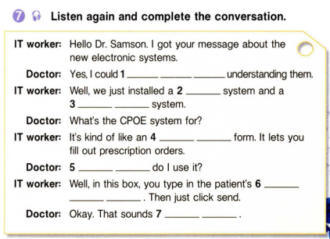
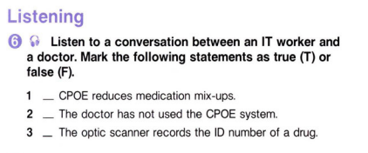
Cloud
Mercury
Mars
Mercury is the closest planet to the Sun and the smallest one
F
T
T

Slide 16
Questions and answer
Question
Answer
Mercury's name has nothing to do with the liquid metal, since Mercury was named after the Roman messenger god
Venus is the second planet from the Sun. It’s terribly hot, even hotter than Mercury, and its atmosphere is extremely poisonous

Slide 17
—Someone Famous
Computing
“This is a quote, words full of wisdom that someone important said and can make the reader get inspired.”

Slide 18
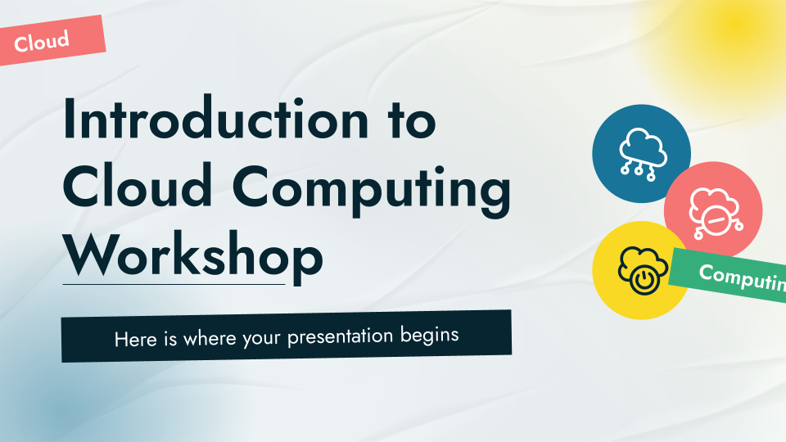
Desktop mockup
Cloud
You can replace the image on the screen with your own work. Just right-click on it and select “Replace image”

Slide 19
Thanks!
Cloud
Do you have any questions?
youremail@freepik.com
+91 620 421 838
yourwebsite.com
Please keep this slide for attribution

