Slide 1



Connecting to Clients and Employees/ Advertising and Marketing
Units 3 & 4

Slide 2

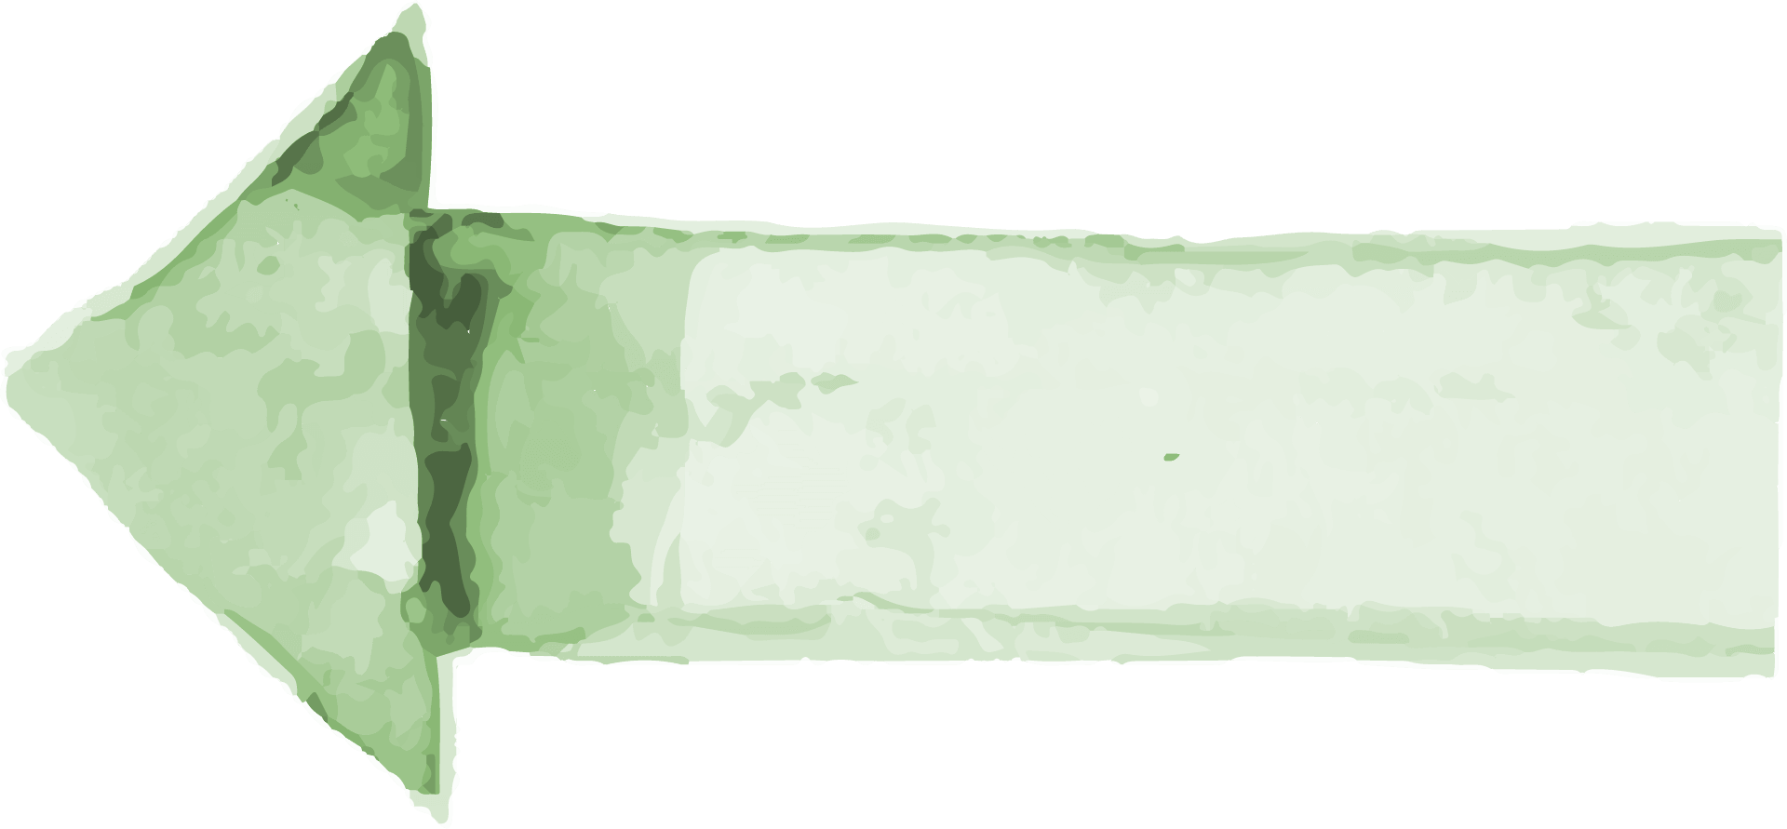

Let’s talk!
01
02
03
What makes a business’s website look profesionals?
How can companies use a website to communicate with clients and employees?
Why is online advertising popular?

Slide 3
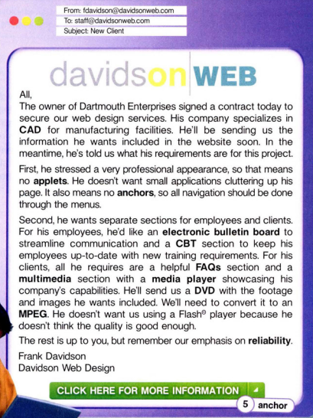
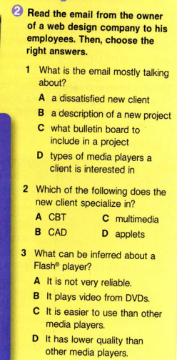
Contents of This Template
Here’s what you’ll find in this Slidesgo template:
A slide structure based on a marketing plan, which you can easily adapt to your needs. For more info on how to edit the template, please visit Slidesgo School or read our FAQs.
An assortment of illustrations and pictures that are suitable for use in the presentation can be found in the two alternative resources slides.
A thanks slide, which you must keep so that proper credits for our design are given.
A resources slide, where you’ll find links to all the elements used in the template.
Instructions for use.
Final slides with:
The fonts and colors used in the template.
A selection of illustrations. You can also customize and animate them as you wish with the online editor. Visit Stories by Freepik to find more.
More infographic resources, whose size and color can be edited.
Sets of customizable icons of the following themes: general, business, avatar, creative process, education, help & support, medical, nature, performing arts, SEO & marketing, and teamwork.
You can delete this slide when you’re done editing the presentation.

Slide 4
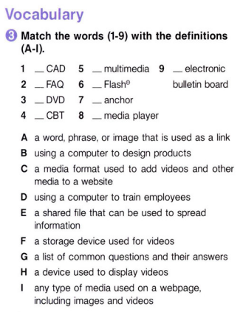
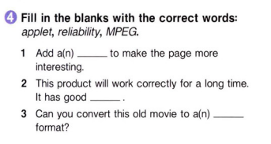


Table of Contents
About Us
Market Analysis
Goals & Strategy
01
02
03
Content Plan
Budget
KPI Overview
05
06
04
B
I
E
G
C
F
A
applet
D
H
Here you could describe the topic of the section
Here you could describe the topic of the section
Here you could describe the topic of the section
reliability
Here you could describe the topic of the section
Here you could describe the topic of the section
Here you could describe the topic of the section
MPEG

Slide 5

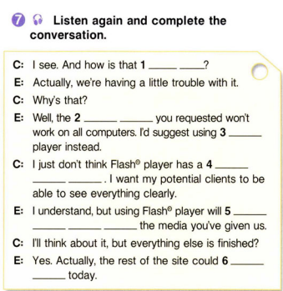
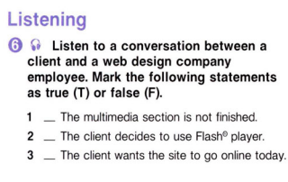


Our evolution
2017
2018
2019
2020
T
Mercury
Venus
Jupiter
Saturn
It’s the smallest and innermost planet in the Solar System
It has a beautiful name, but also very high temperatures
It’s the fifth planet from the Sun and the largest
It’s the sixth planet from the Sun and the second-largest
T
F

Slide 6
It is time to debate!
1. Do you think that you can judge a company only by its website? Why or why not?
2. Is it important for all websites to have pictures and videos? Why or why not?
3. Do you trust companies that do not have a website? Why or why not?
4. Do you trust all websites? Why or why not?
5. Do you think that websites should be free? Why or why not?
6. Do you think that a business can be successful without a website? Why or why not?

Slide 7
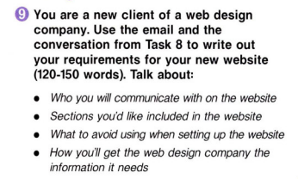
3,235.00
Big numbers catch your audience's attention

Slide 8
04
Unit
Advertising and Marketing

Slide 9
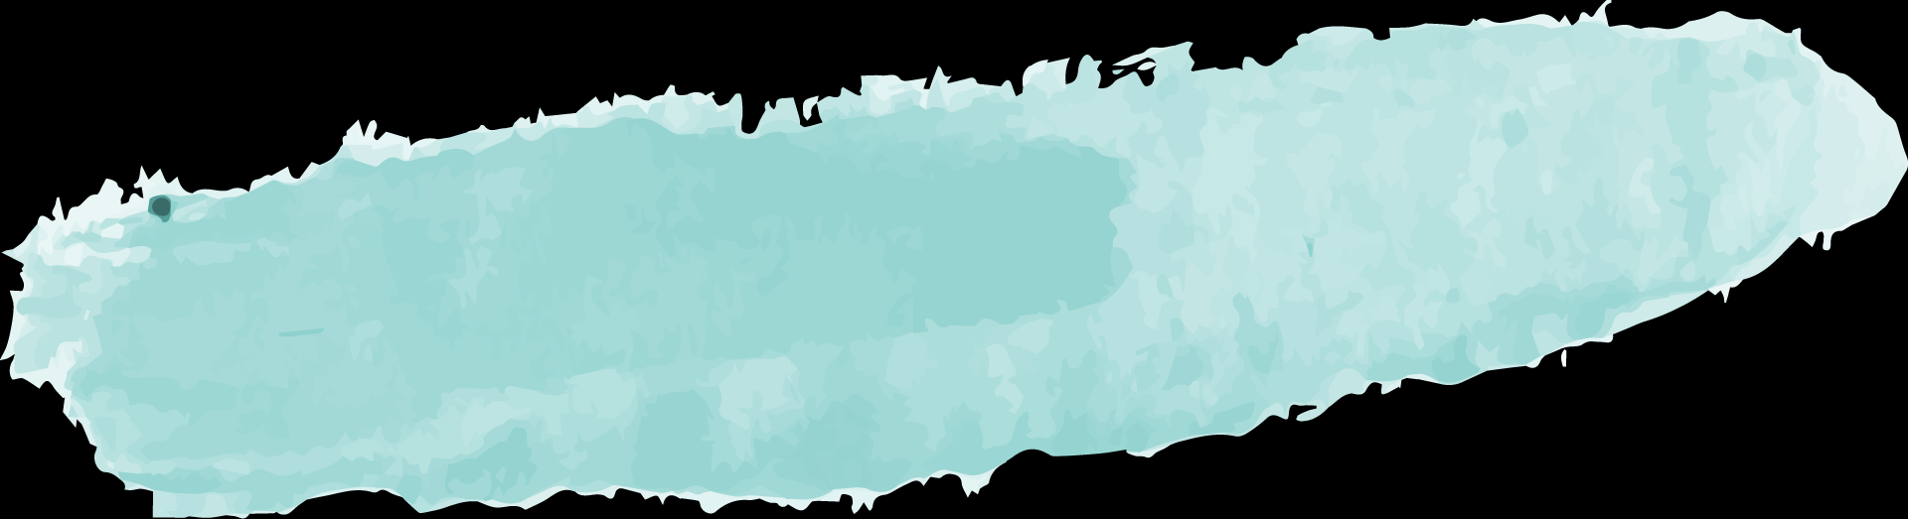
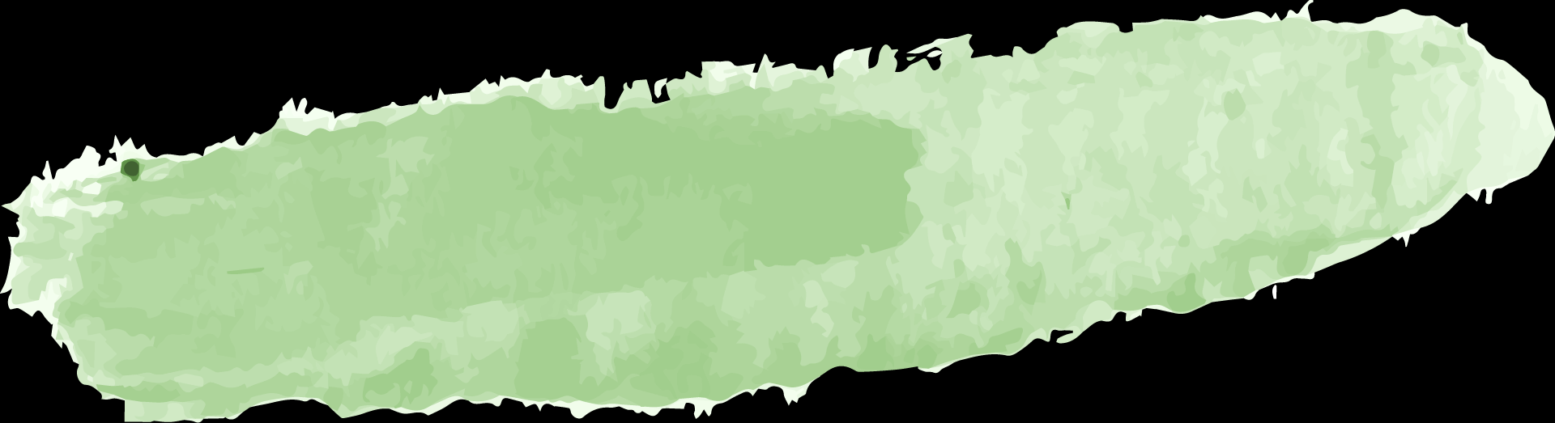

Your idea
Your idea
What advertisements get your attention?
Your idea
Your opinion

Slide 10
Your idea
Your idea
Where is the most effective place to advertise?
Your idea
Your opinion

Slide 11
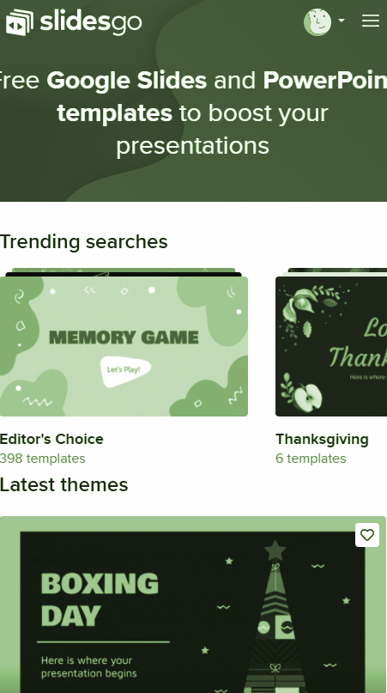
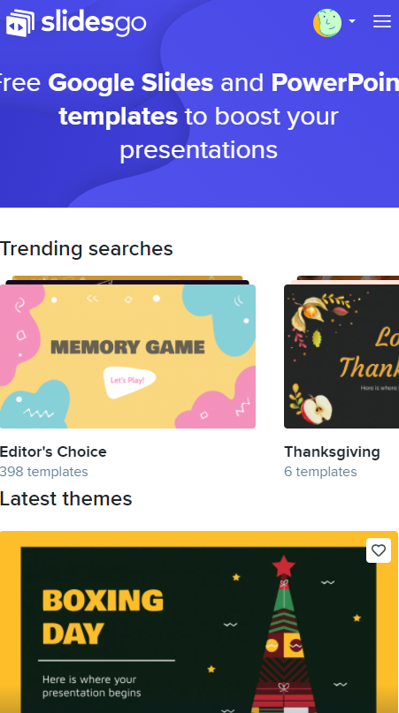
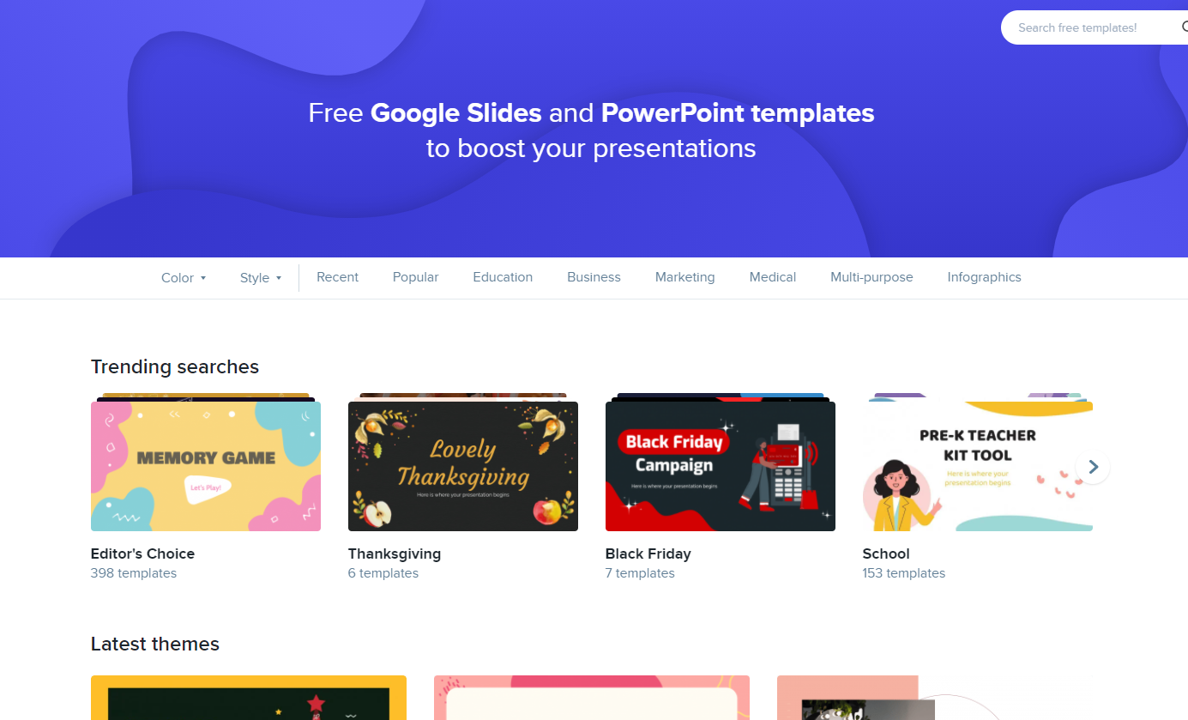
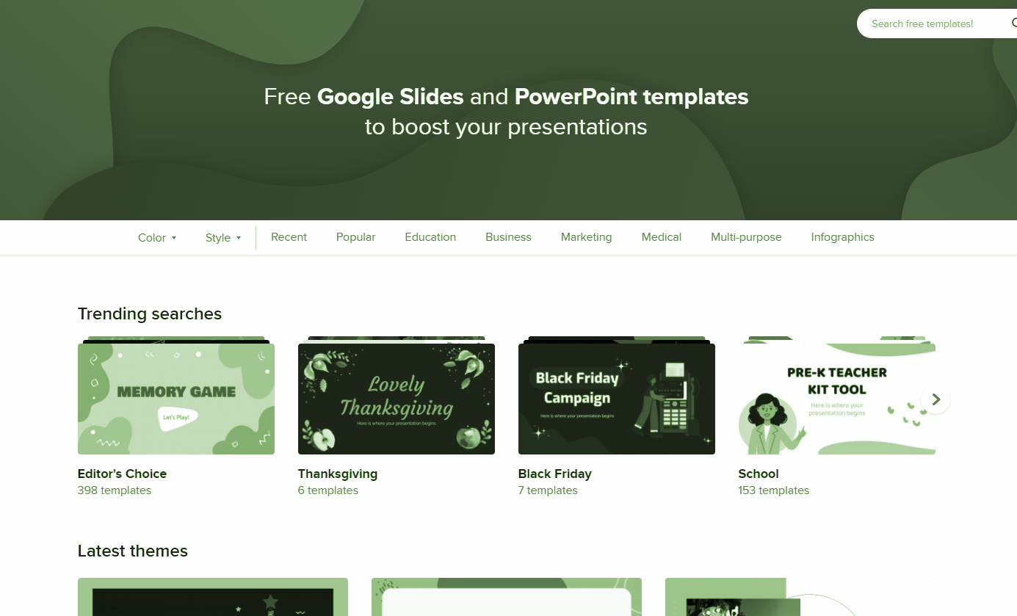
Boost your vocabulary
https://quizlet.com/_ccb8cf?x=1qqt&i=3fju7z

Slide 12
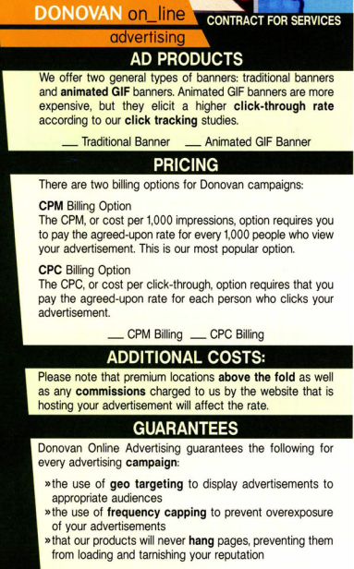
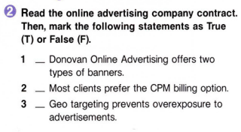



Buyer Persona
Skills:
Influences
Internet
Venus has a beautiful name
Software
Social
T
Angelina Doe
Must Do
Frequency
Despite being red, Mars is a cold place
Earth is the third planet from the Sun
Age: 35
Occupation: IT
Education: University
Personality: Extrovert
T
Must Never
Relationship
F
Saturn is a gas giant and has rings
Mercury is the smallest planet

Slide 13
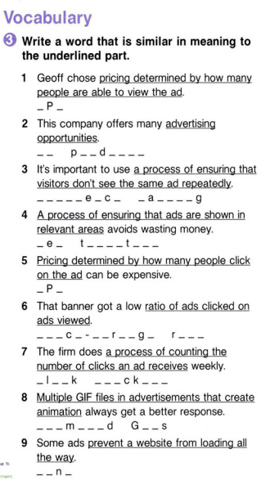
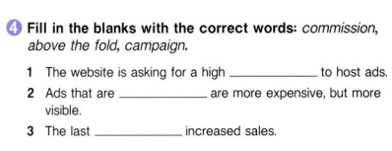
What Sets Us Apart?
100%
organic
A critical
mission
Trusted
partnership
commission
above the fold
Venus has a beautiful name, but also a poisonous atmosphere
It’s the smallest and innermost planet in the Solar System
campaign
It’s the sixth planet from the Sun and the second-largest

Slide 14

Types of Advertising: Rates: Additional Costs: Guarantees:
Imagine that you have your own an Internet advertising company. Fill out the following information about your ads individually.

Slide 15
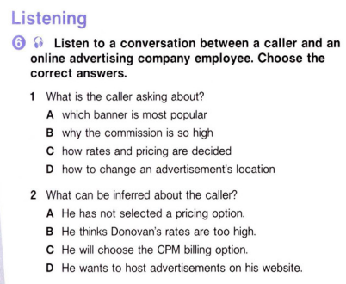
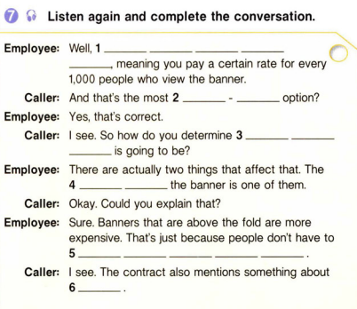
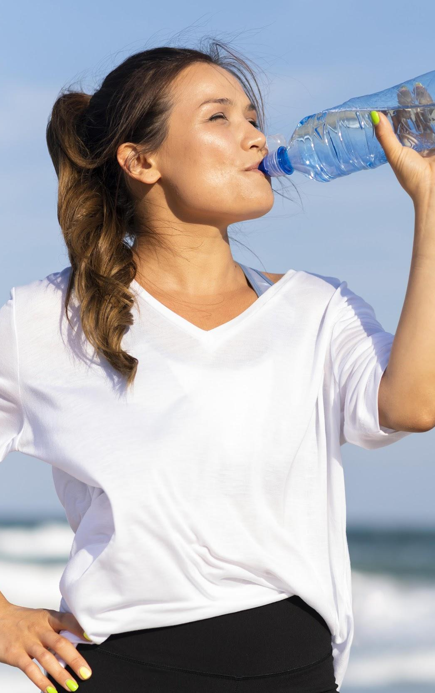
Introduction
Mercury is the closest planet to the Sun and the smallest one in the Solar System—it’s only a bit larger than the Moon

Slide 16
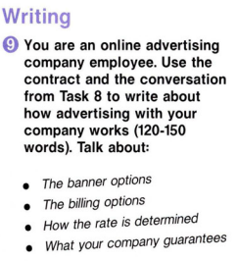
Awesome Words

Slide 17
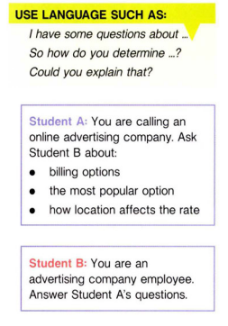
—SOMEONE FAMOUS
“This is a quote, words full of wisdom that someone important said and can make the reader get inspired.”

Slide 18












THANKS Do you have any questions?

Slide 19




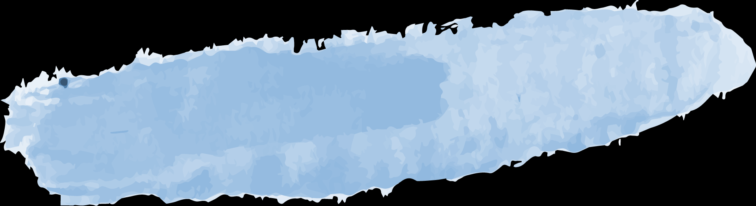
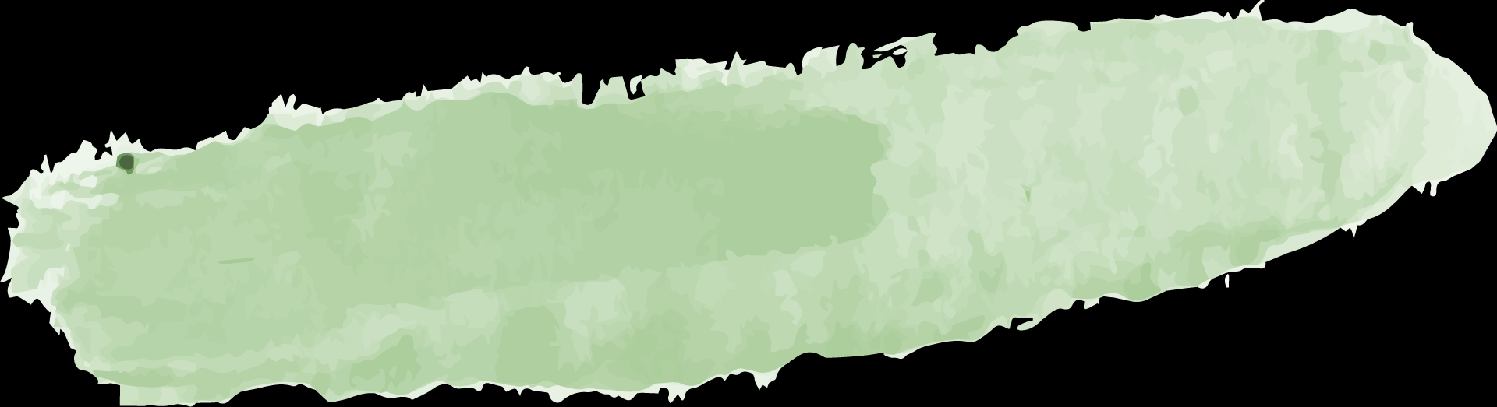
Our Team
David James
Keanu Doe
You can replace the image on the screen with your own
You can replace the image on the screen with your own

