Slide 1
Automation / Telecommuting
Units 5 & 6

Slide 2
01
02
Why do companies use automation?
How has automation advanced recently?

Slide 3
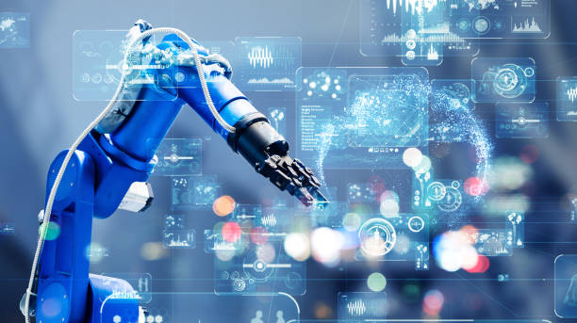
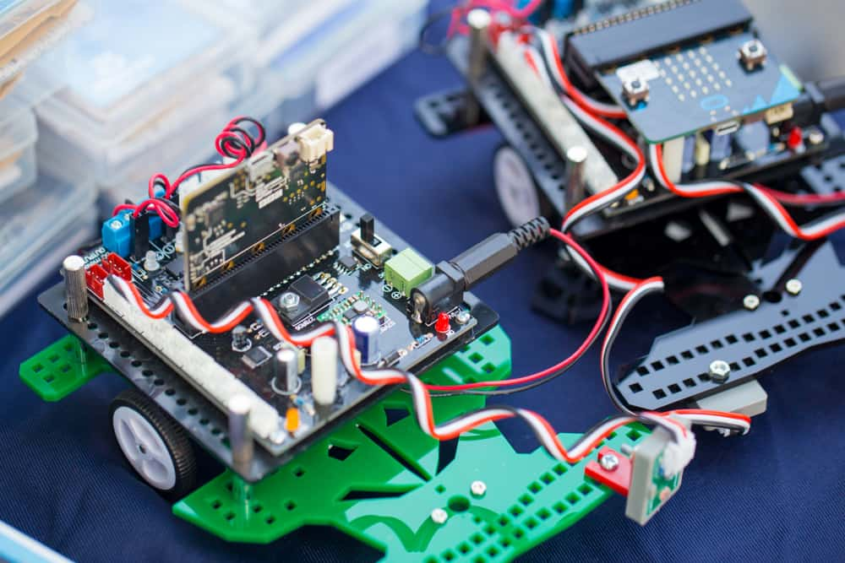
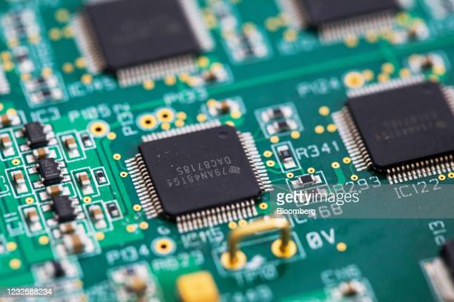
Automation describes a wide range of technologies that reduce human intervention in processes. An embedded system is a combination of computer hardware and software designed for a specific function. An electronic circuit formed on a small piece of semiconducting material, which performs the same function as a larger circuit made from discrete components.

Slide 4
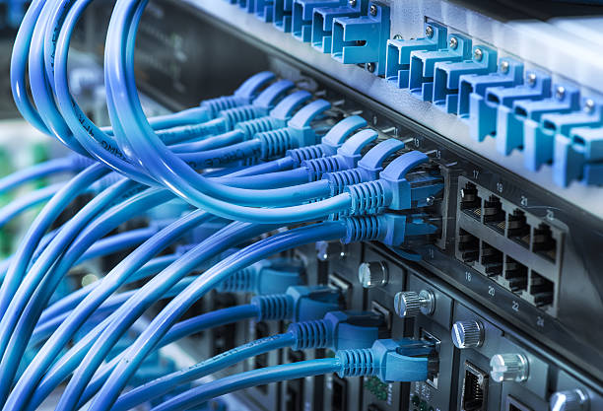
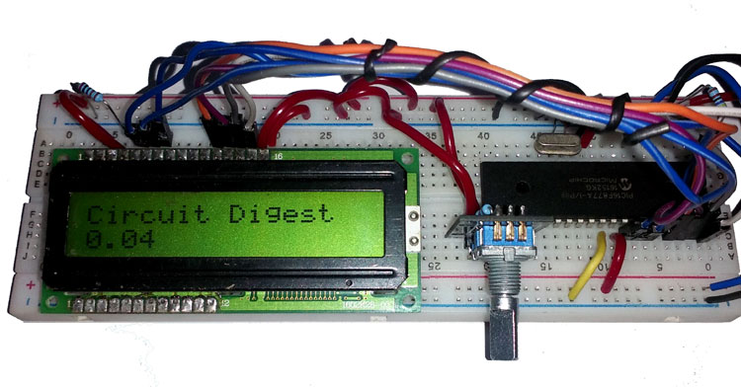
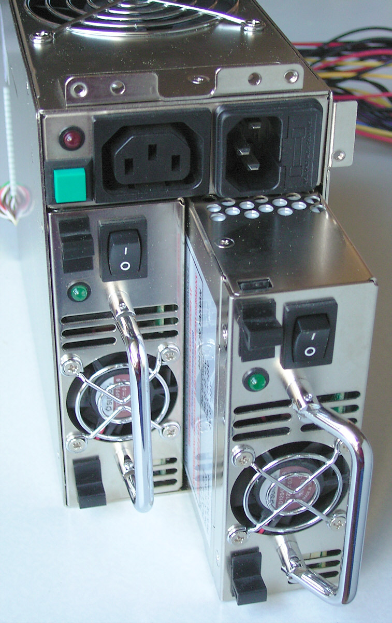
Ethernet protocol connects LANs, WANs, Internet, cloud, IoT devices, Wi-Fi systems into one seamless global communications network An encoder (or "simple encoder") in digital electronics is a one-hot to binary converter. Redundancy is a system design in which a component is duplicated so if it fails there will be a backup.

Slide 5

1. What types of encoder do you know? 2. Where do we use encoders?

Slide 6
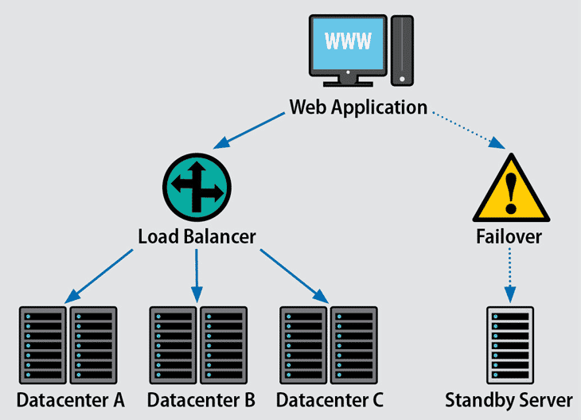
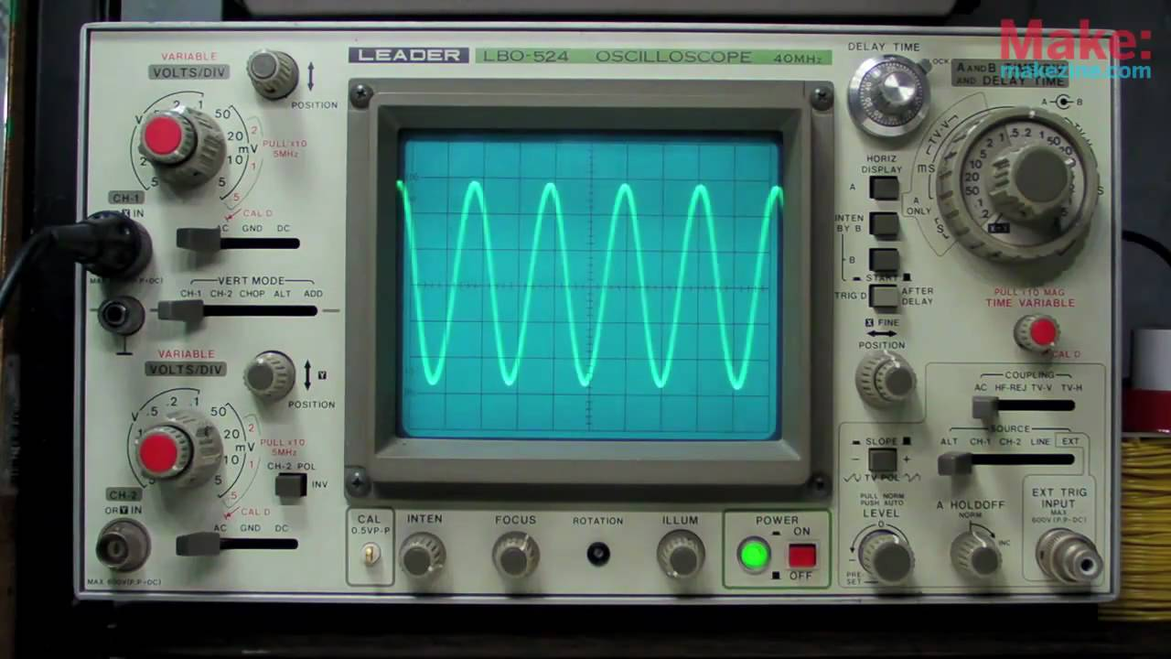
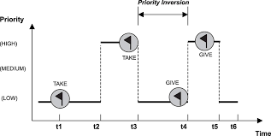
Fault tolerance refers to the ability of a system (computer, network, cloud cluster, etc.) to continue operating without interruption when one or more of its components fail. Oscilloscope is a device for viewing oscillations by a display on the screen of a cathode ray tube. In computer science, priority inversion is a scenario in scheduling in which a high priority task is indirectly superseded by a lower priority task

Slide 7
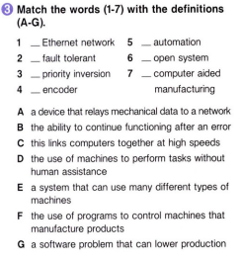
“This is a quote, words full of wisdom that someone important said and can make the reader get inspired.”
C
D
B
E
G
F
A
—Someone Famous

Slide 8

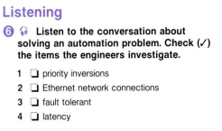
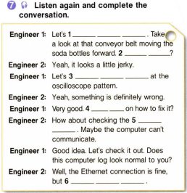
01
Yo

Slide 9
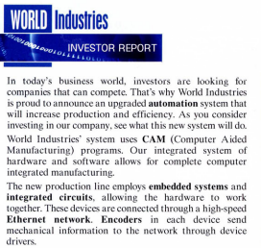
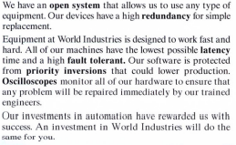

Slide 10
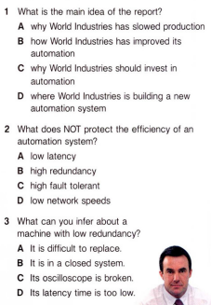
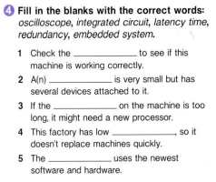
HOA!
oscilloscope
integrated circuit
latency time
redundancy
embedded system

Slide 11
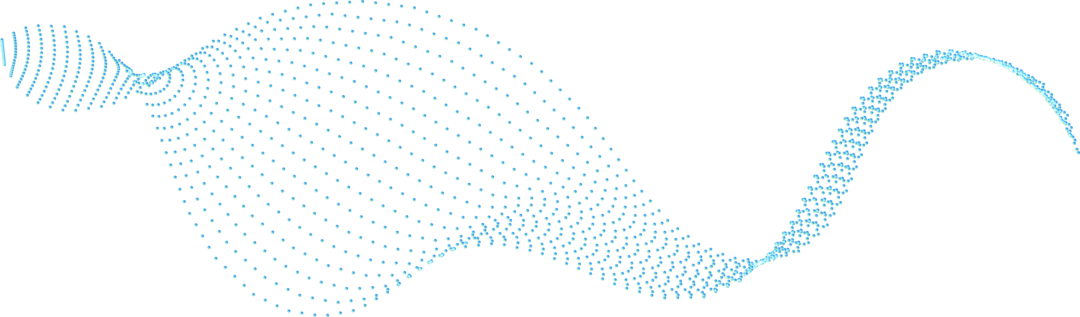




Slide 13
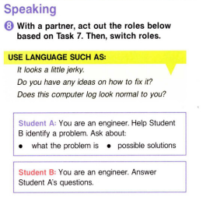
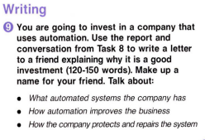

Slide 14
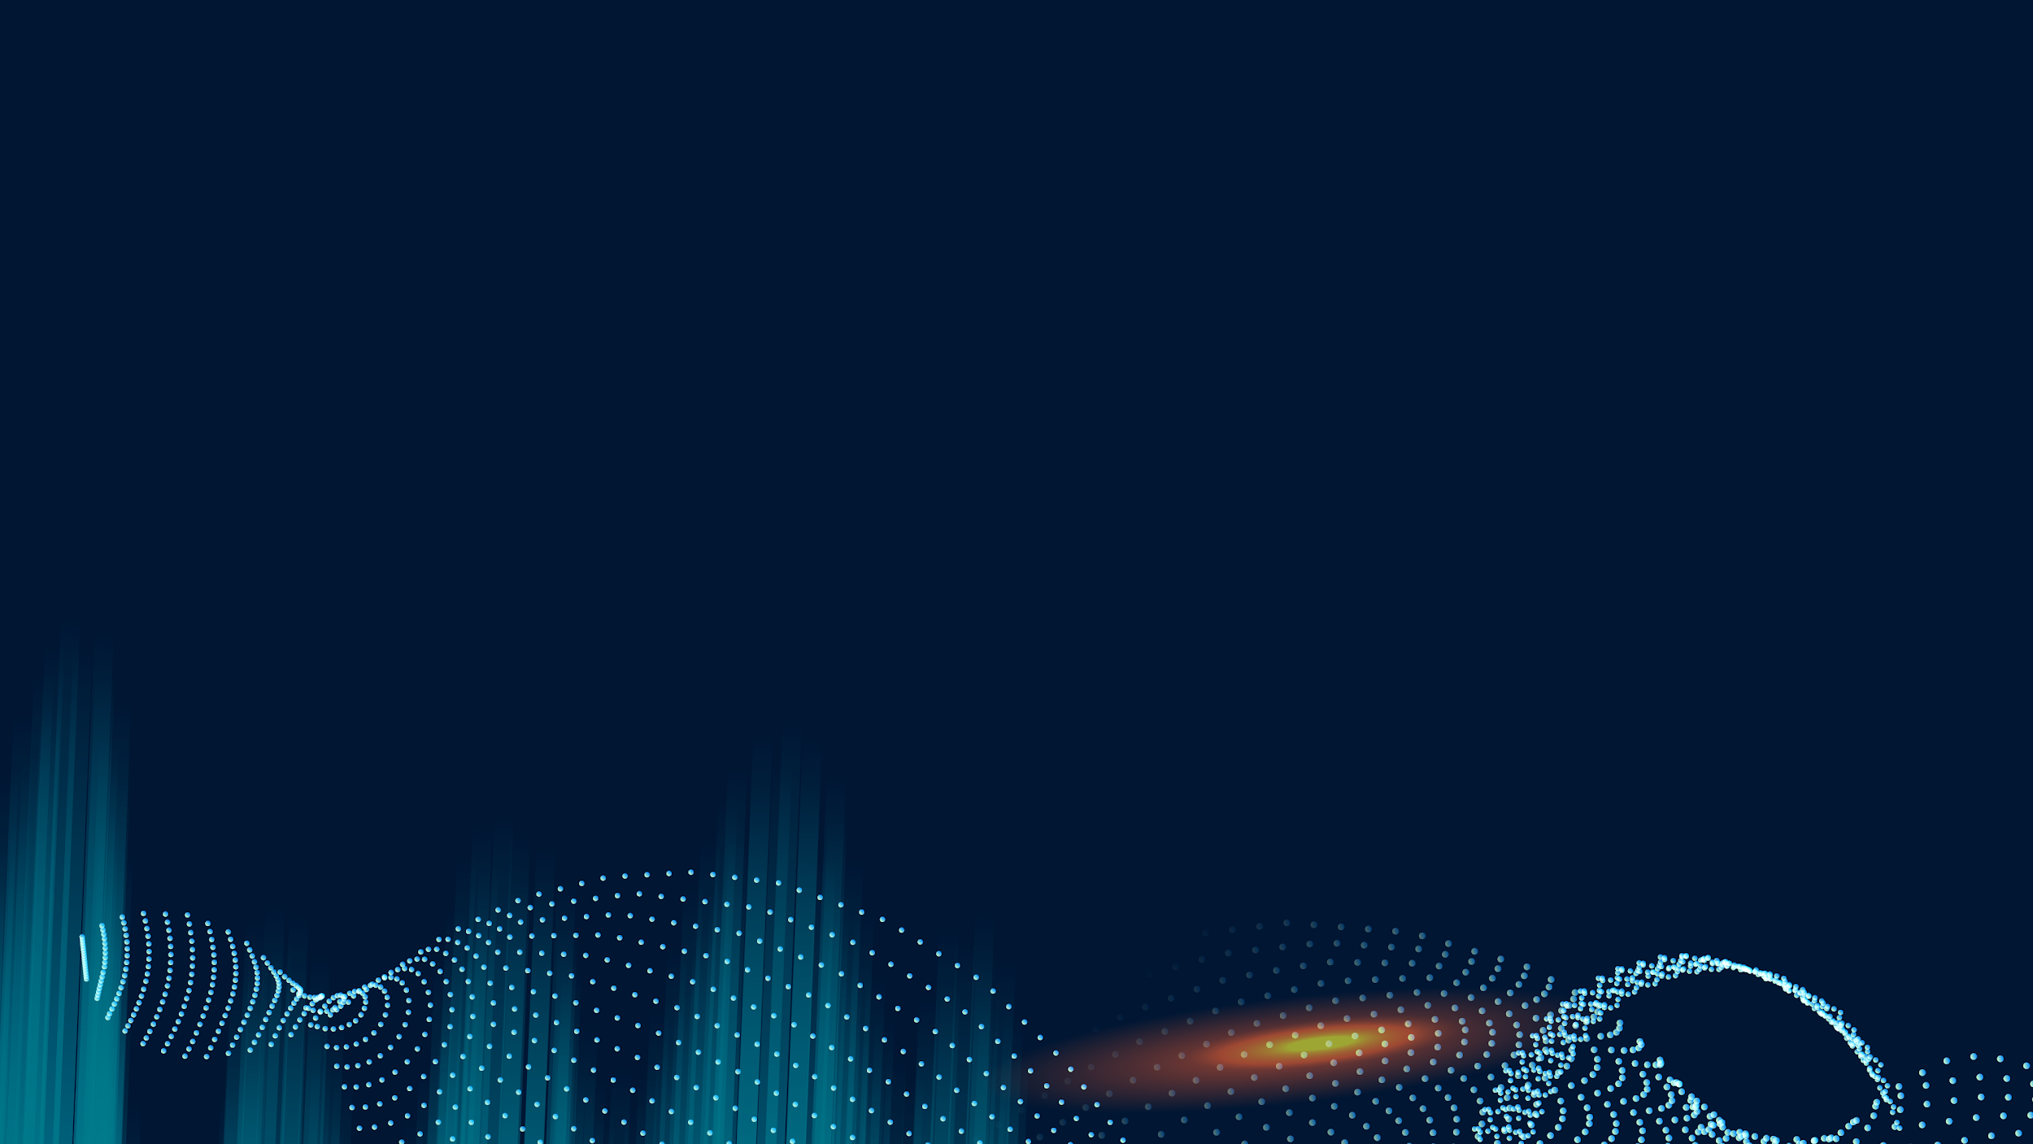

Telecommuting

Slide 15
Let’s discuss these questions!
What are the benefits of telecommuting?
What are the challenges of telecommuting , for workers and management?

Slide 16
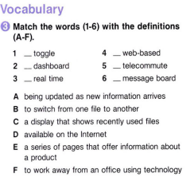
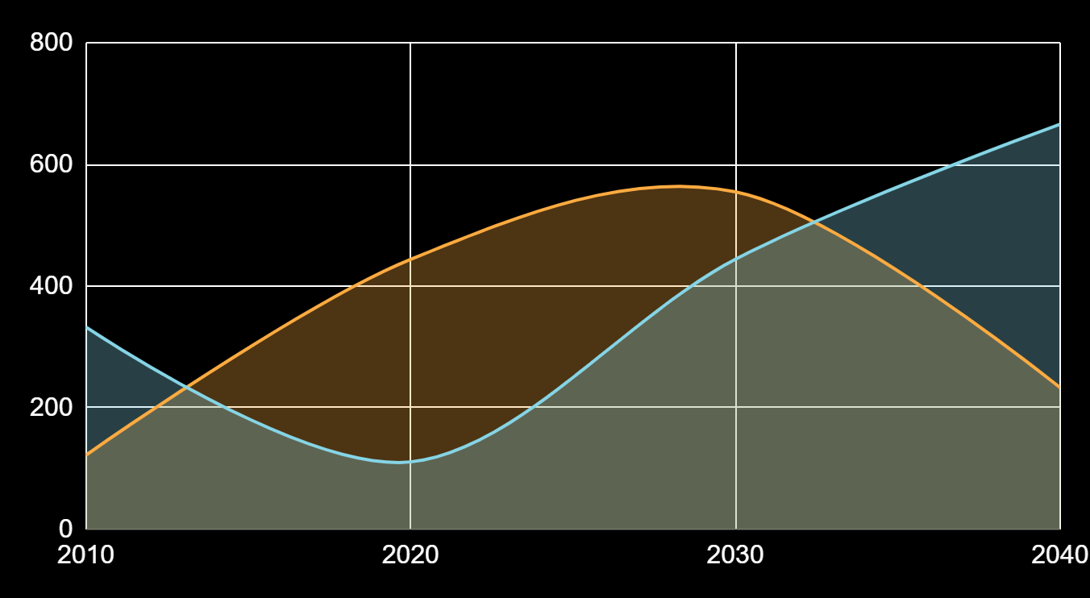
THIS IS A GRAPH!
Factor 1
Factor 2
B
D
C
F
A
E
To modify this graph, click on it, follow the link, change the data and paste the new graph here

Slide 17
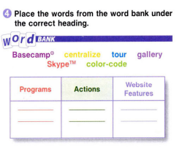
333,000
245,00
386,000
Mercury is the smallest planet
Jupiter is the biggest planet
Skype
centralize
tour
Basecamp
color-code
gallery
Despite being red, Mars is cold

Slide 18
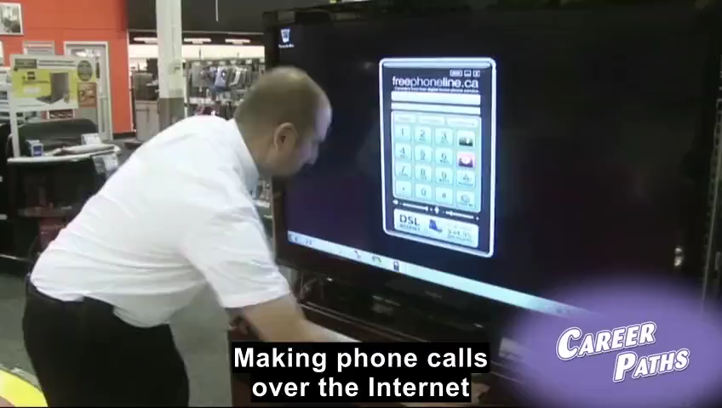
DO YOU NEED FOUR COLUMNS?
MARS
MERCURY
JUPITER
VENUS
Despite being red, Mars is a cold place
Mercury is the closest planet to the Sun
It is the biggest planet in the Solar System
Venus has a beautiful name, but it’s hot

Slide 19

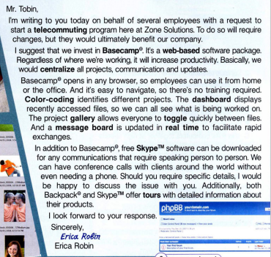
A PICTURE IS WORTH A THOUSAND WORDS

Slide 20
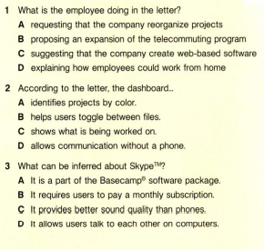
MAYBE YOU NEED TO DIVIDE THE CONTENT
MERCURY
VENUS
Mercury is the closest planet to the Sun and
the smallest one
Venus has a beautiful name and is the second planet from the Sun

Slide 21
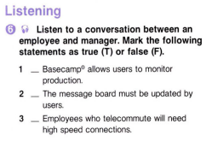
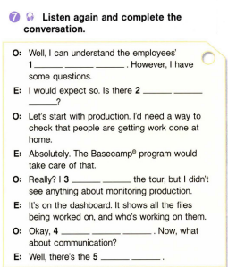
T
F
T

Slide 22

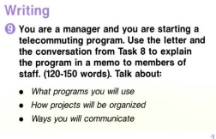

Home assignment

