Slide 1
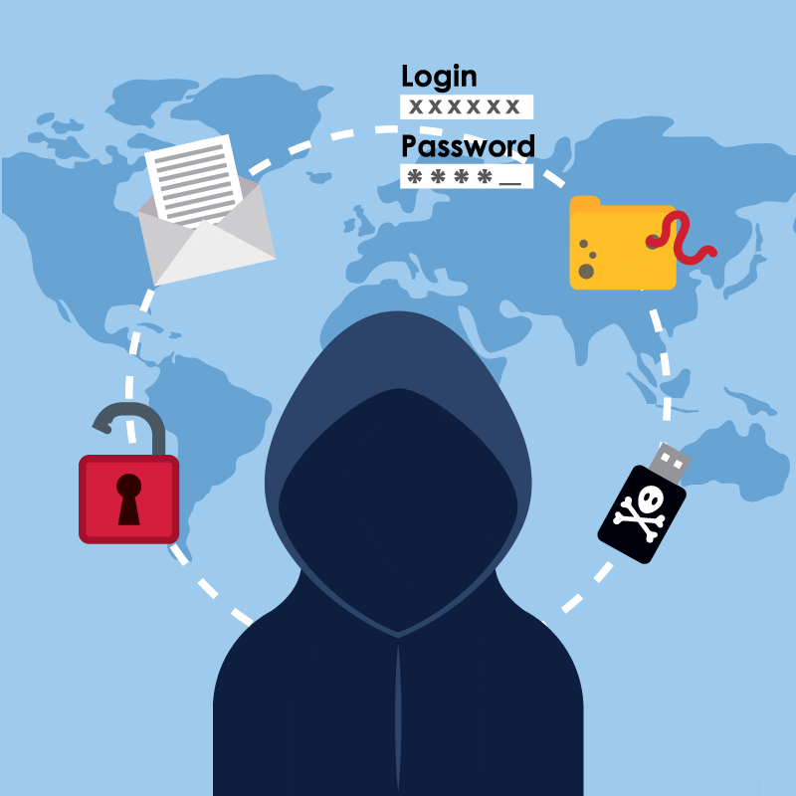
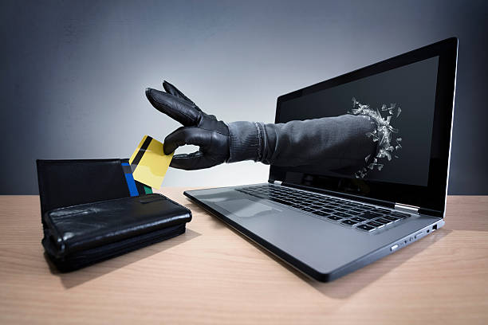
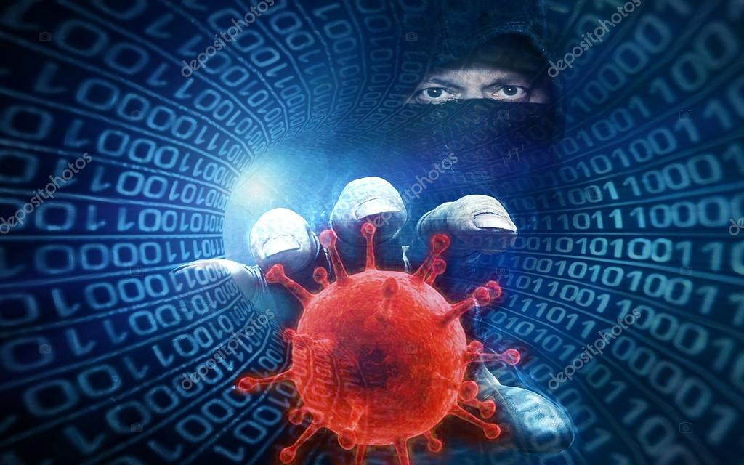

Slide 2
Hackers and Viruses / Identity Theft
Units 7 & 8

Slide 3
MISSION STATEMENT
How do computer viruses impact business?
What should people do when their computers are infected?

Slide 4
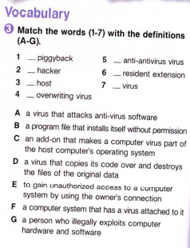
Business Overview
Management Plan
01
04
Market Analysis
Operating Plan
02
05
Marketing Plan
Financial Plan
03
06
Here you could describe the
topic of the section
E
A
Here you could describe the
topic of the section
G
C
F
B
D
Here you could describe the
topic of the section
Here you could describe the
topic of the section
Here you could describe the
topic of the section
Here you could describe the
topic of the section

Slide 5
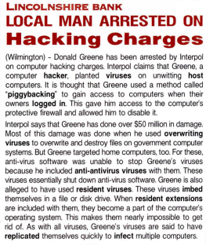
COMPETITORS
Mars
Jupiter
Saturn
Despite being red, Mars is actually a cold place full of iron oxide
It’s a gas giant and the biggest planet in the Solar System
Saturn is a gas giant, composed mostly of hydrogen and helium

Slide 6
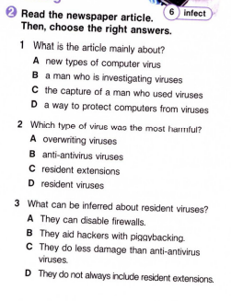
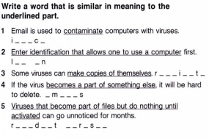
OUR SERVICES
Mercury
Venus
Mars
Jupiter
Saturn
Neptune
Mercury is the closest planet to the Sun
Venus is the second planet from the Sun
Despite being red, Mars is actually a cold place
It’s the biggest planet in the Solar System
Saturn is composed of hydrogen and helium
Neptune is the farthest planet from the Sun

Slide 7

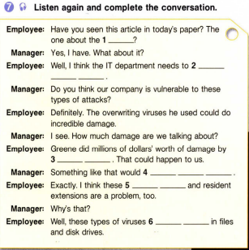
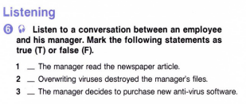
Week 4
Week 1
Week 3
Earth is where we live on
T
F
F
Mercury is the smallest planet
Saturn has several rings

Slide 8
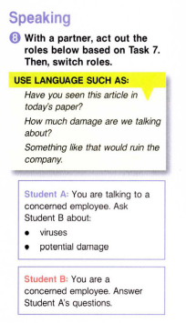
01
BUSINESS OVERVIEW
You could enter a subtitle here if you need it

Slide 9
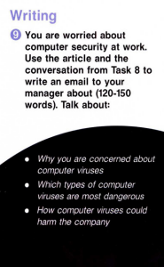
Write a letter

Slide 10

Identity Theft

Slide 11
Discuss the questions
1. How does identity theft affect businesses?
2. How can people avoid falling for phishing schemes?

Slide 12
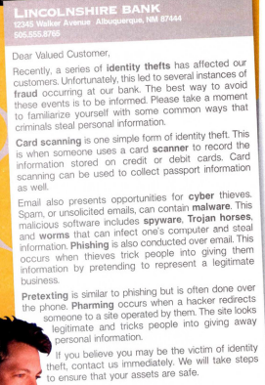
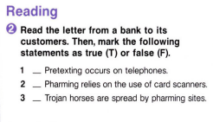
T
F
F

Slide 13
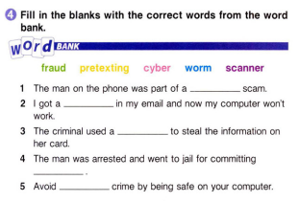
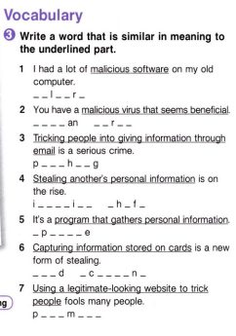
PREDICTED GROW
pretexting
worm
scanner
fraud
cyber

Slide 14
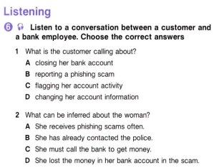
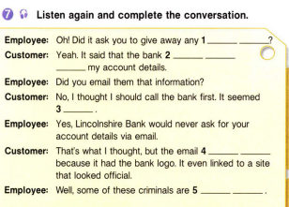
BALANCE SHEET
Assets
Equity
1M
700K
300K
What the company owns
Difference between both

Slide 15

SALES AND DISTRIBUTION
Channel 2
Channel 3
Channel 1
Channel 4
Mercury is the smallest planet
Saturn has several rings
Mars is actually a cold place
Earth is where we live on

Slide 16
Speaking time
Work in pairs
Make up a dialogue
Act your dialogue out

Slide 17
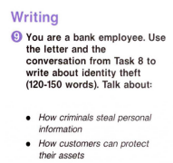
Your home assignment

Slide 18
ALTERNATIVE RESOURCES

