Slide 1
Preventative Measures and Anti-Virus Software
Units 9 &10 (Book 3)

Slide 2
Let’s discuss!
How do people keep their computers safe?
01
Why would a company worry about security?
02
What are some reasons companies would want to restrict access to their private networks?
03
Do you think it's fair for employers to control which websites employees can access at work?
04

Slide 3
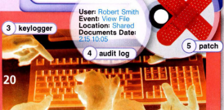
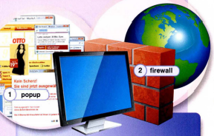

Slide 4
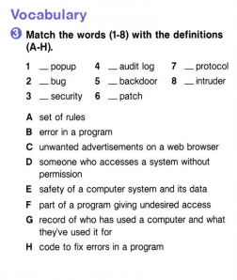
C
G
A
B
F
D
E
H

Slide 5
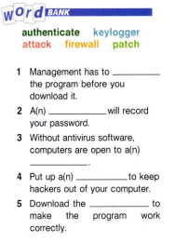
authenticate
keylogger
attack
firewall
patch

Slide 6
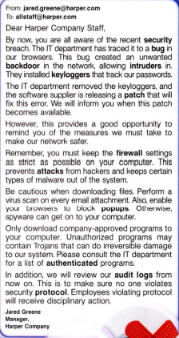
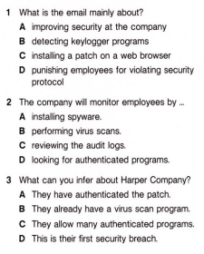

Slide 7
01
JIG SAW Reading
You need to match the headings working in a group and retell the text

Slide 8
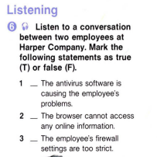
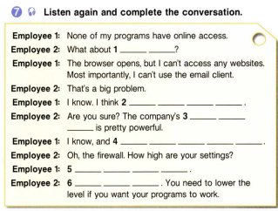

THE CURRICULUM
INTRODUCTION
Mercury is the closest planet to the Sun and the smallest one in System
2XXX | Jupiter is a big planet
2XXX | Earth is where all live
2XXX | Mars is a cold place
2XXX | Saturn has several rings
ADVANTAGES
75%
80%
95%
F
EARTH
VENUS
SATURN
FEATURES
T
55%
NEPTUNE
75%
MERCURY
T

Slide 9
1. What anti-virus software should a user consider buying?
2. Are there any problems with anti-virus software?
Anti-Virus Software

Slide 10
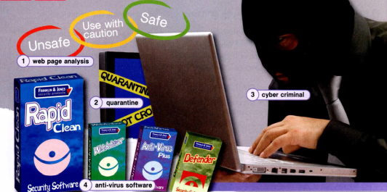


Slide 11
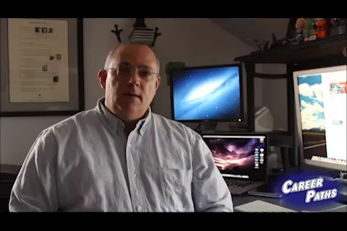
AWESOME WORDS

Slide 12
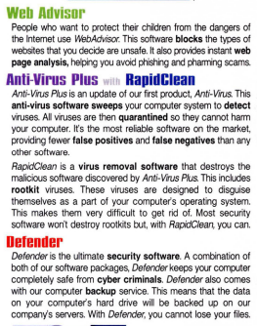
WHAT SETS US APART
JUPITER
Jupiter is a gas giant and the biggest planet in the Solar System

Slide 13
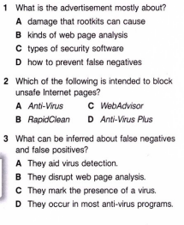
OUR VALUES
SATURN
EARTH
JUPITER
VENUS
Saturn is a gas giant and has several rings
Earth is the only planet that harbors life
Jupiter is the biggest planet of them all
Venus is the second planet from the Sun

Slide 14
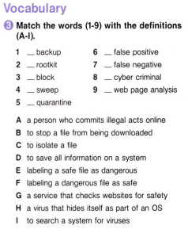
OUR ACADEMIC AREAS
MERCURY
VENUS
JUPITER
MARS
SATURN
EARTH
D
E
H
F
B
A
Mercury is the closest planet to the Sun
G
Venus is the second planet from the Sun
I
C
Jupiter is the biggest planet of them all
Despite being red, Mars is a cold place
Saturn is a gas giant and has several rings
Earth is the only planet that harbors life

Slide 15
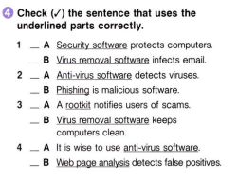
MISSION AND VISION
MISSION
VISION
Saturn is composed mostly of hydrogen and helium. It was named after the Roman god of wealth and agriculture

Slide 16
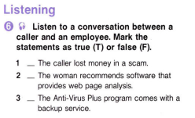
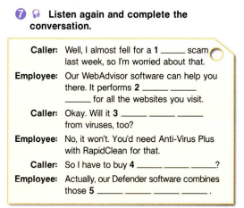
OUR SUCCESS
MERCURY
JUPITER
75%
90%
VENUS
SATURN
85%
95%
Mercury is the closest planet to the Sun
Jupiter is the biggest planet of them all
F
T
Venus is the second planet from the Sun
Saturn is a gas giant and has several rings
F

Slide 17
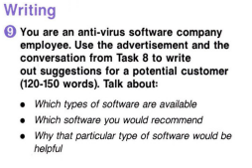

A PICTURE REINFORCES THE CONCEPT
Images reveal large amounts of data, so remember: use an image instead of a long text. Your audience will appreciate it

Slide 18
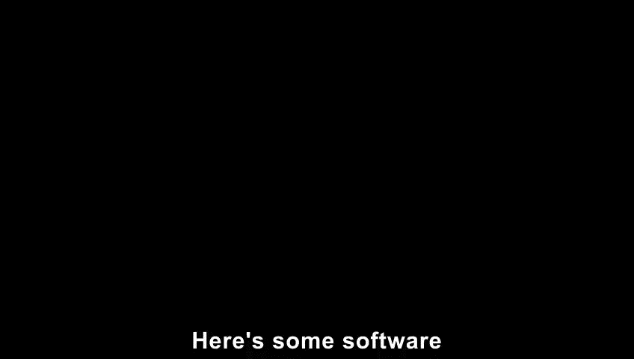
Home assignment
ACTIVITIES
Saturn is a gas giant and has several rings
GOALS
FEEDBACK
piter is the biggest planet of them all
Mercury is the closest planet to the Sun

Slide 19

THANKS!
Do you have any questions?

Slide 20
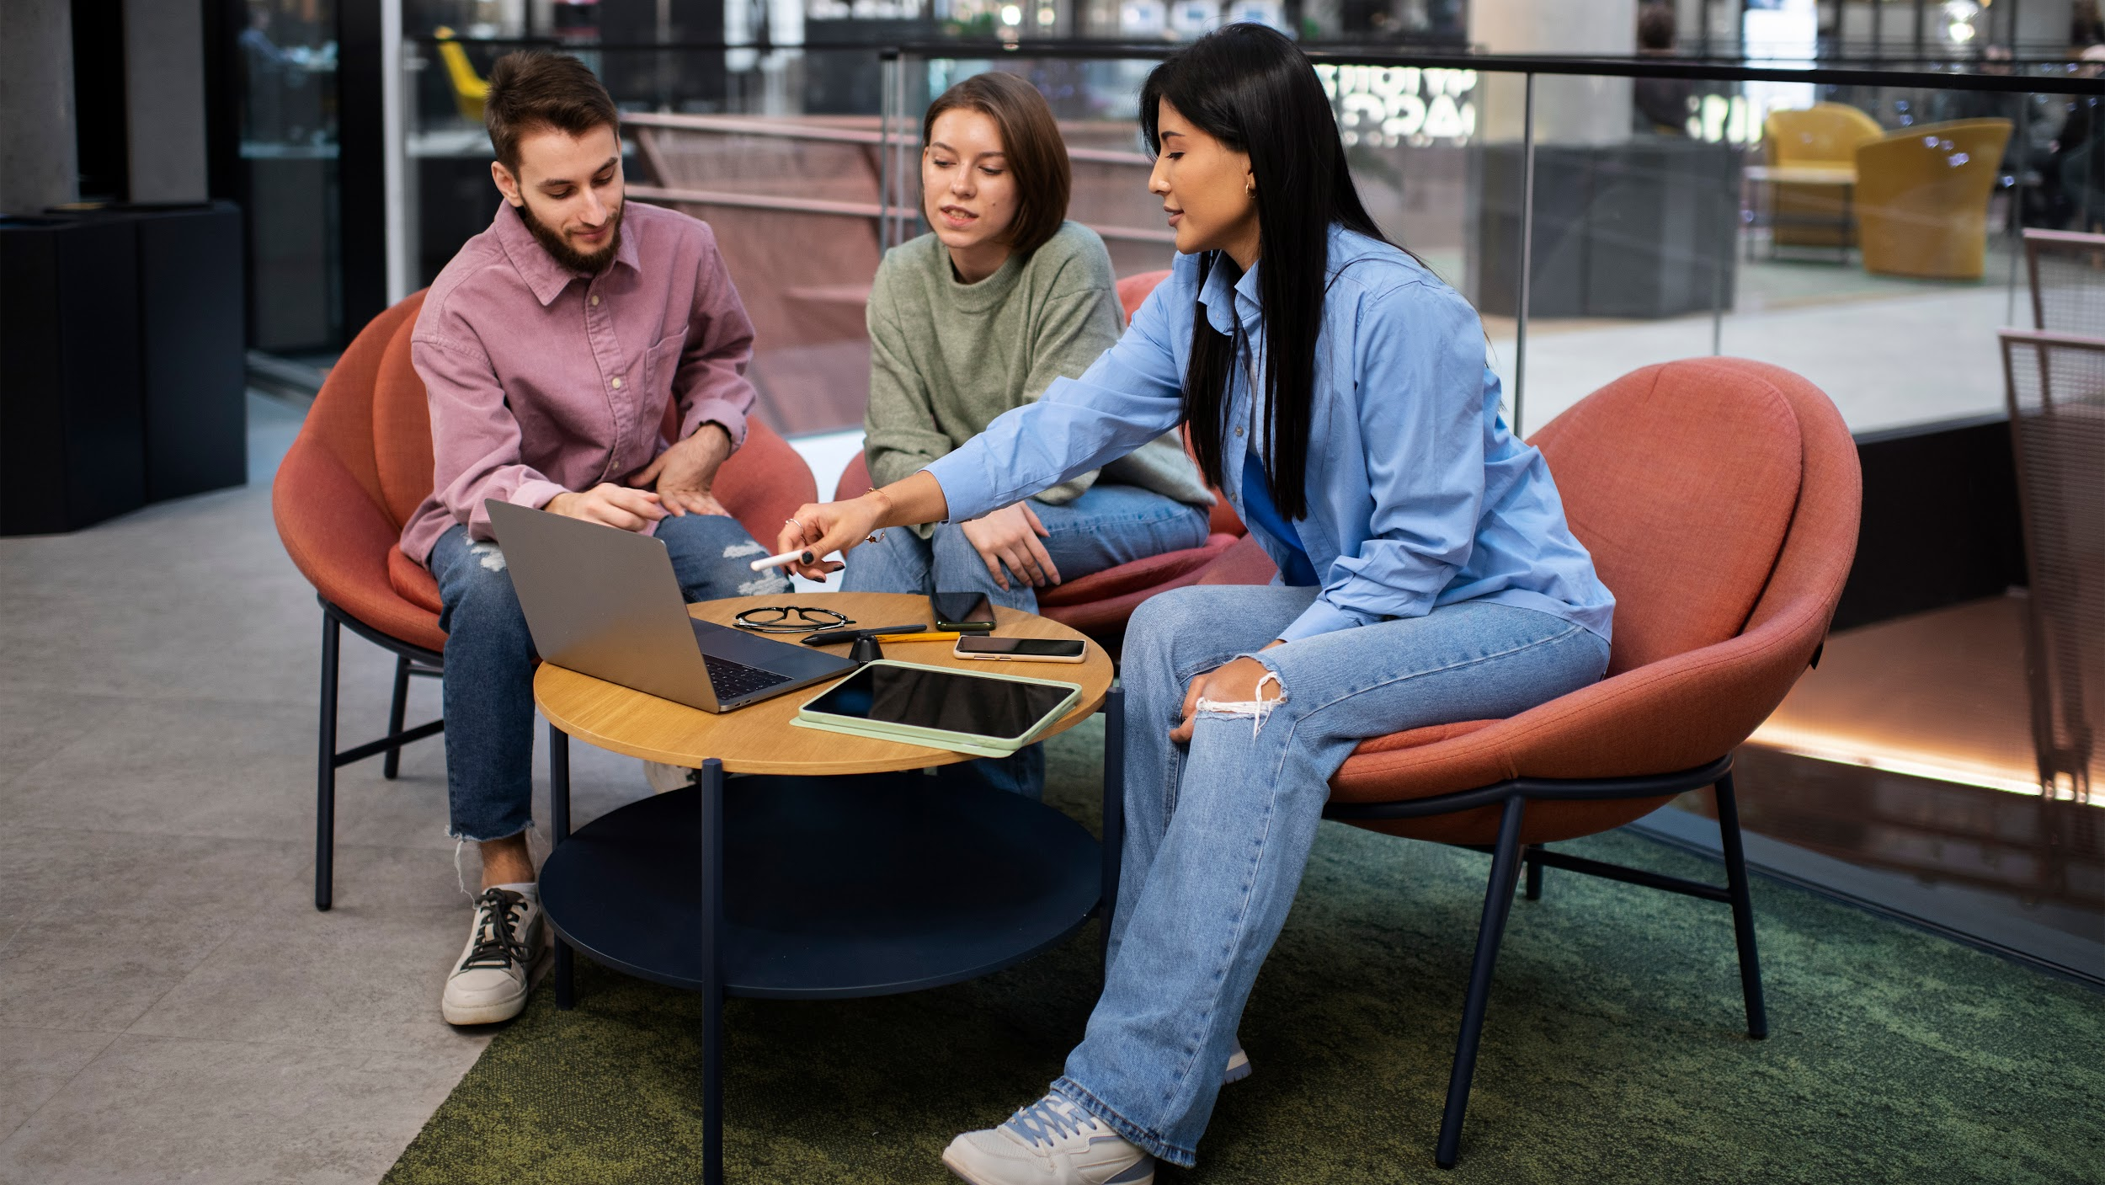
A PICTURE IS WORTH A THOUSAND WORDS

