Slide 1
IDIOMS related to IT & computer engineering

Slide 2

In the loop
Being up-to-date with the latest developments or information in a project.

Slide 3

Our professor always keeps us in the loop about upcoming project deadlines and important changes.

Slide 4
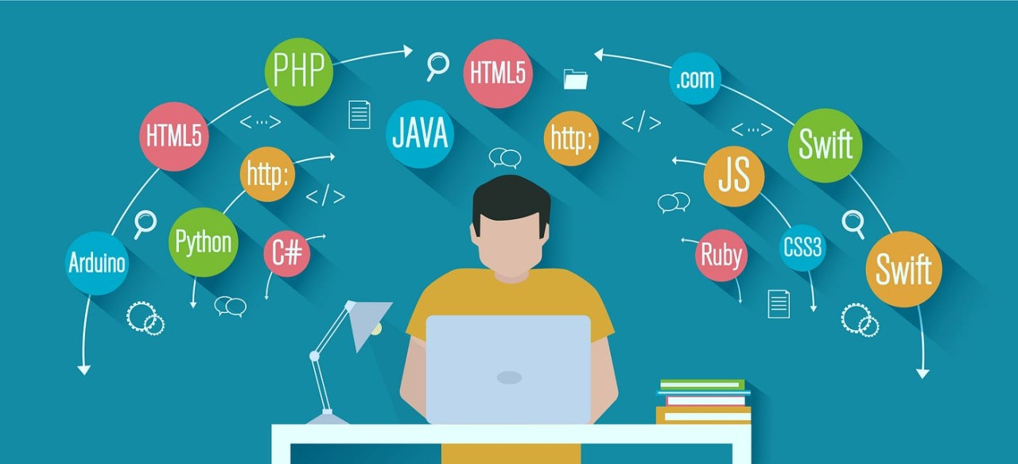
To stay competitive in the tech industry, you need to be in the loop about emerging programming languages and tools.

Slide 5

White hat
Refers to ethical hackers who test and secure systems rather than exploit them.

Slide 6

Our tech club invited a renowned white hat hacker to speak about the importance of ethical practices in cybersecurity.

Slide 7

As future cybersecurity experts, many of us aspire to be white hat hackers who protect systems from malicious attacks.

